Slide 1
Military Family Support 360
Funded by the USDOE OSEP
A project of the Statewide Parent Advocacy Network (SPAN)

Slide 2
Project Initiative
Project Granted to the Statewide Parent Advocacy Network (SPAN) October 2009
Partnership with Exceptional Family Member Program (EFMP)
School Liaison Offices

Slide 3
STOMP
BRANCH

Slide 4
A look at some of the numbers
Exceptional Family Members at JBMDL
Air Force 569 Army 80 Navy/Marines 30
MFS 360 Families Served in FY 2015
Parent count 167 – unduplicated
64 IEP/IFSP/504 meetings attended
6 Mediations, 2 Due Process Hearings
9 4 local/regional/ state community meetings
22 national/federal system meetings

Slide 5
What those numbers reflect:
Autism - Sensory - Communication Delays
ADD/ADHD - Behavior Disability
Deaf/Hearing Impairment
Early Childhood – Developmental Disability
Emotional, Intellectual, Multiple Disability
Specific Learning Disabilities
Asthma-Food Allergies-Gastro-Intestinal Disease
Fragile X-Liver transplants-Down Syndrome
Prader-willi syndrome-Cerebral Palsy
Heart Disease - Neurological Disease
Seizure Disorders - Cancer
Not to mention co-morbidity with anxiety and trauma.
Notes:
Autism 38
Deaf/Hearing Impairment 3
Early Childhood – DD 13
ED 10 / ID 8 / MD 10
Specific Learning Disabilities 16
Some of the Military CYSHCN
Asthma-Food Allergies-ADD/ADHD
Cancer-Fragile X-Liver transplants
Prader-willi syndrome-Cerebral Palsy
Down Syndrome-Heart and Neurological Disease
Not to mention comorbidity with anxiety and trauma.

Slide 6
MFS 360 Intersections in SPAN
PTI
F2F
NEPACT
P2P
FV
Notes:
Individual, direct advocacy
Parent training and profession development/collaboration
Parent leadership training and avenues for development
Policy development and advocacy
Also include building relations and access to community collaborations/agencies

Slide 7
MFS 360 intersections outside SPAN
JBMDL
DOE
DHS
DOL
SCHS

Slide 8
MFS 360 Intersections JBMDL
EFMP M
SLO
EFMP CM
IDS
EFMP FS

Slide 9
MFS 360 Provides
Training – Workshops, Teleconference
Technical Assistance
Information and Referral
Direct and Systems Advocacy
Parent Leadership and Support
to parents of all military-connected children/youth with disabilities and special health care needs from birth to age 26.

Slide 10
Past Project Activities
Leadership Council
Training Workshops on Rights and Responsibilities
Resource Fair and Information Forum
1-Day Autism Conference
STOMP EFMP Event
Camp Expo
SPAN Parent Resource Training
Back to School Boot Camp
Dare to Dream Conference

Slide 11
JBMDL EFMP One-Stop Center
One- Stop Partnership
Military both Medical and Family Support
Community 360 Project
Under one roof – team process
Family plan, Individual/System Advocacy
Best Practice moving forward
Thoughts on braided blended resources

Slide 12
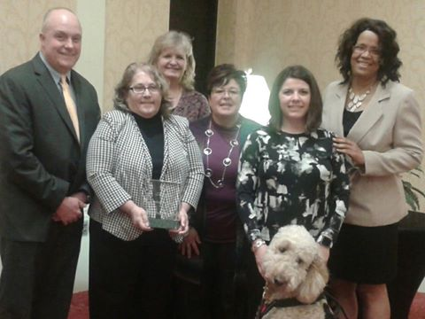
NJ Council on Developmental Disabilities –Community Building Award

Slide 13
Advocacy

Slide 14
Training

Slide 15
Outreach

Slide 16
Families

