Slide 1
Presentation on Preparing Annual Reports for OSEP
Notes:
CS
Welcome to OSEP’s presentation on preparing annual reports for the parent program. I am Carmen Sánchez, the Parent Program Lead. My colleagues, the other OSEP project officers, will also present parts of this webinar today. They include Greg Knollman, Julia Martin Eile, Kristen Rhoads, and David Emenheiser. For ease of accessibility, the webinar’s transcript is included in the notes sections of each slide.

Slide 2
Agenda
Overview of Annual Reports
Guidance for completing Annual Reports
Coversheet
Executive Summary
Section A
Section B
Section C
New this year/timelines
Reminders
Notes:
CS
During this webinar, we will provide an overview of the annual reports; give guidance for completing each section of the report; highlight what is new this year including timelines; and cover reminders of tips and resources to help in writing an excellent report.
The information covered in this webinar applies to the annual report that will be due in May. But in addition, we are requiring that all project submit a “shell” of their annual report in March. The shell is essentially a draft of the annual report, with targets and static information completed, but without any actual data included. You can use this webinar to develop the content of your “shell” as well as the content of the annual report you submit in May. More information about the “shell” is included later in this presentation.

Slide 3
Outcomes of Presentation
Grantees will have greater awareness of the purpose of annual performance reports.
“Annual performance reports are required in order to continue a grant into a new budget period in compliance with ED policies.”
Grantees will have a greater understanding of what is expected of them in the annual reports.
Grantees will feel more confident in completing and submitting their annual reports.
Notes:
CS
We expect to achieve three outcomes from this webinar. First, grantees that listen to this webinar will have greater awareness of the purpose of annual performance reports or APRs. The APR is a required compliance document. The Education Department General Administrative Regulations, known as EDGAR, and uniform guidance establish that an APR is required during each budget period in order to continue the grant. The second outcome of the presentation is that grantees will have a greater understanding of OSEP’s expectations for the annual progress report. The upcoming segment of the presentation will cover expectations for completeness and quality. We expect that by listening to this webinar and following the guidance, and submitting strong “shells” in March, parent center grantees will submit complete and accurate annual reports that will require few if any revisions to receive approval for continuation funding. And the final outcome we expect is that you as grantees will have greater confidence in your ability to complete and submit a strong annual performance report that accurately reflects the quality work your center has done in the past reporting period.

Slide 4
Reporting Requirements (annual and no-cost)
Annual reporting of project performance measures
EDGAR (§75.253)
“The Secretary may make a continuation award for a budget period after the first budget period of an approved multi-year project if the grantee has made substantial progress in achieving the goals and objectives of the project.”
ED Handbook for the Discretionary Grant Process (Section 5.4.8)
“The determining factor in awarding a continuation grant is whether the recipient has made substantial progress within the scope of the approved application in attaining the objectives of the grant as evidenced by meeting the grant’s performance measures.”
Notes:
CS:
We will discuss performance reporting for both annual reports, also known as continuation reports, and no-cost reports. We circled no cost because several grantees are confused about this. In recent years, the procedures for submitting reports during no cost extensions (NCEs) have tightened. A report is required from each project during every fiscal year of the project period. Since all parent centers have a beginning date of October 1 and annual reports are due in May, projects will now be submitting a report in May of their final year. The first annual report will cover a period of five months and the final report will cover a period of seven months.
Projects therefore must also submit an APR in May during their no-cost year. Please contact your project officer for details of reporting requirements if you are now in a no-cost extension.
EDGAR establishes that multi-year funds can be awarded only when the project demonstrates substantial progress toward meeting its goals and objectives. The APR is the means for the program to determine whether a project has made substantial progress toward its goals and objectives. The U.S. Department of Education Handbook for the Discretionary Grant Process further clarifies that the goals and objectives of the project are those approved either in the application or subsequent OSEP-approved revisions.

Slide 5
Grant Performance Report for Continuation Funding
Dear Colleague Letter (also known as the Larry letter )
Instructions for Submitting e-Reports
ED 524B Instructions
ED 524B Form
Notes:
CS
Grantees receive instructions on how to complete the APR from several sources. The Dear Colleague Letter, also known as the Larry Letter, includes the details of the Parent Center Program, including Program Measures and due dates. Written instructions for submitting e-Reports are available, along with online links to the required forms and instructions for completing them. This presentation will highlight certain key aspects in order to clarify the general online guidance for the specific expectations of the OSEP Parent Program. This webinar must not be used instead of the other guidance and instructions but as a practical supplement to all other instructions. Do not hesitate to reach out to your project officer with questions.

Slide 6
APR Review
Consideration is given to the grantees’ performance in terms of both --
Substantial progress toward achieving project outcomes
Fiscal responsibility in use of federal funds
Notes:
CS
In reviewing the APR, the project officer seeks to find convincing evidence that the project has made substantial progress toward its goals and objectives. The PO also seeks evidence of fiscal responsibility in the use of federal funds. Before committing additional funds to a project, the Department looks at risk, that is the likelihood that the federal funds will not produce expected outcomes. When that risk is too high or unclear based on the project performance and report, OSEP might reduce or deny continuation funding, might require additional information in a revised report, or might implement additional monitoring of the project.

Slide 7
Complete the Report Online
Sign into G5 to report
Check access to G5 a week or more before report due date.
Download Word version of 524-B Grant Performance Report.
Part 1 – Cover Sheet and Summary
Part 2 – Project Status
Part 3 – Instructions
Notes:
CS
The APR will be submitted through G5. OSEP recommends that grantees check their access to G5 several weeks prior to the due date to ensure adequate time to resolve any potential issues.
Although the report will be submitted in G5, OSEP recommends drafting the report in a word processing program, such as MS Word or similar. Download all 3 parts of the 524-B Grant Performance Report form. Since you will be submitting a “shell” in March, you can use that “shell” to complete the data for the annual report.
When your report is finalized, you can cut and paste the information into the G5 online form.
Some sections have character or word limits. We recommend that you use clear, concise writing in your reports. However, G5 allows an additional document to be uploaded. You may create one document of the information that did not fit in the form and upload that additional document.

Slide 8
http://www2.ed.gov/fund/grant/apply/appforms/appforms.html
Notes:
CS
This slide shows the url address to and screenshot of the webpage from which you can access the required forms and instructions. Circled by the large yellow oval are the names of the documents to be downloaded. The green circle indicates where to click in order to download the modifiable MS Word version of the forms.
We will now describe the specific information needed on the forms. Greg Knollman will begin by describing the cover sheet.

Slide 9
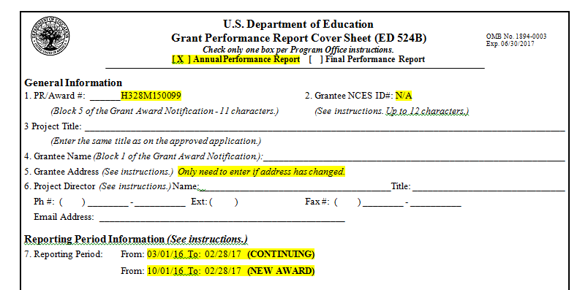
Cover Sheet – Top
Notes:
GK
The next few slides are screenshots of an example coversheet with crucial items highlighted to draw your attention. This slide shows the top third of the coversheet. This same form will be used at the end of your project period for the final report. For this annual report, mark “Annual Performance Report” in the form’s header. On line#1, enter your PRN award number. All parent program PRNs begin with H328. On line#2, enter N/A. Complete lines #3 and 4. Line #5 need only be filled in when your address has changed. Complete line #6. Line #7 shows the reporting period covered by this report and will be completed in one of the two ways shown on this slide. If your grant was awarded in 2016, yours is a new award. Line #7 for New Awards should be completed with the following dates: from 10/01/16 to 2/28/17. All other awards are “Continuing” for which Line #7 should be completed with the dates from 3/1/16 to 2/28/17. Please note that the reporting periods ends 2/28/17 for all awards. The data used for this report will reflect the activities and outcomes from this indicated reporting period.

Slide 10
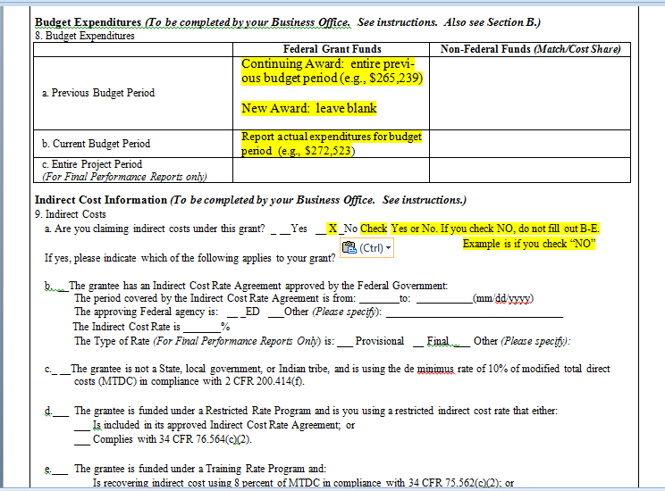
Cover Sheet – Middle (No Rate)
Notes:
GK
Line #8 is the budget information. Line 8a will vary depending on whether this report is for a new award or a continuing award. For new awards, leave Line a blank. For continuing awards, line 8a should be the expenditures reported in the last continuation report. Line b, for both new and continuing awards, reports the funds actually expended during the reporting period. Leave line c blank for annual performance reports.
Line #9 shows the grant Indirect Costs information. On this slide, we show how to complete this form when you are not using an indirect cost rate. Mark “no” on Line a and proceed to Line #10.

Slide 11
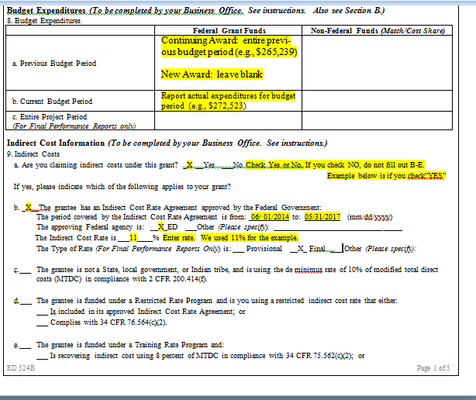
Cover Sheet – Middle (negotiated rate)
Notes:
GK
Direct your attention to Slide 11. This slide shows how to complete Line #9, when you have a negotiated Indirect Cost Rate (ICR). Please note that you complete Line #8 as instructed on previous slide.
When you have a negotiated ICR, mark “yes” on line a. Mark an “x” beside line b and fill in the requested information from your negotiated agreement. The information on this sample slide is an example – do not copy the information shown on this slide. After completing this information from you agreement, proceed to Line #10.

Slide 12
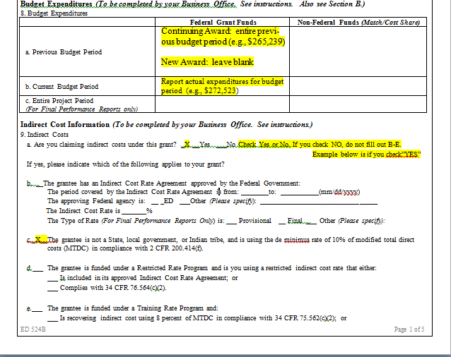
Cover Sheet – Middle (de minimus)
Notes:
GK
This slide shows how to complete Line #9, when you use the de minimus indirect cost rate. Please note that you complete Line #8 as previously instructed.
When you use de minimus indirect cost rate, mark “yes” on line a and mark an “x” beside line c. Proceed to Line #10.

Slide 13
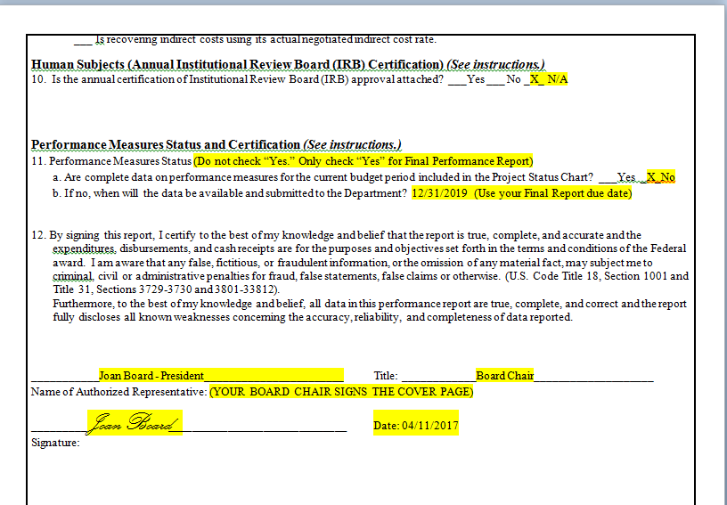
Cover Sheet - Signature
Notes:
GK
Direct your attention to slide 13. Indicate “No” to the human subjects research question on Line #10.
Mark “No” on Line #11a since this is not the project’s Final Report. On Line #11b indicate your Final Report due date. This date is 90 days after the end of your project period. For example, if your project is due to end September 30, 2019, you would write 12/31/2019. If you are not sure of your project end date, review your GAN or ask your PO.

Slide 14
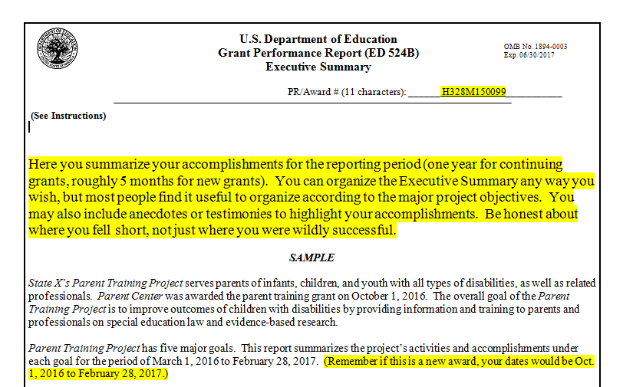
Sample Executive Summary
Notes:
GK
The Executive Summary is the next section of the report. However, OSEP recommends that it be the last part you complete. This section is designed to give an overview of the successes and struggles during this project period. It may be organized however you choose, although typically grantees organize this summary according to the few overarching project objectives. This section must not include the level of detail covered in the other sections – which is why we recommend that you write up the information in the other sections before summarizing it in the Executive Summary. Also remember there is no benefit for writing lengthy responses. Be as concise and direct, while maintaining clarity, in your summary as possible. Refer the reader where in other sections that she or he can locate the supporting details, as needed.

Slide 15
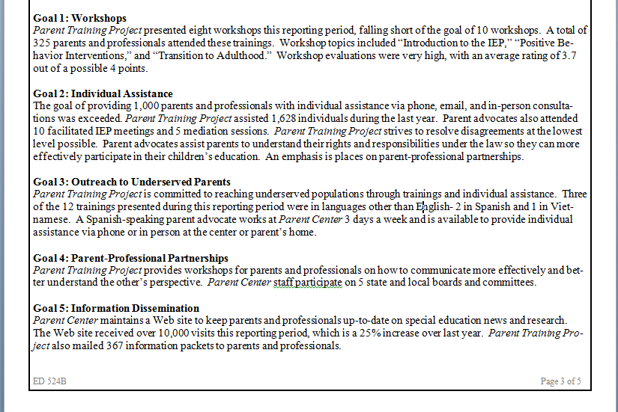
Sample Executive Summary - Objectives
Notes:
GK
This slide shows a sample Executive Summary. Please note each project objective, here listed as a goal, is followed by only a few sentences of summary. As you can see, there is limited data in this summary. Most data are included under the measures.
In the next few slides, Julia Martin Eile will describe report objectives, measures, and data.

Slide 16
Project Objectives
The Project Objectives are what you are trying to accomplish and come from your grant application or subsequent revisions.
(May be called goals in your application)
Project Objectives should be relevant, applicable, focused, and measureable.
Notes:
JME
Thank you Greg! We are now on slide 16. First we need to define a few terms. Project objectives or goals are the overarching purposes of the project, that is what you said the project would accomplish in the grant application or approved revisions. Project objectives should be written so that it is clear to what extent the project is attaining them. They must be relevant and applicable to the Parent Program. Project objectives that are too broad tend to provide no focus for the project implementation. And finally, the Project Objectives must be measureable. As you will see in a few minutes, the Project Objectives are included in the Status Chart. Measures aligned with each Project Objective are listed underneath.

Slide 17
Types of Performance Measures
Program Measures
Measures are determined by the Parent Program in order to meet GPRA measures:
Quality
Relevance
Usefulness
All must be mentioned at least once.
At least one Project Measure must be aligned with each Program Measure.
Notes:
JME
The second term we must define is Program Measures. These measures are determined by the Parent Program to measure program’s performance in compliance with the Government Performance and Results Act - Modernization Act of 2010. The Parent Program has three “GPRA” measures which relate to the quality, relevance, and usefulness of the activities supported through OSEP funds. Each of the GPRA measures must be listed on your APR at least once. You can cut and paste the GPRA measures and their corresponding targets from “QRU Measures for Annual Reports”. However, you do not report any data on the GPRA measure. Underneath each Program (GPRA) measure, you must list at least one Project Measure that aligns with that Program Measure. We provide a few examples in upcoming slides.

Slide 18
Project Performance Measures
Project Measures
What you said you would do in your application or subsequent approved revisions
Some are measures of process or outputs (e.g., number of workshops, number of attendees).
Some are measures of outcomes (e.g. number of attendees with increased knowledge).
Must be clear and measureable
Notes:
JME
The final term to be defined is Project Measure. These measures and targets are from your project application. These are your outputs and outcomes. Outputs refer to the process or activities of the project. Examples include numbers of workshops and numbers of attendees. Outcomes refer to changes as a result of the outputs. An example is number of attendees with increased knowledge. Although both are important for projects to collect, outcomes are the important results that indicate impact. Sometimes, project measures need to be revised for clarity and to be measureable. Your data will demonstrate your project performance against these project measures.

Slide 19
The Basics on Data
Do you have numbers?
Do you know how to collect data?
Are you collecting it?
How do you report it?
How do you use data you already have? (e.g. surveys, evaluation, and demographic data)
Notes:
JME
The basic strength or integrity of your data is known based on the responses to these few questions.
Do you have numbers?
Do you know how to collect data?
Are you collecting it?
How do you report it?
How do you use data you already have? (e.g. surveys, evaluation, and demographic data)
Since everything can be data, it is crucial to identify the specific sources and types of data that best describe your project’s progress. Numbers can be strong data, if you collect and report the data with fidelity. Fidelity is a term-of-art referring to consistently without bias. Are you collecting and reporting your data consistently without bias? What data do you already collect? You might merely need to tighten the methods.

Slide 20
Reporting Data
Be as specific as possible about what you are counting (e.g., individual parents vs. families; all attendees vs. parent attendees; contacts vs. individuals served).
Specify the source of your data (e.g., surveys, sign-in sheets, contact logs).
If you are counting individuals, specify if the number is duplicative (i.e., you count each time a person calls as a separate contact).
Notes:
JME
When reporting the numbers, the methods behind the numbers is equally important and must be described in the narratives. The report should concisely inform the reader what is included and what is not included in the numbers. Some prompts for stronger data reporting are included on the slide.
Be as specific as possible about what you are counting (e.g., individual parents vs. families; all attendees vs. parent attendees; contacts vs. individuals served).
Specify the source of your data (e.g., surveys, sign-in sheets, contact logs).
If you are counting individuals, specify if the number is duplicative (i.e., you count each time a person calls as a separate contact).

Slide 21
Status Chart Form
Notes:
JME
This slide shows the blank form into which you will write your Project Objective, the Program Measure, your Project Measures, and explanation.

Slide 22
Status Chart - Targets
Target and Actual Performance Data
Provide the target you established for meeting each performance measure
Provide actual performance data demonstrating progress towards meeting or exceeding this target
Only quantitative (numeric) data should be entered in the Target and Actual Performance Data boxes.
Notes:
JME
Please note that in the Status Chart, the right columns allow grantees to indicate targets and actual performance data for each Project Measure. These data are quantitative only. The targets were included in your project proposal or approved through subsequent revisions with your project officer. The actual performance data are where you report your project performance. Kristen Rhoads, in the upcoming slides, will review a few common types of targets and performance data.

Slide 23
Status Chart - Data
The Target and Actual Performance Data boxes are each divided into three columns:
Raw Number
Ratio
Percentage (%)
Notes:
KR
Thanks Julia! As shown on the Status Chart, there are three columns for the data. Each column refers to the common types of targets and performance data. One column for each type: Raw Number, Ratio, and Percentage. I will describe each type and how to report it through the next few slides.

Slide 24
Status Chart – Raw Number
Use when performance measures are stated in terms of a single number (e.g., the number of workshops that will be conducted or the number of students that will be served).
Please leave the Ratio and Percentage (%) columns blank.
Notes:
KR
When your performance measure is stated in a single number, it is reported as a Raw Number. The number from the measure is the target, e.g., number of workshops planned. The Actual Performance Data is also a Raw Number, e.g., the number of workshop conducted. When reporting a Raw Number, leave the ratio and percentage columns blank.

Slide 25
Status Chart – Ratios and Percentages
Use when performance measures are stated in terms of a percentage (e.g., percentage of materials deemed to be of high quality).
Complete both the Ratio column and the Percentage (%) column.
Please leave the Raw Number column blank.
Notes:
KR
Measures stated in terms of percentages must be reported in BOTH ratio and percentage. Leave the Raw Number blank. The ratio demonstrates the actual numbers on which the percentage is based. The percentage allows us to compare the actual to the target in the performance measure. Some examples will be provided in a few slides.

Slide 26
Status Chart – Ratios
In the Ratio column (e.g., 99/100):
the numerator represents the numerical target or actual performance data (e.g., the number of materials deemed to be of high quality)
the denominator represents the universe (e.g., all products produced or reviewed)
Please enter the corresponding percentage (e.g., 99%) in the Percentage (%) column.
Notes:
KR
In the Ratio column (e.g., 99/100):
the numerator represents the numerical target or actual performance data (e.g., the number of materials deemed to be of high quality)
the denominator represents the universe (e.g., all products produced or reviewed)
Please enter the corresponding percentage (e.g., 99%) in the Percentage (%) column.

Slide 27
Status Chart – Reminders for grants in their first budget period
If baseline data for a performance measure were not included in your approved application and targets were not set for the first budget period, then enter either the number 999 under the Raw Number column or the ratio 999/999 under the Ratio column of the Target box, depending on how your data will be reported in the future.
Notes:
KR
During the first reporting period, projects may have limited data from the five months between October and February. Projects might need to establish baseline data to determine an appropriate target. After baseline data have been collected during the first budget period, grantees are expected to set targets for the second and any subsequent budget periods and report actual performance data in their annual performance reports. When the project has no valid target and no real performance data, 999 should be entered as the Raw Number and 999/999 as the Ratio. In the next few slides, I will cover some examples of how you can report different scenarios.

Slide 28
Status Chart - Output Project Measures
Notes:
KR
This slide shows the scenario of an output measure. Output measures do not align with Program Measures so there is no need to list outputs under a quality, relevance or usefulness measure. These output measures are reported separately from those Program Measures. In the first example listed as Performance Measure 1a, the number of attendees (500) is the target output. It is a raw number. The actual performance was 521, which is also reported as a raw number. In the second example written as Performance Measure 1b states that “20% of all families attending trainings and workshops will be culturally and linguistically diverse.” The output target of this measure is 20% and the ratio target is 100/500. The denominator 500 is copied from the measure above. The actual performance is reported as 96/521 and 18%. The denominator of 521 is again copied from the actual data reported in Performance Measure 1a.

Slide 29
Status Chart - Output Project Measures – New Grants
Notes:
KR
This slide shows the same scenario for a new center. In the first example listed as Performance Measure 1a, the number of attendees (500) is prorated for five months, or approximately 200 as the target output. It is a raw number. The actual performance was 204, which is also reported as a raw number. In the second example written as Performance Measure 1b states that “20% of all families attending trainings and workshops will be culturally and linguistically diverse.” The output target of this measure is 20% and the ratio target for the five months is 40/200. The denominator 200 is copied from the measure above. The actual performance is reported as 37/204 and 18%. The denominator of 204 is again copied from the actual data reported in Performance Measure 1a.

Slide 30
Status Chart - Outcome Project Measures
Notes:
KR
This slide shows how to report an outcome measure that is aligned with the “usefulness” GPRA measure. Performance Measure 1c lists the “usefulness” GPRA measure and the quantitative data columns show the program targets. These targets can be copied from the “QRU Measures for Annual Reports”. You do not report actual performance data on the GPRA measures. Underneath this Program Measure, the grantee has aligned one Project Measure, which is written as Performance Measure 1d. The target in the measure is a percentage so it is reported as both a ratio, 85/100, and a percentage, in this example 85. The actual performance is also reported as a ratio, in this example 334/363, and percentage, 92.

Slide 31
Status Chart - Program Aligned Project Measures
Notes:
KR
Here is another example of an outcome Project Measure aligned with a Program Measure. In this example the Program Measure is the “quality” GPRA measure along with its target, which were copied from the “QRU Measures for Annual Reports”. Grantees do not report actual performance data on the GPRA Program Measures. The Project Measure aligned with the quality measure has a target of 85% of families would recommend other families to the Parent Center. This measure is reported as a ratio, in this example 85/100, and percentage, 85 percent. The actual performance on this measure is also reported as a ratio, for example 16/18, and percentage, 88 percent. This example highlights that the performance data of the 18 responses to the survey, 16 indicated they would recommend other families.

Slide 32
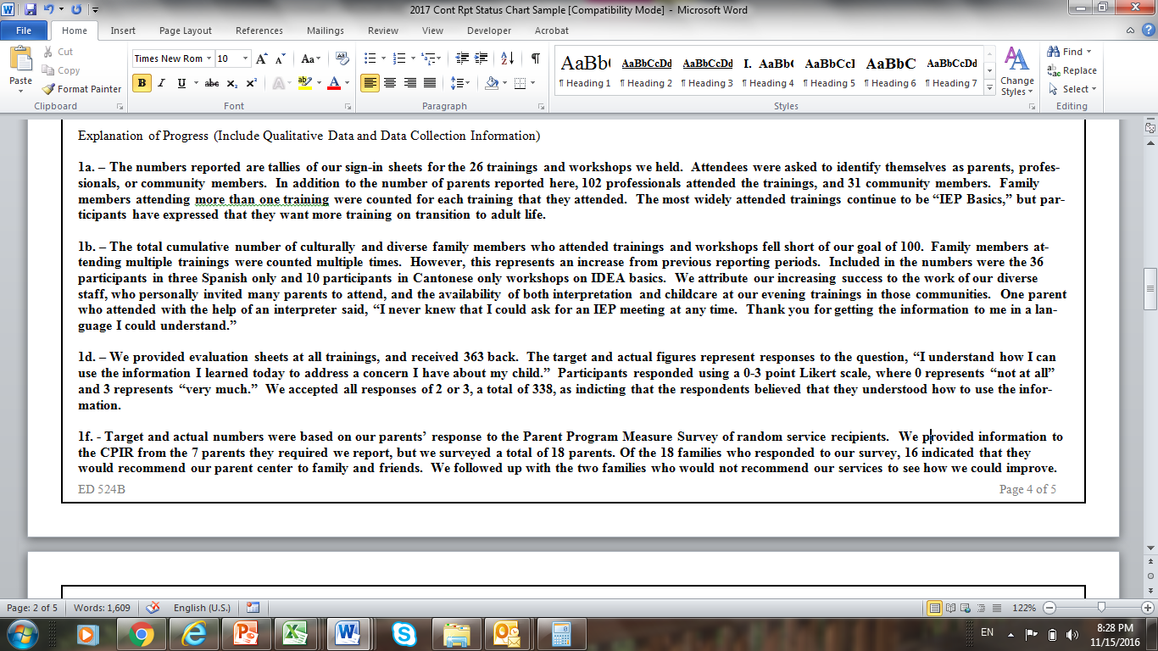
Status Chart Narrative
Notes:
KR
As Julia mentioned above, the Status Chart Narrative allows you to describe the data as reported. Answering what, how, and when further describes the data in the chart. Again, we expect brevity and concise narratives. The narrative must be organized so that the description is clearly identified by the measure number and its letter. The addendum document uploaded with the report can allow for additional narrative that does not fit into the form.
As you can read in the examples, the narratives provide the context and meaning of the quantitative data reported in the status chart. David Emenheiser will cover the other sections necessary to complete your annual report.

Slide 33
Section B – Budget Information
Include information in Section B if there has been a change in your budget, and as appropriate, when the changes were approved by project officer.
Notes:
DE
Thank you Kristen. On slide 32. Section B of the 524 Form allows grantees to describe their budget information for the reporting period. Many parent center grantees are in regular communication with their project officer about updates on project performance and any relevant budget implications. In fact many parent centers submit requests for changes to budgets as needed throughout the project period. However, some parent centers fail to communicate regularly with OSEP on changes made to their budgets. In those instances the reporting of changes must be made on the APR in Section B.

Slide 34
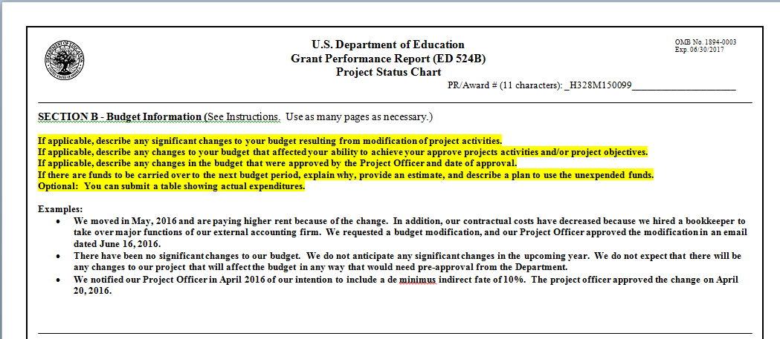
Section B – Budget Information
Notes:
DE
Section B of the APR must include description of significant changes to the project budget that result from modifications of the project activities. If changes to the budget might interfere with the project achieving its proposed and approved activities and objectives, those changes must be described. How the project will modify activities in order to achieve project objectives should be provided in this section. The grantee should include the date of prior project officer approvals to budget changes. This section should include an explanation of funds expended as listed on the cover sheet line 8b. This explanation should include potential carryover of funds and how these carryover funds will be expended to meet the project objectives. Grantees often report these budget changes in a table.

Slide 35
Section C – Other Information
All reports must contain information about organization eligibility.
(Information on Board membership)
Notes:
DE
Slide 34. Section C allows grantees to report on any information not included in other sections of the form. This section can include information on language access and outreach plans as well as other significant organizational information. As you know, non-profit parent organizations are the only grantees eligible to be awarded a PTI or CPRC. The definition of parent organization is identified in statute. Parent Center grantees must affirm their ongoing eligibility to be awarded a parent program grant by providing the organizational information in Section C of the APR. Specifically a majority of the Board must be parents of children with disabilities.

Slide 36
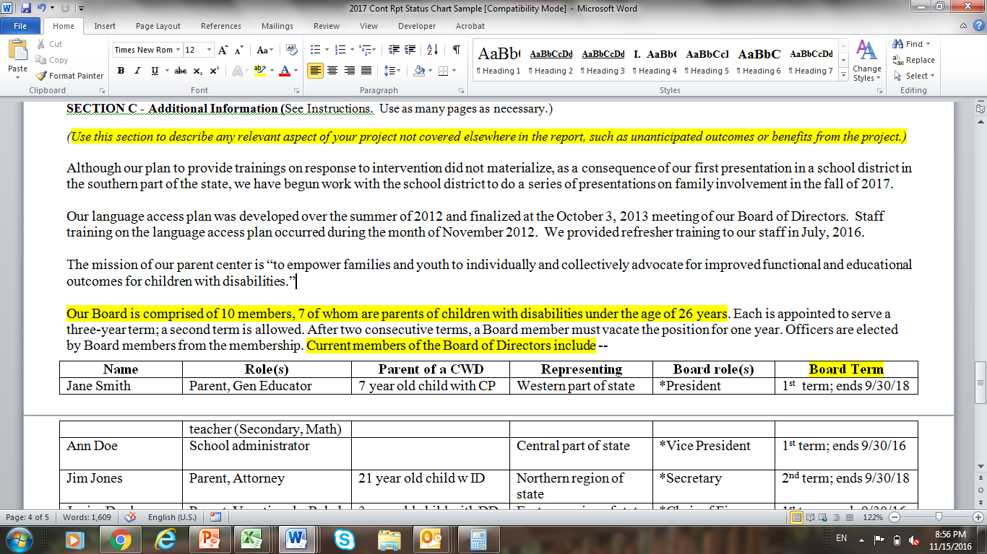
Section C – Example
Notes:
DE
The table shown on this slide is an example format of the information OSEP requires to attest that your organization continues to be eligible for funding. A brief description of the number of Board members with vacancies should precede the table. The table must include name, role, parent of CWD, representation, Board role, and term of office. The Role includes the area(s) of expertise which this person brings to the Board. The parent status must indicate both the age and disability of the child. The Board should represent the entire geographical area served by the project. The Board Role lists any offices this person holds with the organization. The term of office lists when this Board member will leave their office, the Board or both.

Slide 37
New This Year
Project Officers are requiring grantees to email “shell reports” to project officers in March.
Shell reports are:
Draft coversheet
Draft Section A
Just the performance measures/objectives
For the shell, you can use XXs if data are to be collected/analysis incomplete.
For the shell, you do not need to complete the explanation of progress.
Draft Section C – Board of Directors Listing
Notes:
DE
Slide 36: In order to improve the quality of the APRs, all grantees must submit a shell report to their PO in March. The POs will review the shells and provide feedback by the end of March. In certain circumstances, parent centers might be referred to TA for additional support in revising and improving their APR shell.
These shells will include no data or performance reporting. They must include an unsigned draft coversheet (except line 8 which is the budget information). Also, the shell must include Section A – the Status Chart – completed with Project Objectives, Program Measures, and Project Measures. All the measures must include targets. For the shell, the performance data columns may be left blank or filled in by “XX” to hold the place for the data. No narrative should be included in the shell.
Also, the shell must include a draft Section C that only includes the Board information.

Slide 38
Timelines
Email draft shells to your Project Officer by March 3.
Draft shells should be Word documents.
Your Project Officer will provide comments via email by end of March.
Submit final Annual Report to G5 by Date in Dear Larry Letter (usually first Friday in May).
Notes:
DE
Your PO needs to receive your shell in Word format by March 3. The program staff will review and provide comments by the end of March. The APR based from the approved shell must be submitted in G5 by the date in the Dear Larry letter, which is likely to be May 5, 2017.

Slide 39
Sending in the Report
Work on the shell and report in Word and cut and paste into G5.
Use G5 to submit report online.
A signed signature page (Board Chair) must accompany the final report. Upload and attach the scanned signed coversheet into G5.
You cannot make late submission without OSEP approval. G5 will lock you out if the report is late.
Notes:
DE
As mentioned before, it is recommended that you draft your report using MS Word. When you have it just the way you want it, copy the report into G5 to submit. The coversheet must be signed by your Board Chair. Upload a scanned signed coversheet into G5 for one submission into your permanent grant file. G5 sends an automated note to your PO that you have submitted your report. Do not be late, the system will lock you out at deadline. We recommend that you plan to submit your report at least one day before the deadline.

Slide 40
Resources
Documents
“QRU Measures for Annual Reports”
Dear Colleague Letter
People!
TA
OSEP
Notes:
DE
OSEP and the PTACs developed a document to assist parent centers in aligning their project measures to program measures. This document, called QRU Measures for Annual Reports, lists several common project measures and how they would align with program measures. The Dear Colleague letter will be sent in a month or so. Read that letter carefully. Most important resources are the folks at OSEP and TA. We are all interested in the parent centers submitting excellent reports that show the tremendous achievements your center has accomplished this year. Do not hesitate to ask your questions.

Slide 41
Keep In Mind
Asking questions can be more important than having answers.
Struggling with questions is the only way to get to answers.
Families are helped best when parent programs work on continuous improvement.
Notes:
DE
Asking your questions is often more important than thinking you have the answers.
Project measurement and performance reporting can be difficult. Struggling with your questions can lead to better answers.
And those better answers can lead to better projects, when the centers work to improve continuously.

Slide 42
Thank you for all you do for children and families!
Notes:
DE
Thank you for your attention today and all that you do to make lives of our children and their families better.

