Slide 1
CPIR Webinar Series for Parent Centers
Improving Early Learning Outcomes
Part 1 | Using the Part C training modules with families and staff Lisa Küpper, CPIR
Part 2 | Using the ECTA Center’s resources for families, staff, & SSIP work Christina M. Kasprzak & Lynne Kahn, ECTA Center

Slide 2
Building the Legacy for Our Youngest Children with Disabilities
14 modules planned
8 completed so far
Each with:
Trainer guide
4-color slideshow
Handouts
Activity sheets
http://www.parentcenterhub.org/repository/legacy-partc/

Slide 3
To Make Training Both Vivid & Relevant
Each trainer guide purposefully includes:
Ways to engage your audience quickly
Interesting tidbits and facts you can share
Real-world examples
Use of adult learning principles
Lots of connections to more info

Slide 4
Building the Legacy for Our Youngest Children with Disabilities
Tips on Using the Modules
with families
for staff development
http://www.parentcenterhub.org/repository/legacy-partc/

Slide 5
Using the modules with families
Tailor the training
How much time do you have?
How much do your participants already know?
What do they need to know?
Refer them to the Hub pages on early intervention for easier reading
http://www.parentcenterhub.org/repository/babies/
http://www.parentcenterhub.org/repository/parabebes/

Slide 6
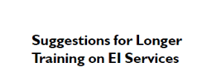
Suggestions | How to Tailor the Training
Look for headers like these.

Slide 7
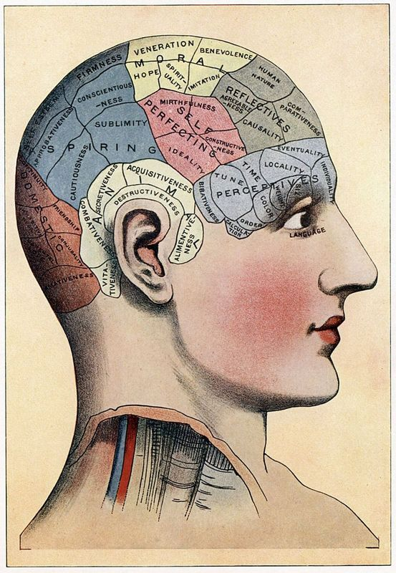
Incorporating Principles of Adult Learning
Ways to enhance your audience’s learning
Make it clear how your information can be used in the learner’s real life
Have learners share what they already know on the subject
Have learners identify what they’d like to know on the subject
Include hands-on activities
Include group activities
Have learners get up and move around every 15 minutes or so
See the handout for more info

Slide 8
Identify key topics for your Center or staff
Using the modules in staff development
Focused readings and discussion for staff on key topics
Go topic by topic, or module by module
What’s required by law?
How does this play out in MY State?

Slide 9
Also Useful for Both Families & Staff
http://www.parentcenterhub.org/repository/babies/
http://www.parentcenterhub.org/repository/parabebes/

Slide 10
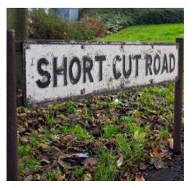
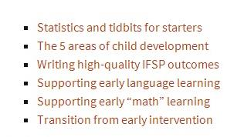
And Just for Parent Centers
http://www.parentcenterhub.org/repository/shortcuts/
…straight to the many great resources identified in the training modules

Slide 11
http://www.parentcenterhub.org/repository/ webinar-earlylearning2014/
You can find the slides, helpful handouts, and (very soon) the recording of this webinar on the webpage we’ve created for this event.

Slide 12
Thank you very much for attending this webinar.
Next up in CPIR’s webinar series?
Thursday, December 4th @ 3 pm Eastern Universal Design for Learning and Access to the General Curriculum
Give us your input!!!!
Write to debra@parentcenterhub.org

