Slide 1



Leveraging LTSAE/SPAN Partnership
for Collective Impact in New Jersey
Diana Autin - Executive Co-Director, SPAN
Deepa Srinivasavaradan - CDC’s Act Early Ambassador to NJ
Notes:
Introduction - Diana
The Statewide Parent Advocacy Network (SPAN) is a 30-year old family organization. It is a "one stop" for New Jersey families and is the Parent Training & Information Center; Family to Family Health Information Center; Family Voices State Affiliate Organization; Parent to Parent USA affiliate; and a chapter of the Federation of Families for Children's Mental Health. Nationally SPAN is a partner with Family Voices on the National Center for Family Professional Partnerships, funded by the Maternal and Child Health Bureau, and houses the National Center for Parent Information and Resources and the National RAISE Transition Parent TA Center, funded by the US Department of Education.

Slide 2

SPAN’s Vision & Mission
VISION - All families will have the resources and support they need to ensure that their children become fully participating and contributing members of our communities and society.
MISSION - To empower families and inform and involve professionals and others interested in the healthy development and education of children and youth, to enable them to become fully participating and contributing members of our communities and society.
Notes:
Diana - Our foremost commitment is to children and families with the greatest need due to disability or special health/mental health needs; poverty; discrimination based on race, sex, language, immigrant or homeless status; involvement in the foster care, child welfare, or juvenile justice systems; geographic location; or other special circumstances. Our motto is, "Empowered Parents: Educated, Engaged, Effective!" Our logo includes a bridge, as we aim to serve as a bridge between parents and professionals, from parents to the services they need across systems, and among diverse parents.

Slide 3
LTSAE Ambassador for NJ
SPAN staff member selected as LTSAE Ambassador in May 2014; selected for second 2-year term (2016-2018).
LTSAE NJ Focus
  Leveraging partnerships to ensure that all efforts related to early developmental monitoring and screening are working together to compliment each other, maximize impact, and reduce duplication.
Building on SPAN’s many existing collaborations, the LTSAE Ambassador has helped build and extend partnerships.
Notes:
Deepa - The focus of LTSAE project allows opportunities for creation of policies and protocols to address gaps and ensure consistency in access to effective screening, and development and dissemination of NJ-specific, family-friendly, culturally competent tools and resources to meet identified needs.

Slide 4
LTSAE/SPAN Collaboration
Parent Training & Information (PTI) Center
Family to Family Health Information Center-Family Voices
Family WRAP: Project Care (Family Resource Specialists supporting families)
NJ Statewide Parent to Parent (connecting families to emotional support)
NJ Inclusive Child Care Project
Partners for Prevention of Birth Defects & Developmental Disabilities
Improving Pregnancy Outcomes (connecting women to critical services)
Military Family Support 360 Center
D70 Medical Home Systems Integration Project
Notes:
Deepa - Learn the Signs. Act Early (LTSAE) information and resources are shared by all SPAN projects with families and professionals. This is very helpful for increasing the reach of the LTSAE materials to diverse audiences while helping the different projects meet their deliverables.
For example:
Early Care & Education providers through trainings provided by the Inclusive Child Care Project & Pediatric practices which includes FQHCs participating in the Family WRAP Medical Home Systems Integration Project received the materials.
Community Health Workers through Improving Pregnancy Outcomes Project disseminate the materials.

Slide 5
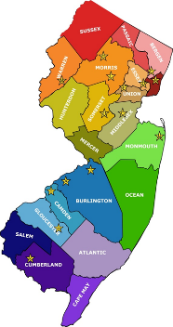
NJ Act Early State Team
State Agencies
  NJ Department of Health - Family Health Services
    Special Child Health & Early Intervention Services
    Improving Pregnancy Outcomes/Central Intake
  NJ Department of Children & Families
    Help Me Grow; Project LAUNCH; Home Visiting; Children’s System of Care
  NJ Department of Human Services
    Division of Development Disabilities, Office on Autism, Office for Prevention of Developmental Disabilities
Notes:
Diana - Because SPAN is funded by and provides support to families served by all of the NJ state agencies focused on children and families, there were existing collaborations between SPAN and these agencies that provided immediate opportunities for collaboration with the Act Early ambassador. Deepa was already serving as the NJ Association of Maternal and Child Health Programs’ Family Delegate for NJ, participating on calls with the state Department of Health, AMCHP, and the US Maternal and Child Health Bureau. She was also participating in meetings of our state’s Infant Child Health Committee, which is a subcommittee of our NJ Council for Young Children.

Slide 6
NJ Act Early State Team
Other Organizations
Boggs Center on Developmental Disabilities (UCEDD, LEND)
NJ Council on Developmental Disabilities
SPAN Parent Advocacy Network
Governor’s Council for Medical Research & Treatment of Autism
Center of Excellence on Autism at Montclair State University
American Academy of Pediatrics-NJ Chapter
Disability Groups (Autism NJ, POAC, Autism Family of Services, the Arc)
Notes:
Diana – how Deepa’s role as LTS.AE Ambassador helped strengthen our role on the Act Early State team – a state team comprising of 13 members from the Act Early State Team attended the North East Regional Act Early Summit in CT in May 2015.

Slide 7
NJ’s Act Early State Implementation Grants
Parent-led training initiatives to increase awareness of importance of developmental screening using validated tools:
2012 - 2014: Federally Qualified Health Centers (FQHCs)
2014-2016: Head Start and other early childhood programs
Notes:
Deepa - Working with the Act Early State Team on the Act Early State Implementation Grants funded by AMCHP, SPAN staff, including the LTSAE Ambassador to NJ disseminated Act Early materials and provided information on “Red flags in child development” to Federally Qualified Health Centers and Head Start/Early Head Start Programs through parent-led screening trainings. Through this effort, county-specific and statewide flowcharts were developed to serve as quick reference guides to help families and professionals get started with connecting with several important types of services and supports when developmental concerns are identified in young children. This work was also supported by the Early and Continuous Screening workgroup of the Community of Care Consortium.
Partnership between The Boggs Center on Developmental Disabilities & the Statewide Parent Advocacy Network
Parents led training and shared their families’ journey to diagnosis
Featured LTSAE materials and other statewide and local resources

Slide 8
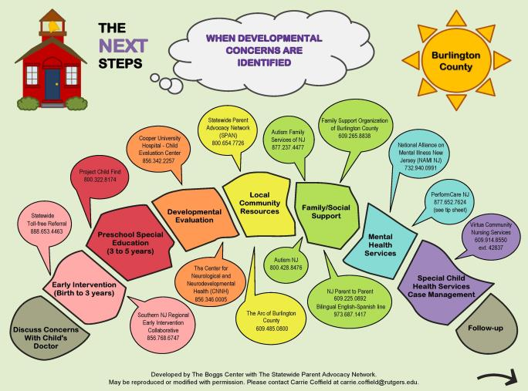
County-Specific Flow Chart
http://rwjms.rutgers.edu/boggscenter/projects/ActEarlyFlowCharts.html
Notes:
Deepa - Pictured on this slide, is a flow chart that lists several important connections that providers should help families make upon recognizing a developmental concern for their child. A flow chart like this one was developed for each of New Jersey’s 21 counties as part of New Jersey’s second Act Early State System’s Grant project, providing in-person parent led training to Head Start staff. Once again, our goal for these flow charts is for them to serve as a starting point for families, educators, and others to help connect families with the appropriate types of services and supports when a concern about a child’s development is detected. We used the state’s website of evaluation centers to populate the list and listed as many as could fit in the bubbles on the front and on the list on the back, keeping the entire document readable and to one page. We did not intend for this to be an exhaustive list of all the resources available to families. It is our hope that family navigators, supporters or case managers will suggest to families additional connections or resources not included on the charts. These re-designed flow charts are meant to be more colorful and appealing for families and child care staff and are meant to be hung in a central location and/or shared with families.
These county-specific flow charts are available for download from the Act Early page on The Boggs Center’s website, at the URL listed on this slide.

Slide 9
Notes:
Deepa – Statewide flowchart (disseminated as magnets).

Slide 10
Notes:
Deepa

Slide 11
Aligning LTSAE with Early Childhood Systems
  Community of Care Consortium (COCC) Meetings
    Early & Continuous Screening Workgroup co-chaired by LTSAE Ambassador & HMG/ECCS Coordinator
  LTSAE Collaboration with HMG/ECCS
    LTSAE Ambassador is the parent lead for the state-level improvement team
  Infant Child Health Committee (ICHC) Meetings
    LTSAE Ambassador provides updates at each meeting
    LTSAE Ambassador & other SPAN staff participate on workgroups
Notes:
Diana - New Jersey was the recipient of a series of 3 Integrated Systems Grants funded by the U.S. Department of Health and Human Services, Health Resources and Services Administration, Maternal and Child Health Bureau (MCHB), which were collaborative efforts convened by a partnership between SPAN, the New Jersey Department of Health (NJDOH), and the New Jersey Chapter of the American Academy of Pediatrics (NJAAP). This partnership was expanded to form a statewide Community of Care Consortium (COCC) for CYSHCN with stakeholders from state departments, community agencies, Act Early state team, health care providers, parents, youth, educators, and other interested community members, who meet regularly to collectively advance and improve the system of services for CYSHCN in New Jersey.
Stakeholders participating in the statewide meetings include representatives from NJ Department of Health/Title V, NJ Department of Human Services/Office on Autism, NJ AAP, NJ Primary Care Association/FQHCs, NJ Early Intervention Services, NJ Head Start Association, other organizations serving children and families across the state as well as diverse parent leaders. The workgroups of the COCC are based on the core outcomes for children and youth with special health care needs – Early and Continuous Screening, Medical Home, Transition and Health Care Financing. Each workgroup of the COCC meeting is co chaired by a parent leader and a professional or state agency representative. State agency partners include the NJ Departments of Health, Human Services, Children and Families, and Labor-Division of Vocational Rehabilitation Services. The COCC has four workgroups – Medical Home & Community-Based Services, Health Insurance and Financing, Early and Continuous Screening, and Transition to Adulthood, based on the MCHB six core outcomes for systems of care for CYSHCN. To address the sixth core outcome, family engagement and family-professional partnership, each workgroup is co-chaired by a parent leader and a professional or state agency representative. The COCC convenes quarterly and provides opportunities for continuing the discussion and efforts with partners across the state. The LTSAE Ambassador co-chairs the Early & Continuous Screening Workgroup with ECCS/HMG Coordinator; this workgroup serves as the Help Me Grow workgroup of the NJ Infant-Child Health Committee, a committee of NJ’s Council on Young Children.
New Jersey has two systems integration initiatives through the Office of Early Childhood Programs at the NJ Department of Children and Families (NJDCF) – ECCS/Help Me Grow and New Jersey Project LAUNCH, which aligns with the work through the Early Childhood Race to the Top grant housed at the NJ DOE. The LTSAE Ambassador participates as a member of the NJ team in the Help Me Grow National forum and maintains ongoing communication with NJDCF to customize and print Act Early materials locally.
The Infant Child Health Committee is our cross sector early childhood stakeholder group; Help Me Grow/ Early Childhood Comprehensive Systems initiative, NJ Project LAUNCH, and other early childhood partners statewide have aligned with this committee to operate as their state level stakeholder group. The priorities of this committee include family/child health, infant/child mental health and children with special needs. The work of this committee is to address barriers and gaps, strengthen linkages to resources and supports around these priority areas, which impact state and local level issues.

Slide 12
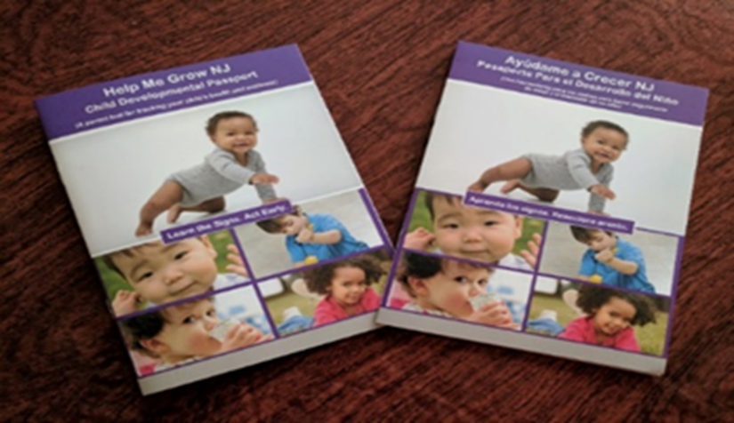
NJ’s Child Developmental Passports
Notes:
Deepa – A tool that was created in collaboration with LTSAE and NJ HMG/ECCS and SPAN is highlighted as one of the resources that parents can be connected to. Parents can use this tool along with the Center for Disease Control’s (CDC’s) Milestones Moments booklet to track their child’s health, wellness, and development. It includes:
Definitions of Developmental Monitoring and Screening
Well-Child Visit Tracker to track child’s height, weight, immunizations, etc., and particularly head circumference which is critical information, given the current Zika crisis
Developmental Tracker to track child’s developmental and/or autism screening information including results and referrals for follow-up
Notes Section to help keep track of child’s growth and development
Contact information for NJ Early Intervention, Project Child Find, Statewide Parent Advocacy Network (SPAN) – NJ’s “one-stop” for families with children, and Help Me Grow NJ’s Central Phone Line
The Passports are available in:
ENGLISH: http://www.spanadvocacy.org/sites/default/files/files/Child%20Development%20%26%20Health%20Passport-English.pdf
SPANISH: http://www.spanadvocacy.org/sites/default/files/files/Spanish%20Passport%20%282%29.pdf

Slide 13
Notes:
Deepa - In partnership with NJ Help Me Grow, the Milestones Brochure has been customized for NJ with contact information for local resources such as the Help Me Grow 2-1-1, SPAN, EI and Project Child Find.

Slide 14
Notes:
Deepa

Slide 15

Benefits to other SPAN programs
Overall
  Helps raise awareness of SPAN as a resource for programs serving young children and their families
NJ Inclusive Child Care Project:
  Early Childhood Challenge added focus on training families and early childhood providers on importance of and strategies for screening
  Resources to share with early childhood providers
PTI & F2F:
  Resources to share with families in addition to connecting them to early intervention when their children “fail” a screen or when parents notice apparent developmental delays
Notes:
Diana - Overall
Helps raise awareness of SPAN as a resource for programs serving young children and their families
NJ Inclusive Child Care Project:
Early Childhood Challenge added focus on training families and early childhood providers on importance of and strategies for screening. The LTS.AE Ambassador was able to support the development of the new training materials focused on screening
Resources to share with early childhood providers. The LTS.AE Ambassador can provide copies of NJ customized materials to share with early childhood providers as well as to secure copies of other CDC LTS.AE materials
PTI & F2F:
Resources to share with families in addition to connecting them to early intervention when their children “fail” a screen or when parents notice apparent developmental delays

Slide 16


Thank You!
“ACT EARLY”
TO
HELP ME GROW!!
Diana Autin Deepa Srinivasavaradan
Executive Co-Director CDC’s Act Early Ambassador to NJ
Statewide Parent Advocacy Network Statewide Parent Advocacy Network
diana.autin@spannj.org deepas@spannj.org

