Slide 1
OSEP Quarterly Call
With Parent Centers
December 15, 2016

Slide 2
TOPICS
Website Accessibility
Program Measures Collection
New Requirements for Annual Reports
New Resources from CPIR

Slide 3
Web Accessibility
Working with Office for Civil Rights to provide general information to all parent centers
We have provided information to the Office for Civil Rights about parent centers
Office for Civil Rights welcomes individual conversations with centers since consent agreements are open to negotiation
Centers can receive technical assistance on making websites accessible before a complaint

Slide 4
Program Measures collection 2017
31 Centers chosen to submit service descriptions for the short-term measures collection
  Quality
  Relevance
  Usefulness
Centers notified on Monday, December 12
Brand-new centers and centers chosen last year should not be included.
Final service descriptions due January 16
October service counts submitted to the Center for Parent Information and Resources will be used to calculate index for cost measure

Slide 5
Long-Term program Measures
Long-term measures collected this year will establish baseline for subsequent targets
Long-term measure 3.1 is new
  “Parents served by the Parent Training and Information Center Program will be able to work with schools and service providers effectively in meeting the needs of their children”
Program Measures Survey results provided to the Center for Parent Information and Resources in November will be used to calculate baseline

Slide 6
Program Performance Measure Results 2016
Measure | Target | Actual
1.1 Quality | 97% | 92.9%
1.2 Relevance | 97% | 92.9%
1.3 Usefulness | 97% | 92.9%
1.4 Cost | 1.1 | 0.84
2.1 Rights | N/A | N/C
3.1 Working Together | N/A | N/C
Notes:
Here are the results of the GPRA 2015-2016 data collection work As stated before, the long-term measures were not collected in 2016. Notice that we did not meet the target of 97 percent for quality, relevance, and usefulness, scoring a 92.9% for all three measures. Given that there were only 28 centers in the sample, this represents only two centers who did not meet each criterion. In fact, it was the same two parent centers who did not meet any of the three criteria. In both cases, we believe that it’s not a question as to whether the services are actually high quality, highly relevant, and highly useful but rather whether the service description accurately reflected the quality, relevance, and usefulness. We realize that many of you have provided multiple descriptions over multiple years, and some of you have been chosen almost every other year, but it’s important that you approach every service description with renewed energy and attention so that you can do justice to the excellence of your services. Again, there will be considerable TA available to you, but you need to ask for it and take advantage of it.
Lastly, we recognize that it has become increasingly more difficult to meet the targets without getting 100 percent. As a consequence, the targets are being reduced to 93% in 2017 and 90% in 2018 and forward. Nevertheless, please pay attention to writing the best possible description when your parent center is chosen to participate.

Slide 7
Targets for Program Measures
For 2017, targets for short-term measures (quality, relevance, and usefulness) will be changed to 93%
For 2018 and subsequent years, targets for short-term measures (quality, relevance, and usefulness) will be 90%
Targets for cost measure will remain unchanged: index of 1.1
Targets for long-term measures will be established for 2019, 2021, etc. using 2017 numbers as baseline

Slide 8
Resources for Program measures
Performance Measures workgroup in CPIR workspaces available to all parent centers
  Annotated exemplar service descriptions available on the workspace
Recorded webinar on the 2017 performance measure process available at http://www.parentcenterhub.org/repository/osep-webinars/
Regional PTACs available to provide technical assistance

Slide 9
Improving Annual Reports
Inconsistent quality of annual reports
Missing and incorrect information
Multiple submissions of some reports needed
New requirements related to reporting of program measures not clearly understood
High correlation between report “shells” being submitted to project officers and strong annual reports

Slide 10
New Requirement APR Submission
A “shell” of the APR will be submitted by all projects by March 3
  Submitted as a Word document as attachment in email
Project officers will provide feedback on “shell” by end of March
Approved shell will be used to submit annual report in May in G5

Slide 11
“Shell” Contents
Cover sheet will contain static information and budget information if available
  No signature of Board Chair
No Executive Summary
Section A Status Chart will contain all project objectives, project measures, and program measures
  Targets will be included
  No actual data
  No explanation of programs
Section B Budget Information blank
Section C to contain chart of current Board of Directors

Slide 12
Resources for APR’s
Recording of 2017 Webinar on APRs will be on CPIR website after December 19
Email detailing expectations for the “shell” will be sent in new year, including attachments with detailed examples and instructions
“Dear Larry” letter will be sent in February with information for annual report submission
Regional PTACs available for technical assistance
Project Officers welcome any questions

Slide 13
Additional Information & Reminders
Final regulations for disproportionality have been released and information is available at the OSERS Spotlight page: http://www2.ed.gov/about/offices/list/osers/index.html
Please respond to a survey from the Center for Technology and Disability on parent center needs related to technology and children with disabilities

Slide 14
Questions?

Slide 15


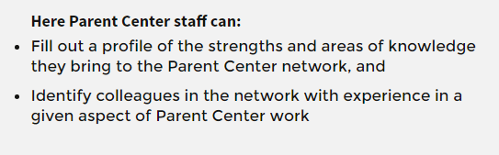
Quick Review | The 5 Ws of the WKW
“Where”
http://www.cpirwhoknowswhat.org/
The “Why”
of the website
The
“What”

Slide 16
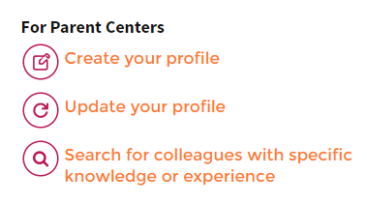
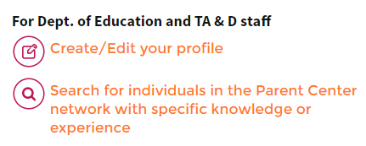

Quick Review | The 5Ws of the WKW
The “Who”
“When”
Right now!

Slide 17

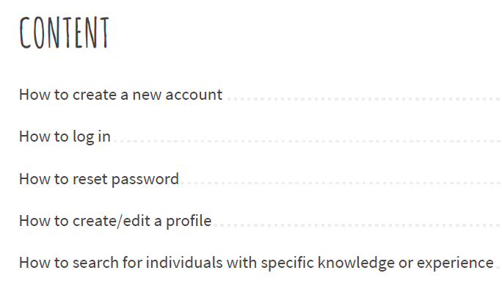
User Tools Include…

Slide 18
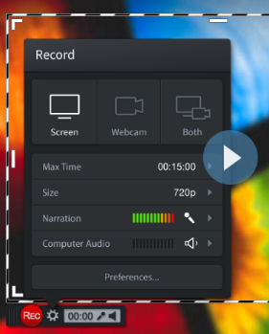


Tools Will Also Include…
“How To” Videos
Regional trainings?
Your
Suggestions?
The Buzz

Slide 19
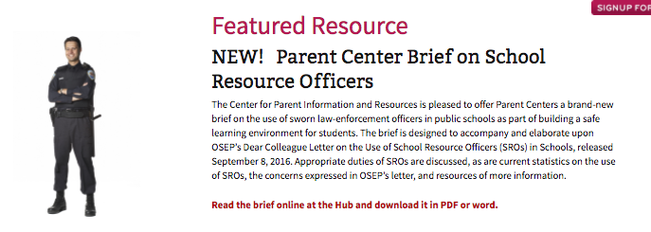
Briefs on Recent OSEP Guidance
Every Student Succeeds Act (ESSA)
Resources
Behavior Supports and School Discipline
School Resource Officers
FAPE
Parent Center Guide
Fact Sheets on key components
Training of Trainer materials
www.parentcenterhub.org/resources

Slide 20
Serving Youth in Juvenile Justice Systems
Development of New Resources
Parent Center Advisors
Technical Advisors
Parent Center Exemplars
USED & OJJDP Centers and Model Demonstration Projects
Disproportionality – Systemic Change Agents
Best Practices?
Examples?
Parent Center Advisors
Technical Advisors
Parent Center Exemplars
Stakeholders’ Guide
Other resources & tools

Slide 21
Thank You!
We appreciate all you and your projects do to support families of children with disabilities!

