Slide 1
OSEP Quarterly Call with Parent Centers
Office of Special Education Programs
March 24, 2016

Slide 2
Agenda
Updated information on the Every Student Succeeds Act
Effective Communication in Public Elementary and Secondary Schools
Notice of Proposed Rulemaking on Significant Disproportionality
Overview of the State Correctional Education Self- Assessment Tool (SCES) and Guidance

Slide 3
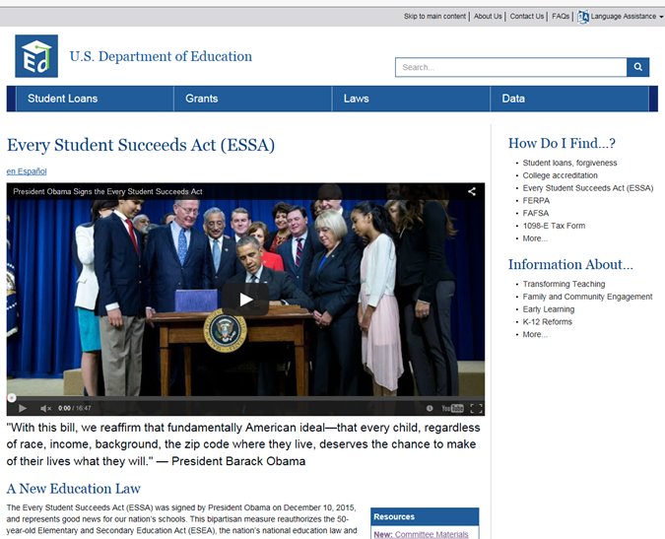
http://www.ed.gov/ESSA

Slide 4
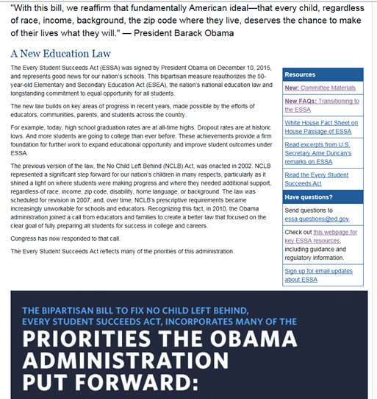

Slide 5
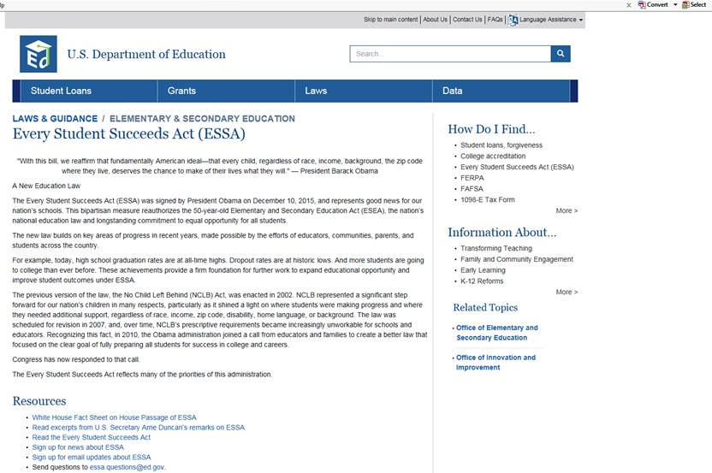
http://www2.ed.gov/policy/elsec/leg/essa/index.html

Slide 6
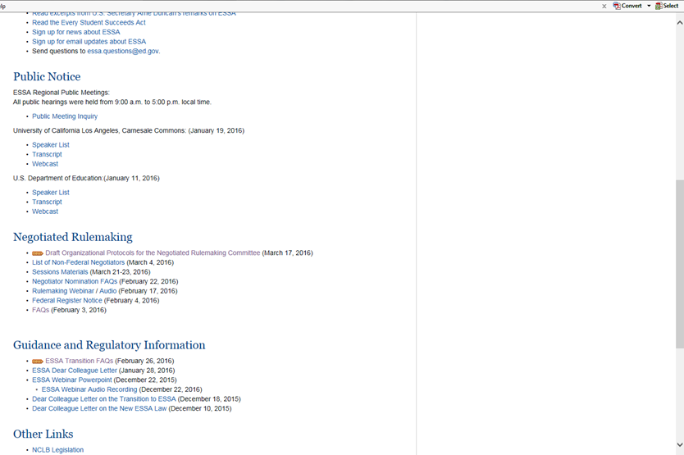
http://www2.ed.gov/policy/elsec/leg/essa/index.html

Slide 7
Effective Communication in Public Elementary and Secondary Schools
U.S. Department of Education
-Anne Hoogstraten, Office for Civil Rights
- Laura Duos, Office of Special Education Programs
March 24, 2016

Slide 8
Please note:
This presentation provides general information and does not represent a complete recitation of the applicable law and policy in this area. It does not address specific issues of compliance because determinations of compliance depend on specific facts on a case-by-case basis. The language used in these slides is approved for the purposes of this presentation only and should not be used for other purposes.

Slide 9
Background
K.M. v. Tustin Unified School District,
725 F.3d 1088 (9th Cir. 2013)
Compliance with IDEA does not automatically satisfy the school’s Title II effective communication obligations for a student.

Slide 10
Federal Requirements
IDEA, Section 504, and the ADA each address the obligations of public schools, including charter schools, to meet the communication needs of students with disabilities, but do so in different ways.
Public schools must comply with all three federal laws, and while compliance with one will often result in compliance with all, sometimes it will not.

Slide 11
Individuals with Disabilities Education Act
FAPE is provided through the provision of special education and related services in conformance with an individualized education program (IEP).
Provide the opportunity to access, and make progress in, the general education curriculum.
IEP requirements include consideration of a child’s communication needs.

Slide 12
Section 504 of the Rehabilitation Act of 1973
Prohibits disability discrimination in federally assisted programs or activities.
The joint DCL on effective communication did not focus on Section 504.
As a general rule, violations of Section 504 also constitute violations of Title II;
One way of meeting a school’s Section 504 FAPE requirements is to comply with the IDEA FAPE requirements.

Slide 13
Title II of the ADA
Prohibits disability discrimination against qualified individuals with disabilities by all State and local governments, regardless of whether those entities receive Federal funds.
Requires public entities, such as LEAs and public charter schools, to ensure that communication with individuals with disabilities is as effective as communication with students without disabilities.

Slide 14
Who is a qualified individual with a disability under Title II?
Disability under Title II means:
(1) a physical or mental impairment that substantially limits one or more major life activities or major bodily function;
(2) a record of such an impairment; or
(3) regarded as having an impairment.
Qualified individual with a disability is one who meets the essential eligibility requirements.

Slide 15
Who is a child with a disability under the IDEA?
A child with a disability is a child:
evaluated in accordance with IDEA procedures as having one of the 13 disabilities listed in the definition, and
who, by reason thereof, needs special education and related services.

Slide 16
How do public schools meet their Title II effective communication obligations?
Public schools must provide appropriate “auxiliary aids and services” to ensure that communication with students with disabilities is as effective as with other students so that these students have an equal opportunity.

Slide 17
Title II defenses
Public schools need not provide a specific auxiliary aid or service if the school can show that providing that aid or service would result in a fundamental alteration or undue financial or administrative burdens.
But still must take other appropriate steps, i.e., provide other auxiliary aids or services, that would not result in fundamental alteration or undue burdens.

Slide 18
What are auxiliary aids and services under Title II?
Auxiliary aids and services make aurally or visually delivered information available to students with hearing, vision, or speech disabilities so that they can receive information from, and convey information to, others as effectively as students without disabilities.

Slide 19
How do schools decide which auxiliary aid or service provides effective communication?
Individualized determination;
Primary consideration;
Case-by-case basis considering:
Communication used by the student, and communication requested by the student (if different from communication used);
The nature, length, and complexity of the communication involved;
Context of communication.

Slide 20
What does “primary consideration” mean?
A school must give “primary consideration” to the particular auxiliary aid or service requested by the student with a disability (or the student’s parent).
Subject to available defenses, a school must honor the request unless it can show that an alternative is as effective and provides the student an equal opportunity to participate and benefit.

Slide 21
To be effective, appropriate auxiliary aids and services must be provided . . .
In accessible formats;
In a timely manner; and
In such a way as to protect the student’s privacy and independence.

Slide 22
How do IDEA FAPE and Title II effective communication requirements differ?
Title II: communications with persons with disabilities are “as effective as” communications with other persons;
IDEA: FAPE must be individually designed to provide meaningful educational benefit to the child.

Slide 23
How are requests made for Title II auxiliary aids and services?
Title II does not designate a particular contact person or a specific process.
School district can determine who and how, and should make that information publicly available.
For IDEA-eligible children, school district has an affirmative obligation to do Title II assessment. No specific or separate parental request is required.

Slide 24
May information from IDEA evaluations be used when considering a Title II request for auxiliary aids or services?
Title II does not mandate a particular process.
Information obtained during IDEA evaluation can be relied on in Title II analysis, but must apply a Title II standard.
Must provide Title II auxiliary aids and services in timely manner; cannot wait for IEP process to run its course.

Slide 25
Can the IEP Team make decisions about the provision of auxiliary aids and services required under Title II?
If a school district designates the IEP Team as having the responsibility of making decisions about the auxiliary aids and services required under Title II, then the IEP Team may make this decision.

Slide 26
Is the dispute resolution process for Title II different than under the IDEA?
Under the IDEA, a parent can request mediation, file a complaint with the State educational agency, or request an impartial administrative hearing.
Under Title II, a parent can file a Title II complaint with ED OCR or DOJ, file a grievance with the school district, or file a civil lawsuit in Federal court.
Administrative exhaustion may apply

Slide 27
Resources
Dear Colleague Letter on Effective Communication: http://www2.ed.gov/about/offices/list/ocr/letters/colleague-effective-communication-201411.pdf
Frequently Asked Questions on Effective Communication for Students with Hearing, Vision, or Speech Disabilities in Public Elementary and Secondary Schools:
http://www2.ed.gov/about/offices/list/ocr/docs/dcl-faqs- effective-communication-201411.pdf
Government’s amicus brief in Tustin:
http://www.justice.gov/crt/about/app/briefs/kmtustinbr.pdf

Slide 28
Notice of Proposed Rulemaking (NPRM)Significant Disproportionality
Jill Harris, Policy Analyst
Office of Special Education and rehabilitative Services

Slide 29
What is significant disproportionality (SD)?
Significant disproportionality occurs where districts identify, place outside the regular classroom, or discipline children from any racial or ethnic group at markedly higher rates than their peers.

Slide 30
What is in the current IDEA regulation?
States have discretion in establishing methodologies for identifying SD
If a state identifies a district as demonstrating SD, the district must:
Set aside 15% of their IDEA, Part B funds to provide comprehensive, coordinated early intervening services (CEIS) to children in regular education in grades K-12.
Review and revise district policies to ensure compliance with the IDEA and report publicly on those revisions.
Notes:
Accordingly, in 2004 IDEA Amendments, Congress again found that greater efforts were needed to address misidentification of children of color and required states to determine if SD is occurring in the district relative to identification and placement.

Slide 31
So what data resulted from current regulation?
In 2013, in a nation of over 13,000 school districts, only 491 districts were identified by states as demonstrating significant disproportionality.
Only 2 to 3 percent of districts were identified and required to take action.

Slide 32
What does the Department propose?
The proposed rule will require that:
States use a standard methodology to measure SD based on race and ethnicity in the LEA.
Use the standard methodology to identify SD in the identification, placement or discipline (including suspensions and expulsions) of a child.
And it will:
Broaden the use of CEIS funds to include:
Children with disabilities K-12.
Children with and without disabilities in preschool.

Slide 33
Our Goal
The intent of the proposed regulation is not to limit services for children with disabilities who need them; rather, the purpose is to ensure that children are not mislabeled and receive appropriate services.

Slide 34
What you can do……
The Department seeks comment on 13 specific questions in the NPRM.
You may be particularly interested in the questions regarding:
What TA should be put in place to prevent under-identification of students to avoid designation of significant disproportionality.
Whether there should be restrictions on how the CEIS funds may be used with children already receiving Part B services.
How the Department should measure the impact of the regulation once it is final.

Slide 35
And…..
Share the NPRM with others.
Stay tuned for state and local discussions regarding SD.
Comment!

Slide 36
Final Notes
The SD NPRM is open for comment until May 16, 2016.
Comments are submitted at Regulations.gov

Slide 37
Overview of the State Correctional Education Self- Assessment Tool (SCES) and Guidance
Office Special Education and Rehabilitative Services(OSERS)
Office of Special Education Programs (OSEP)
Presenter:
Al Jones – Associate Division Director, Monitoring and State Improvement planning Division
Notes:
Gregg: Introduction

Slide 38
2014 Correctional Education Guidance Package
Dear Colleague Letter on IDEA for students with disabilities in correctional facilities.
Dear Colleague Letter on Federal Civil Rights Laws that apply to juvenile justice residential facilities that receive Federal funds.
Dear Colleague Letter on Access to Pell Grants for Students in Juvenile Justice Facilities for campus financial aid professionals clarifying when otherwise eligible youth who are confined in juvenile justice facilities are eligible to receive Federal Pell Grants
Guiding Principles for Providing High-Quality Education In Juvenile Justice Secure Care Settings

Slide 39
Guiding Principles for Providing High-Quality Education In Juvenile Justice Secure Care Settings
A safe, healthy facility-wide climate that prioritizes education, that provides the conditions for learning, and encourages the necessary behavioral and social support services.
Necessary funding to support educational opportunities for all youth within long-term secure care facilities.
Recruitment, employment, and retention of qualified education staff with skills relevant in juvenile justice settings.
Rigorous and relevant curricula aligned with State academic and career and technical education standards that utilize instructional methods, tools, materials, and practices that promote college-and career-readiness.
Formal processes and procedures through statutes, memoranda of understanding, and practices that ensure successful navigation across youth serving systems and smooth reentry into communities.

Slide 40
Value of Interagency Coordination
Enables agencies to appropriately address FAPE as it pertains to the high rate of mobility of students with disabilities in the correctional education system.
Facilitates communication between key partners (e.g, transfer of records; data collections, monitoring, and parent involvement).
Facilitates models that emphasize State re-entry options (e.g, virtual and evening/alternative schools, dual enrollment high school college programs and GED).
Enhances the availability of flexible and reliable funding.
Enables synchronization of activities and timelines (e.g, joint monitoring and professional development activities.
Strengthens collaboration with community based organizations (e.g. probation and parole officers and other social services).
Notes:
Youthful offenders are served by numerous public agencies as they work their way through the juvenile justice or adult corrections systems. These agencies may include the courts, social service agencies, detention centers, group homes, rehabilitation programs, school programs, and correctional institutions. When schools are not informed that youths are incarcerated, information about special education needs cannot be transferred.
When schools are not informed that youths are incarcerated, information about special education needs cannot be transferred. Even when schools are informed of incarceration, IEPs and other pertinent information may not be transferred because of poor or inadequate coordination with the school system (Schrag, 1995).
This presents a problem for the correctional facility because resources needed for assessment of such youths typically are not readily available in the facility. A lack of guidelines or written procedures for the exchange of information (e.g., notification of incarceration and exchange of records) interferes with the transition of students into and out of correctional facilities.
Transition of youths from the correctional facility back into school and/or the community is extremely difficult (Leone, 1994). A successful transition to the community requires the coordinated efforts of institutional staff, families, probation and aftercare professionals, and educators (Leone et al., 1991a). The availability of integrated support services (e.g., counseling, career planning, and social work services) to improve this transition is limited. Corrections education programs that serve a large region or a whole State are further challenged by interagency coordination because this necessitates working with personnel and procedures from multiple schools and agencies (Markowitz, 1998).
http://www.edjj.org/Publications/pub05_01_00.html (Interagency coordination)
http://cecp.air.org/juvenilejustice/docs/Collaboration%20in%20the%20Juvenile%20Justice%20System.pdf

Slide 41
State Correctional Education Self-Assessment Tool
The SCES is a voluntary tool that was developed by OSEP to assist States in self-assessing their systems for providing special education and related services to students with disabilities in correctional facilities.
The self-assessment is not a monitoring tool, it will serve as a document to assist OSEP in providing appropriate technical assistance to States.

Slide 42
The Organization of the SCES
The self-assessment is organized into three main areas:
The first area highlights requirements for interagency agreements between SEAs and other public agencies, including responsible non-educational public agencies.
The second area provides a tool to evaluate and track the State’s progress in addressing States’ and SEAs’ responsibilities to students with disabilities in correctional facilities.
The third area provides a tool to evaluate and track how the Individuals with Disabilities Education Act (IDEA) requirements are being addressed by public agencies in your States, including LEAs, and correctional facilities that operate as LEAs, and non-educational public agencies.
State Directors of Special Education may find it helpful to collaborate with Elementary and Secondary Education Act (ESEA), Title I, Part D Personnel, Correctional Education Directors, and/or State Commissioners of Corrections in completing the self-assessment.

Slide 43
Discussion and Questions
Notes:
1.

