Slide 1
Best Practices in Outreach
The webinar will begin shortly.
For Audio: 877-713-0446,
Conference Code: 101 725 8988
Please mute your computer speakers & phone line during this webinar.
Please use the Chat Box to tell us:
The name of your Parent Center
Your state
Your email address
Center for Parent Information & Resources

Slide 2
A Few Reminders on Webinar Etiquette
Everyone will be muted.
Please feel free to use the “Chat” box for your questions or comments.
You can also “Raise Your Hand” using the icon at the top left.

Slide 3
Best Practices in Outreach
Our Presenters
Nelsinia Ramos, Wisconsin FACETS
Esperanza Reyes, Utah Parent Center
Judy Wiley, Native American PTAC (NAPTAC)

Slide 4
Agenda for Today’s Webinar
In today’s webinar, we will:
Discuss why best practices in outreach are important
Introduce and familiarize the Parent Center network with the Best Practices in Outreach page on the Parent Center Hub
Give you resources and examples about outreach

Slide 5
Current Cultural Landscape
Demographics (American Community Survey 2015)
Race | Number | % of Population
One Race | 311,437,291 | 96.9%
Two or More Races | 9,981,530 | 3.1%
 |  | 100%
White | 234,940,100 | 73.1%
Black or African American | 40,695,277 | 12.7%
American Indian or Alaska Native | 2,597,249 | 0.8%
Asian | 17,273,777 | 5.4%
Native Hawaiian & Other Pacific Islander | 554,946 | 0.2%
Some Other Race | 15,375,942 | 4.8%
Two or More Races | 9,981,530 | 3.1%
 |  | 100%
*Hispanic or Latino of any Race | 54,496,122 | 17.6%
Source: [Powerpoint Slide] Georgetown University National Center for Cultural Competence. Community of Practice on Cultural and Linguistic Competence in Developmental Disabilities. July 31, 2017. Deep Dive: Exploring the Multiple Dimensions of Culture and their Impact for Developmental Disabilities Systems.
Notes:
-This is the current breakdown of what the nation’s population looks like. Individuals can identify themselves as belonging to one racial category or multiple racial categories. (First set of data)
-When “One Race” is broken down into its individual components, we have the ones we are familiar with. Individuals may still identify with “some other race” that is not described on this list. This is all based on self-identification.
-Lastly, Hispanics or Latinos are represented in all the race categories. Due to the high percentage of individuals who self-identify as Hispanics or Latinos, this is the only ethnicity represented on this table.

Slide 6
Current Cultural Landscape
What are the TRENDS we see based on Census data?
U.S. Population 2014-2060
Minority-Majority
By 2020, the child population will cross over the threshold
By 2044, we will become a “Plurality Nation”
By 2060, close to 1 in 5 individuals will be foreign born
Source: [Powerpoint Slide] Georgetown University National Center for Cultural Competence. Community of Practice on Cultural and Linguistic Competence in Developmental Disabilities. July 31, 2017. Deep Dive: Exploring the Multiple Dimensions of Culture and their Impact for Developmental Disabilities Systems.
Notes:
-This clarifies why this topic is so timely for parent centers and provides a background of the changes that we are experiencing as a nation.
-Encourage individuals and parent center staff to familiarize themselves with the changing demographics of their state.
-”Plurality Nation”= No individual race or ethnic group is projected to have greater than a 50 percent share of the nation’s total population. Over 50% of the people living in the United States will belong to a minority group, essentially becoming a “minority-majority”.
-The native born population is expected to increase by 22 percent (growing to 339 million) and the foreign-born population is projected to grow by 85% (from 42 to 78 million).
CUTURAL BARRIERS TO ACCESSING SERVICES AND SUPPORST
-Historical mistrust of health care, mental health, education, and social service professionals.
-Experiences of racism, discrimination and bias
-Cultural beliefs about the meaning of disability (including differing value systems)
-Stigma
-Literacy and health literacy
-Limited English Proficiency
In order to better prepare to serve these segments of the population, we need to have the appropriate resources available to us as professionals serving these families.

Slide 7
Why These Resources?
Process for review of products to determine their Usefulness, Relevant and High Quality
Gather Stakeholders/Parent Centers
Gather High Quality
Resources on Outreach
The Team Reads and Rates Each Resource
Highly Rated Resources Are Posted to CPIR Website
Notes:
8 Stakeholders were gathered from Parent Center staff they included Directors, and outreach trainers.
Next we gathered parent centers materials on best practices on outreach
Teams we’re developed to evaluate products.
Materials were viewed and rated on usefulness, relevancy and high quality.
Materials rated high were then posted to the CPIR website

Slide 8
Best Practices in Outreach page
http://www.parentcenterhub.org/ best-practices-in-outreach/
Notes:
Open the link from the internet. So we can review the pages in it.

Slide 9
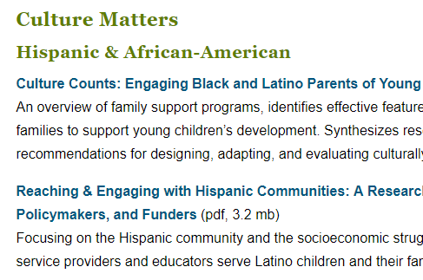
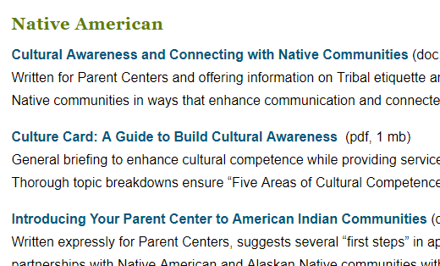
Sections You’ll Find on the Best Practices in Outreach Page

Slide 10
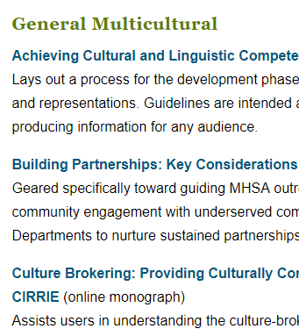
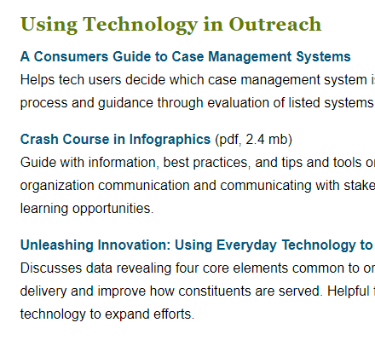
Sections You’ll Find on the Best Practices in Outreach Page

Slide 11
Using Outreach to Increase Access
“Online toolkit demonstrates how to implement an outreach service to expand access to health services, practices, and products.
Examples answer the questions of what outreach is, when is it needed, and give suggestions of common methods of outreach and creative and nontraditional ideas for implementation. Also touches upon cultural awareness.”
Notes:
http://ctb.ku.edu/en/table-of-contents/implement/access-barriers-opportunities/outreach-to-increase-access/main
It’s reasearch

Slide 12
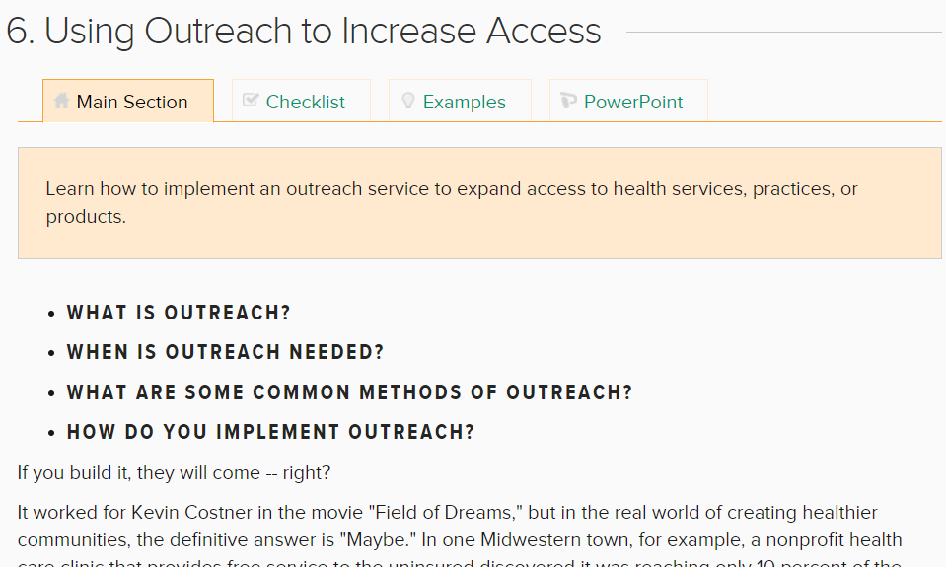
Using Outreach to Increase Access
Group Analysis
Type of resource: webpage
Is this a good resource to share?
Main page, checklists, examples, PowerPoint
Topic (physical, multicultural, communication)
Needs further review?
Notes:
http://ctb.ku.edu/en/table-of-contents/implement/access-barriers-opportunities/outreach-to-increase-access/main
Main page: What is outreach, When is outreach needed, What are some common methods of outreach; How do you implement outreach?

Slide 13
Using Outreach to Increase Access
Practical step-by-step guidance in community-building skills
Toolkits include:
Community assessments
Communications
Strategic planning
Leadership management
Community interventions
Implementation

Slide 14
Section 1. Modifying Access, Barriers & Opportunities
Other sections:
Extending Opportunities for the Poor
Increasing Access for People with Physical Disabilities
Using Outreach to Increase Access

Slide 15
Checklist

Slide 17
Resources in Action- Example
“Minority Parent & Community Engagement: Best Practices and Policy Recommendations for Closing the Gaps in Student Achievement“
Ethnic minority organization’s best Practices for Engaging Minority Parents
Common Barriers Hindering Parent Engagement & Successful Strategies to Overcome Them
Policy Recommendations to Improve Ethnic Minority Parent and Community Engagement
Notes:
http://www.parentcenterhub.org/wp-content/uploads/2016/09/Minority-Parent-and-Community-Engagement_maldef-report_final.pdf
Talk about the resource in particular:
This article was useful in helping me design training and presentations that had proven strategies to help educators reach out to and engage these families.
It has three major sections that (1) Summarize the strategies by major groups and well-known organizations that serve them, (2) Describes the very specific barriers experienced by these families that discourage parent participation, and (3) makes key policy recommendations at a broader level.
Not only does this help inform our staff in how we provide services, but these resources also help us speak to the larger system about the needs of these families.
-Just recently, in the beginning of August, I was able to present alongside another Parent Center staff member and our State Education Agency at our annual “Special Education Law Conference” using information that I accessed on this particular article. I remembered the resources on the outreach page and was able to rely on it to express what I had already seen in the education system, but had the advantage of having these ideas already organized in a useful way that I could then refer back to.
Our presentation was titled, “How to Help Parents Meaningfully Participate in Special Education”, with the last section focusing on engaging ethnically and linguistically diverse families.

Slide 18
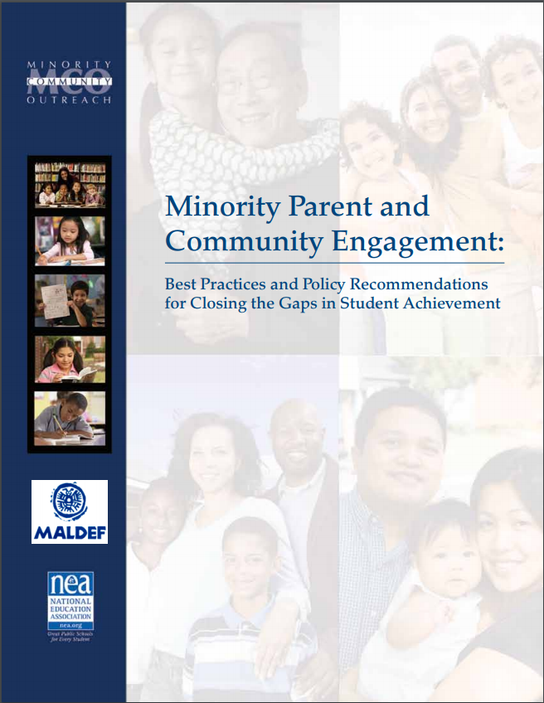
Resources in Action- Example
http://www.parentcenterhub.org/wp-content/uploads/2016/09/ Minority-Parent-and-Community-Engagement_maldef-report_final.pdf

Slide 19
Resources in Action- Example
Georgetown University National Center for Cultural Competence
An entire website full of resources
Self-Assessments and Tools
Community of Practice on Cultural and Linguistic Competence in Developmental Disabilities
https://nccc.georgetown.edu/
Notes:
https://nccc.georgetown.edu/
This website contains a wealth of information and can be searched by title and type. It includes learning modules under their “Distance Learning” tab that enables anyone to access additional material online.
The self-assessment tools have guides and even includes one on “Cultural and Linguistic Competence Assessment for Disability Organizations (CLCADO)”.
The Community of Practice has the goals of (1) advancing and sustaining cultural and linguistic competence (CLC) systemically through changes in values, policy, structures, and practices; and (2) responding effectively to the growing cultural and linguistic diversity among people with DD and their families who reside in states, territories, and tribal nations. Additional resources will be developed by the states involved in this CoP, and I am a participant of our Utah team.

Slide 20
Resources in Action- Example
https://nccc.georgetown.edu/

Slide 21
Outreach to Native Americans
In this brief, NAPTAC explores how Parent Centers might plan and conduct outreach to Native families within the reality of tribal sovereignty and the governing policies of individual tribal communities.
http://naptac.org/wp-content/uploads/2017/01/sovereignty-outreach.pdf
Notes:
Judy recently used this page to work with the NA PTAC cohort group to show how to take first steps when working with Native American families.

Slide 22
Outreach to Native Americans
http://naptac.org/resources/for-parent-centers/outreach-titlevi-webinar/
Notes:
Judy recently used this page to work with the NA PTAC cohort group to show how to take first steps when working with Native American families.

Slide 23
Outreach to Native Americans
http://naptac.org/wp-content/uploads/2017/04/native-values-communication-final.pdf
Notes:
Judy recently used this page to work with the NA PTAC cohort group to show how to take first steps when working with Native American families.

Slide 24
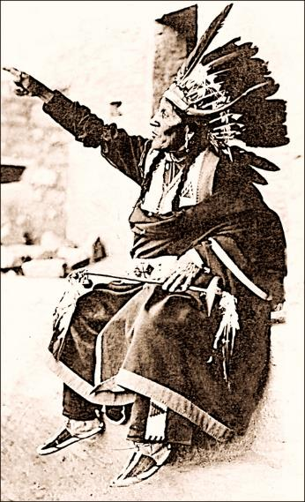
Questions?
Concerns?
Comments?
Notes:
Save questions until the end. This will be our time for answers for any questions.

Slide 25
Contact Information
Nelsinia Ramos
(414) 374-4645
nramos@wifacets.org
Judy Wiley
(505) 250-4144
judy@epicsnm.org
Esperanza Reyes
(801)272-1051
esperanza@utahparentcenter.org

Slide 26
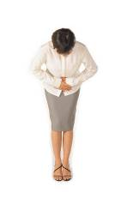
Thank you very much for attending this webinar.
Debra Jennings, Project Director debra@parentcenterhub.org
Myriam Alizo, Project Assistant malizo@spannj.org
Jessica Wilson, Communication and Dissemination jwilson@spannj.org
Lisa Küpper, Product Development lkupper@fhi360.org
Ana-Maria Gutierrez, Tech Support and Social Media agutierr@fhi360.org

Slide 27
Your feedback helps CPIR improve.
Please take a moment to complete a very brief survey about the usefulness of this webinar to you.
We’ve posted the link in the “Chat” box.
http://survey.constantcontact.com/survey/a07eenrzy4sj857c24h/start
Again, thank you!

