Slide 1

“Achieving Positive Educational Outcomes for Students in Correctional Settings: Effective Cross-Office and Agency Collaboration”
U.S. Department of Education
Office of Special Education and Rehabilitative Services/Office of Special Education Programs
Office of Elementary and Secondary Education/Office of Safe and Healthy Students
U.S. Department of Justice
Neglected and Delinquent Technical Assistance Center

Slide 2

Agenda
Introduction and Overview
Office of Special Education and Rehabilitative/Office of Special Education Programs
Office of Elementary and Secondary Education/ Title I Part D
Office of Safe and Healthy Students/Homeless Children and Youth Program
Neglected and Delinquent Technical Assistance Center
United States Department of Justice
Questions and Answers

Slide 3
Purpose
To provide State Education Agencies (SEAs), Local Education Agencies (LEAs), Technical Assistance (TA) providers, and others groups or entities a general overview of federal agencies efforts and tools to improve educational outcomes for students with disabilities in correctional facilities.
General Information:
Office of Civil Right First Look: Key Data Highlights on Equity and Opportunity Gaps in our Nation’s Public Schools:
    http://www2.ed.gov/about/offices/list/ocr/docs/2013-14-first-look.pdf
Office of Special Education Programs: Correctional Education Link GRADS 360:
  https://osep.grads360.org/#program/correctional-education
ED and DOJ: Correctional Education Package:
  http://www2.ed.gov/policy/gen/guid/correctional-education/index.html
OSEP: Improving Outcomes for Youth with Disabilities in Juvenile Corrections Toolkit, November 2016: https://www.osepideasthatwork.org/jj
OSEP: The Office of Special Education and Rehabilitative Services (OSERS) 2017
  A Transition Guide to Postsecondary Education and Employment for Students and Youth with Disabilities

Slide 4
OSERS/OSEP
Research To Practice Division (RTP)
Re-Entry & Model Demos
David Emenheiser
Monitoring and State Improvement Planning Division (MSIP)
Correctional Education a Focus Area
Marion Crayton and Curtis Kinnard

Slide 5
OSEP: Research To Practice Division Resources
These resources among others are available on https://www.osepideasthatwork.org/jj
Professional Development Modules on Youth with Disabilities in Juvenile Corrections
  Part 1: Improving Instruction
  Part 2: Transition and Reentry to School and Community
  http://iris.peabody.vanderbilt.edu/about/
Parent Resources:
  Webinar for professionals working with parents of JJ-involved students with disabilities.
  Future companion resources for parents of youth with disabilities in corrections.
  http://www.parentcenterhub.org/

Slide 6
OSEP: Research To Practice Division - Model Demos
Model demonstration projects:
  Reentry of students with disabilities from JJ facilities to education, employment, and community programs.
  Cross-cohort analysis of common measures: student outcomes and systems change.
  The link to the common webpage is http://mdcc.sri.com/cohort7.html
  Contacts to the individual Model Demos are:
  Site Project Director Email
  Arizona State U Sarup Mathur sarup.mathur@asu.edu
  U of Minnesota David Johnson johns006@umn.edu
  U of Oregon Deanne Unruh dkunruh@uoregon.edu

Slide 7
Correctional Education: OSEP
Monitoring and State Improvement Planning Division
Correctional Educational Guidance Package: December 2014
  Identify Evidence-Based Practices for improving education programs in juvenile justice facilities, as well as areas in which Federal legal obligations apply.
IDEA Dear Colleague Letter: December 2014
  Clarify to States and public agencies their obligations under the Individual with Disabilities Education Act to ensure the provision of A Free and Appropriate Public Education (FAPE) to eligible students with disabilities in correctional facilities.
IDEA 2015 Leadership Conference: July 2015
  Emphasize the importance of strengthening partnerships between Federal and State Agencies to ensure provision of educational services to youth with disabilities in correctional settings

Slide 8
Correctional Education: OSEP
Self-Assessment and DMS Clarifications
Correctional Education State Self- Assessment Tool: March 2016
  An OSEP developed voluntary tool to assist States in self-assessing their systems for improving special education and related services to students with disabilities in correctional facilities.
National Correctional Education Webinar: June 2016
  Clarify to States and public agencies any outstanding questions and key points of the State Correctional Education Self-Assessment Tool.
National Correctional Education RDA Differentiated Monitoring and Support Webinar: February 2017
  Clarify to States and public agencies any outstanding questions or concerns pertaining to the RDA Differentiated Monitoring and Support process.

Slide 9
OSEP: Correctional Education Factors
Results Driven Accountability (RDA), represents a shift from compliance-based monitoring to an accountability system based on Differentiated Monitoring and Support (DMS)
  Key point: DMS is designed to provide differentiated levels and types of monitoring and support based on each State’s unique strengths, progress, challenges, and needs.
DMS factors for Correctional Education FFY 2016-17 focus areas:
  Key point: to assess risk factors for OSEP and assist States in improving educational programming for students with disabilities in correctional settings

Slide 10
OSEP: States DMS Designations
Universal Level: effectively address the needs of all States and is focused on prevention to minimize the need for more targeted or intensive engagement-
37 States
Targeted Level: based on OSEP’s identification of common needs among multiple States- 17 States
Intensive Level: monitoring and support is reserved for those State educational agencies and Lead agencies experiencing the most intense or complex challenges to implementation- 6 States

Slide 11
OSEP: Targeted or Intensive Technical Assistance Factors #1
DMS Data for Correctional Education area of focus: FFY 2016-17
Title I Part D: number of students with disabilities who were served in a LEA juvenile corrections or detention program- FFY 2013-14
  14 States
OCR Data: number of hours per year that educational programming is offered during the regular school year in a juvenile justice or detention facility-FFY 2013-14
  10 States
Title I Part D: number of juvenile justice students that earned a high school diploma or GED- FFY 2013-14 while in the facility.
  11 States

Slide 12
OSEP: Targeted or Intensive Technical Assistance Factors #2
DMS Data for Correctional Education area of focus: FFY 2016-17
OSEP 618 Data: percentage of students with disabilities in a State who exited special education by dropping out.
  6 States
OSEP 618 Data: number of students with disabilities who were suspended or expelled from school within a State- for more than 10 days.
  14 States

Slide 13

OSEP: Conceptualizing Correctional Education
Through the Use of an Implementation Science Framework
  Correctional Education
  “A fundamental component of rehabilitative programming offered in juvenile justice confinement facilities…”
  Technical Assistance for States
  New Mexico
  Implementation Science
  Implementation science is the study of methods to promote the integration of research findings and evidence into policy and practice.

Slide 14
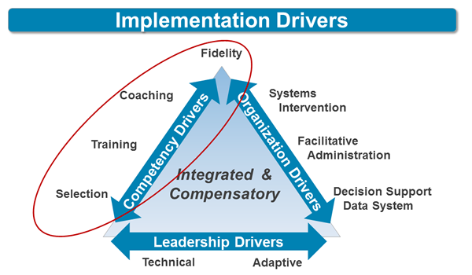
OSEP: Implementation Science Frameworks
Usable Interventions
Implementation Stages
Implementation Drivers
Implementation Teams
Improvement Cycles
http://implementation.fpg.unc.edu/

Slide 15
OESE- OSHS
Title I Part-D, Federal Program Manager
Office of Elementary & Secondary Education
Earl Myers, Jr.
Education for Homeless Children and Youth Program
Office of Safe & Healthy Students
Elyse Robertson

Slide 16
Title I, Part-D
Program Purpose:
Improve educational services for children and youth who are neglected or delinquent (N or D).
Provide services so that youth who are N or D can successfully transition from institutionalization to further education or employment.
Prevent youth from dropping out of school.

Slide 17
Title, I Part-D
  Focus Areas:
  Priorities around Correctional Education
  Link: Prevention and Intervention Programs for Children and Youth who are Neglected, Delinquent, or At Risk
https://www2.ed.gov/programs/titleipartd/index.html

Slide 18
OSHS: Guidance on Students with Disabilities Experiencing Homeless
Youth’s Reentry to Local Educational Agency:
  Many youth exiting juvenile justice facilities may end up in homeless situations. Local liaisons can help a reentering homeless youth navigate school district and community resources. Interagency coordination and collaboration is important to ensure youth receive rights and services for which they are eligible.
    Resources Map by State: https://nche.ed.gov/states/state_resources.php
    Youth Homelessness and Juvenile Justice Brief: https://nche.ed.gov/ibt/justice.php
McKinney-Vento Rights and Support:
  McKinney-Vento Homeless Assistance Act (McKinney-Vento Act) can help youth who are homeless get support they need (e.g., physical, behavioral, health, education, and other).
  The Every Student Succeeds Act amended the McKinney- Vento Act in 2015 reauthorizing new requirements to support youth by:
    ensuring transportation until the end of the school year in which permanently housed;
    introducing new feeder/receiving school of origin rights;
    providing college counseling and FAFSA independent student status letters of determination; and
    strengthening tutoring, counseling, mentoring, and case management services for each youth.

Slide 19
OSHS: Education for Children and Youth Resource and Data Overview
Education for Children and Youth (EHCY) Program and Data Overview:
1.3 million children and youth, are identified by local liaisons annually in recent years. About 17% have IEPs and many enrollment disputes involve homeless students with disabilities.
  EHCY National Data Summary; https://www2.ed.gov/programs/homeless/performance.html
  EHCY Data Publications: https://www2.ed.gov/programs/homeless/resources.html
Coordinated Resources and Guidance on IDEA and McKinney-Vento Act
  Special Education Resources: https://nche.ed.gov/ibt/sc_spec_ed.php
  EHCY Non-Regulatory Guidance: https://www2.ed.gov/programs/homeless/legislation.html
Coordinated Implementation on IDEA and McKinney-Vento Act
  Special Education and Homelessness:
    https://www2.ed.gov/policy/speced/guid/spec-ed-homelessness-q-a.pdf

Slide 20
NDTAC
Neglected and Delinquent Technical Assistance Center
Transition Toolkit 3.0
Simon Gonsoulin

Slide 21
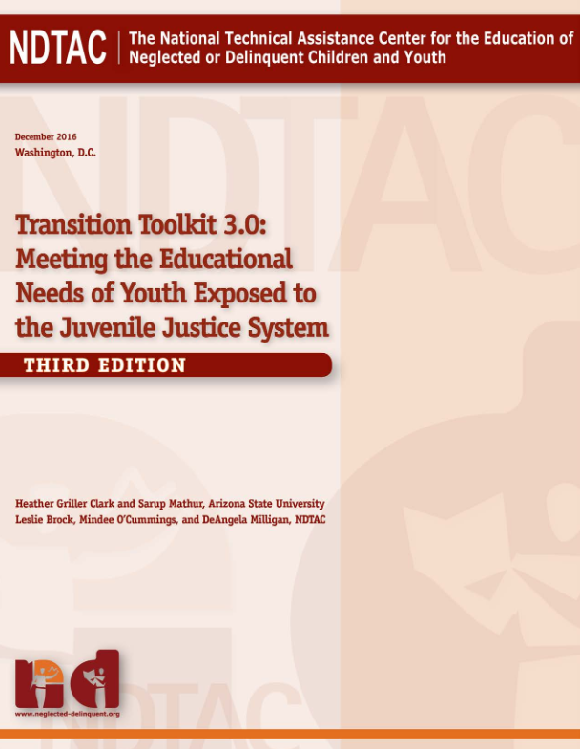
NDTAC’s Transition Toolkit 3.0
Overview of Educational Transition
NDTAC’s Transition Toolkit brings together strategies, existing practices, and updated resources and documents on transition to enable administrators and service providers to provide high-quality transition services for children and youth moving into, through, and out of education programs within the juvenile justice system.
http://www.neglected-delinquent.org/resource/transition-toolkit-30-meeting-educational-needs-youth-exposed-juvenile-justice-system

Slide 22
NDTAC: What is Transition?
A Set of activities that are:
  Coordinated
  Supportive
  Outcome-focused
  Across multiple Systems
Stages of Transition:
  Stage 1: Entry into the justice system
  Stage 2: Residence
  Stage 3: Exit from incarceration
  Stage 4: Aftercare

Slide 23
NDTAC: Effective Transition Efforts
Transition Planning at first contact.
High levels of engagement with youth in the development of plans that include family, agency, and school members.
Supports, services, and processes that are culturally and linguistically competent and well-monitored.
Well-trained staff who are sufficiently funded; and a dedicated transition coordinator who oversees the process.

Slide 24
DOJ
United States Department of Justice
Federal Civil Rights Laws
Shelley Jackson

Slide 25
Department of Justice
Brief Overview
  U.S. Attorney General has authority to remedy a “pattern or practice” of conduct that violates the constitutional or federal statutory rights of youth in juvenile justice institutions (Civil Rights of Institutionalized Persons Act, 42 U.S.C. Section 1997; 42 U.S.C. Section 14141)
  In the Civil Rights Division, this work is done by the Special Litigation Section.
Federal Civil Rights Laws
  Title IV – prohibits discrimination on the basis of race, color or national origin by recipients of federal financial assistance.
  Title IX – prohibits discrimination on the basis of sex by recipients of federal financial assistance.
  Section 504 of the Rehabilitation Act – prohibits discrimination on the basis of disability by recipients of federal financial assistance.
  ADA Title II – prohibits discrimination on the basis of disability by state and local government entities, regardless of whether they receive federal financial assistance.

Slide 26
Department of Justice
DOJ’s Civil Rights Division has a long history of addressing the civil rights of youth in juvenile correctional facilities, including the education rights of youth with disabilities.
CRIPA and 42 U.S.C. 14141 allow DOJ to seek remedies for pattern and practice violations of youths’ IDEA rights in juvenile correctional facilities.
Most recent case -- Leflore County, MS. Juvenile Detention Center.
January 2016 IDEA findings:
  Failure to comply with Child Find requirements
  Failure to promptly obtain youths’ IEPs
  Denial of FAPE
Efforts to resolve these findings are ongoing.
https://www.justice.gov/crt/rights-juveniles
https://www.justice.gov/crt/special-litigation-section-cases-and-matters0#juv

Slide 27
Federal Contacts for Information and Handouts
Department of Justice
Department of Education
OESE/OSHS/OCTAE
Department of Education (OSEP)
Neglected and Delinquent Technical Assistance Center (NDTAC)
Shelley Jackson, Deputy Chief, DOJ Special Litigation Section, 202-305-3373, Shelley.Jackson@usdoj.gov
John McLaughlin, ED-OESE –OSHS, Federal Coordinator, Education for Homeless Children and Youth Program, 202-401-0962, John.McLaughlin@ed.gov
Elyse Robertson, ED-OESE-OSHS, Special Assistant to Education Homeless Children and Youth Program, 202-401-0962, Elyse.Robertson@ed.gov
Earl Myers, Jr. ED-OESE-OSHS, Federal Coordinator, Neglected and Delinquent Education Program, Title I Part D, 202-453-6716, Earl.Myers@ed.gov
Sean Addie, Office of Career, Technical, and Adult Education, Office of Correctional Education, 202-245-7374, sean.addie@ed.gov
David Emenheiser, OSEP/RTP, Re-Entry & Model Demos Lead, 202-245-7556, David.Emenheiser@ed.gov
Sarah Allen, OSEP/RTP, Re-Entry & Model Demos Co/Lead, 202-245-7875, Sarah.Allen@ed.gov
Marion Crayton, Education Program Specialist, OSEP- Correctional Ed. Co/Lead and Implementation Science, 202-245-6474, Marion.Crayton@ed.gov
Curtis Kinnard, Education Program Specialist, OSEP-Correctional Ed. Lead, 202-245-7472, Curtis.Kinnard@ed.gov
Simon Gonsoulin, Project Director- Neglected and Delinquent Technical Assistance Center, 202-403-5653, sgonsoulin@air.org

Slide 28
Questions and Answers
SEAs, LEAs, Correctional Facilities and Non-Educational Agencies
Has your agency used the 2014 Correctional Education guidance package from ED and DOJ?
Do you have ideas for additional technical assistance from ED or DOJ that would be helpful in this area?

