Slide 1
Partnering with Families in the Digital Learning Process: A Symbiotic Endeavor
February 22, 2023
CPIR Webinar

Slide 2
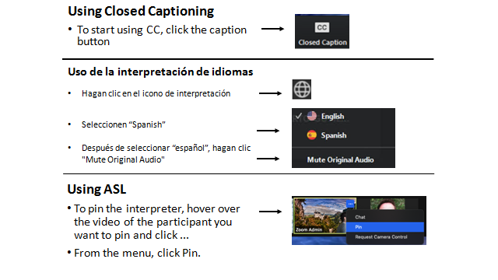
Closed Captioning Options

Slide 3
Session Facilitators
Christine Fox
Project Director, CITES
CAST
@cafox
Maggie Pickett
she/her
Senior Technical Assistance Specialist
CAST
@MaggieP_AT
Michelle Soriano
she/her
Technical Assistance Specialist
CAST
@MichelleEDUC8

Slide 4
Accessibility Commitment
Understandable
Clear structure and layout
Consistent formatting
Effective use of images
Robust
Checked for accessibility using an accessibility check built into PowerPoint
Perceivable
Alt text on images
High color contrast
Readable font
Operable
Distinct slide titles
Shortened links with descriptive back-halves

Slide 5
Creative Commons
Resource created by The Center on Inclusive Technology & Education Systems at CAST and licensed under a Creative Commons Attribution 4.0 International License. All other rights reserved related to third party content. Resource contact(s): Maggie Pickett & Michelle Soriano.

Slide 6
Language Check
Identify First
People First
Definition: The use of a descriptive word first to describe a person/oneself.
Reason for Use: Believe the disability is an inherent part of one's identity.
Example:
Autistic individual
Disabled person
Definition: The use of a descriptive word last to describe a person/oneself.
Reason for Use: Emphasize the person before the disability.
Example:
Person who is blind
Student who is deaf

Slide 7
Today’s Objectives
We will…
Identify Family Engagement best practices across the 5 framework areas of Leadership, Teaching, Learning, Assessment, and Infrastructure.
Describe the essential nature of the 2-part symbiotic relationship between families/caregivers and educators
Identify 2 resources from CITES that support implementation of the Family Engagement practices.
Reflect, what are your goals for our time together today?

Slide 8
Home Base
The home base document is your one-stop-shot to all session materials and summaries of content.
bit.ly/EngageFamiliesFeb23

Slide 9
CITES

Slide 10
The goal of CITES
Empower districts to create and sustain inclusive technology ecosystems that foster intentional collaboration between EdTech, AT, and InfoTech to benefit students with disabilities and all students.
cites.cast.org

Slide 11
Creating Inclusive Technology Systems
Current Reality
Our Goal
Assistive Technology, Instructional Technology, Communities, Educators. Separate values, data, and knowledge.
All helping children learn.
A supported system of collaboration with shared values, data, and knowledge.
Helping all children learn.

Slide 12
Enhancing the NETP
National Education Technology Plan

Slide 13
Framework Areas
Leadership
Infrastructure
Teaching
Learning
Assessment
Notes:
Aligned to the NETP – Family Engagement critical area for CITES Framework.

Slide 14
Framework Development Process
Knowledge Development
Framework Development
Evidence Review
Finished
Learn more at bit.ly/FrameworkDevelopment

Slide 15
Leadership in Inclusive Technology systems
Family Engagement

Slide 16
Definition of Symbiosis
Symbiosis (noun):
A cooperative relationship (as between two persons or groups)
Symbiosis Definition & Meaning - Merriam-Webster

Slide 17
Family Engagement Policy
Every Student Succeeds Act (ESSA): Requires schools to meaningfully engage the parents of all students and ensure that they are given input and influence in decision-making.
Individuals with Disabilities Education Act (IDEA): Requires that the parents of students with disabilities are full and equal participants with school personnel on their child’s individualized education program (IEP) team.
Notes:
Because of the demonstrated impacts and benefits of implementing family engagement practices,
our federal partners encourage their use in law:

Slide 18
Bronfenbrenner’s Ecological Systems Theory & CITES Framework Categories
Read more by visiting the Literature Review on Family Engagement at
bit.ly/FamilyEngagementLitReview

Slide 19
What is Symbiosis in Family Engagement
What does symbiosis look like, feel like, sound like in family engagement practices?

Slide 20
Framework Areas with Family Engagement
Leadership
Infrastructure
Teaching
Learning
Assessment
Family Engagement

Slide 21
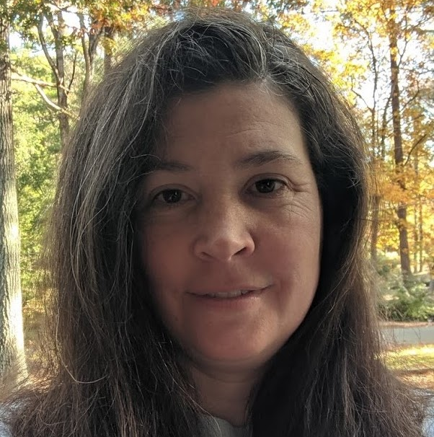
CITES Family Engagement Study
326 family members of K-12 students with disabilities from across the US completed an online survey.
10 family members who completed the survey participated in focus groups
Researchers combined survey and focus group data to identify family engagement practice recommendations.
Dr. Angelica (Angel) Morgan, Ph.D.
Notes:
The CITES family engagement study had three phases.
First, family members of students with disabilities attending public schools across the United States completed an online survey to report on how often education leaders and classroom educators included families in discussions about information, educational and assistive technology. Families also reported on the communication methods used for family engagement.
In the second phase, ten family members who completed the survey participated in focus groups to discuss the impact of family engagement practices.
Lastly, researchers combined survey and focus group data to identify family engagement practice recommendations.

Slide 22
Jammin’ To Family Engagement
bit.ly/FamEngJamFeb23

Slide 23
The what and the how
The What and the How

Slide 24
Leadership Family Engagement Practices
Partner with Families
Communicate with Families
District leaders ensure that families and community members are partners in all phases of development and implementation.
District leaders communicate about technology with families efficiently, effectively, and equitably.

Slide 25
Leadership Actions to Partner with Families
Partner with established family engagement networks (e.g., Parent Teacher organizations) to engage family voices, experiences, and perceptions in technology planning.
Gather feedback from families regularly and use those data to improve implementation
Include families in the development of remote learning plans

Slide 26
Leadership Actions to Communicate with Families
Guarantee communications are accessible to connect with the widest audience possible (e.g., translation, use of simple, non-technical language, using alt text on images).
Partner with established family engagement networks (e.g., Parent Teacher organizations) to offer just-in-time technology support.
Allow extra time for family meetings when an attendee is non-English speaking to ensure complete understanding.

Slide 27
Infrastructure Family Engagement Practices
Provide Families Access:
Provide Technical Support to Families:
District technology leaders provide families with adequate access to district technology tools and subscriptions.
District leaders provide timely, responsive, and quality technical support to families.

Slide 28
Infrastructure Actions to Provide Families Access
Provide a parent app or portal as a one-stop-shop for family communication and information gathering.
Share a comprehensive list of digital tools the district uses with general information, log in information.
Publicize the district’s student privacy and security policies and share best practices.
Establish a process for families, support staff, and AT providers of students with low incidence and/or significant disabilities to access student accounts.

Slide 29
Infrastructure Practices to Provide Families Technical Support
Solicit feedback from families when provisioning technology devices and software to students with disabilities, to ensure the usability and accessibility of that technology.
Host easy to access trainings using multiple modalities to all families for commonly used digital tools in the district, including accessible technologies and materials and assistive technologies.
Offer help desk support to all families and ensure help desk staff are knowledgeable about accessible and assistive technologies to offer comprehensive support to families of students with disabilities.

Slide 30
Discuss District-Level Practices
In the chat, share one thing that:
Squared with your thinking
Still circling in your head

Slide 31
Assessment Family Engagement Practices 1 & 2
Include Families in Large-Scale Assessment Administration
Include Families in Accommodation Decisions
District leaders include families as partners in managing large-scale assessments
Educators include families as partners in decision-making for assessment accommodations.

Slide 32
Assessment Family Engagement Practices 3
Include Families in Data-Based Decisions
District leaders and educators include families as partners in data-informed decision-making, including instructional and transitional, programmatic, and systemic.

Slide 33
Actions to Include Families in Large-Scale Assessment Accommodation Decisions
Equitably include families of students with accessibility needs in large-scale assessment selection, implementation planning, and alternative options.
Share how large-scale assessment data is used with families to establish a culture of continuous improvement in education

Slide 34
Actions to Include Families in Accommodation Decisions
Provide families with information and training on available supports for statewide and classroom universal tools and accommodations for all learners, particularly those students with disabilities.
Engage families in decision-making to identify and align instructional and assessment accommodations.

Slide 35
Actions to Include Families in Instructional and Transition Decisions
Provide families with assessment data in an understandable format.
Combine information from families about student learning, extra-curricular activities, and behavior at home and in the community with student work and educator observations to make well-informed instructional and transition decisions

Slide 36
Actions to Include Families Programmatic and Systemic Decisions
Engage families in the data analysis processes that drive programmatic decisions.
Engage families in the data analysis processes that drive systemic decisions.

Slide 37
Teaching Family Engagement Practices
Engage Families in the Learning Community
Support Families Shifting Role:
Educators consider families part of the learning community and engage in frequent, direct communication with families.
Educators support the shifting role of parents in the learning process from parent advocate to student self-advocacy coach

Slide 38
Actions to Engage Families in the Learning Community
Engage in regular communication with families that is bi-directional through familiar means (i.e., text message, email, etc.).
Get to know families’ cultural perspectives and unique abilities to develop personalized and culturally-relevant learning experiences
Use family volunteers to facilitate inclusive digital learning activities
Allow families to be part of the planning process to help inform classroom accommodations and supports.

Slide 39
Actions to Support the Shifting Role
Encourage families to advocate for the learning supports their learners require.
Provide families and students with a variety of resources and training to guide their transition to become a self-advocate and be self-determined young adults.

Slide 40
Actions to Include Families in the Learning Process
Share what students learn in school through a class website or parent portal
Provide families with talking points to discuss what students are learning in school
Provide families with supplemental resources to take part in learning at home
Host workshops for families to engage in learning with their students

Slide 41
Learning Family Engagement Practices
Empower Families to Support Student Learning
Educators involve families in the learning process to help students continue to learn outside of school.

Slide 42
Discuss Practioner-Level Practices:
In the chat, share one thing that:
Squared with your thinking
Still circling in your head

Slide 43
Jammin’ To Family Engagement with the CITES Framework
bit.ly/FamEngJamFeb23

Slide 44
Quote from Dr. Joy Smiley-Zabala
I used to think I was passionate about assistive technology. What I’ve learned is that I’m very passionate about participation and learning.
So, this is not about the technology. This is about people’s lives…living and learning and the functions that have to do with that. ​
And that is where the passion lies.
Dr. Joy Smiley-Zabala

Slide 45
The Joy Zabala Fellowship
For more information go to:
bit.ly/joy-zabala-fellowship

Slide 46
CITES Community of Practice
Join the conversation:​
Quarterly open community meetings via zoom​
Slack channel discussions​
Social media networking​
Would you like to invite others to the CITES Community of Practice?​
Please do! Here is an invitation link to share.​
cites.cast.org/more/community-of-practice

Slide 47
Thank you! Stay connected.
Website: cites.cast.org
Professional Learning: castpl.org
Books & Media: publishing.cast.org
Email: cites@cast.org
Phone: (781) 245-2212
178 Albion Street Suite 210 Wakefield, MA 01880

Slide 48
Disclaimer
This content was developed under a grant from the US Department of Education, #H327T180001. However, the contents do not necessarily represent the policy of the US Department of Education, and you should not assume endorsement by the Federal Government. Project Officer: Anita Vermeer, M.Ed.
Resource created by The Center on Inclusive Technology & Education Systems at CAST and licensed under a Creative Commons Attribution 4.0 International License.

