Slide 1

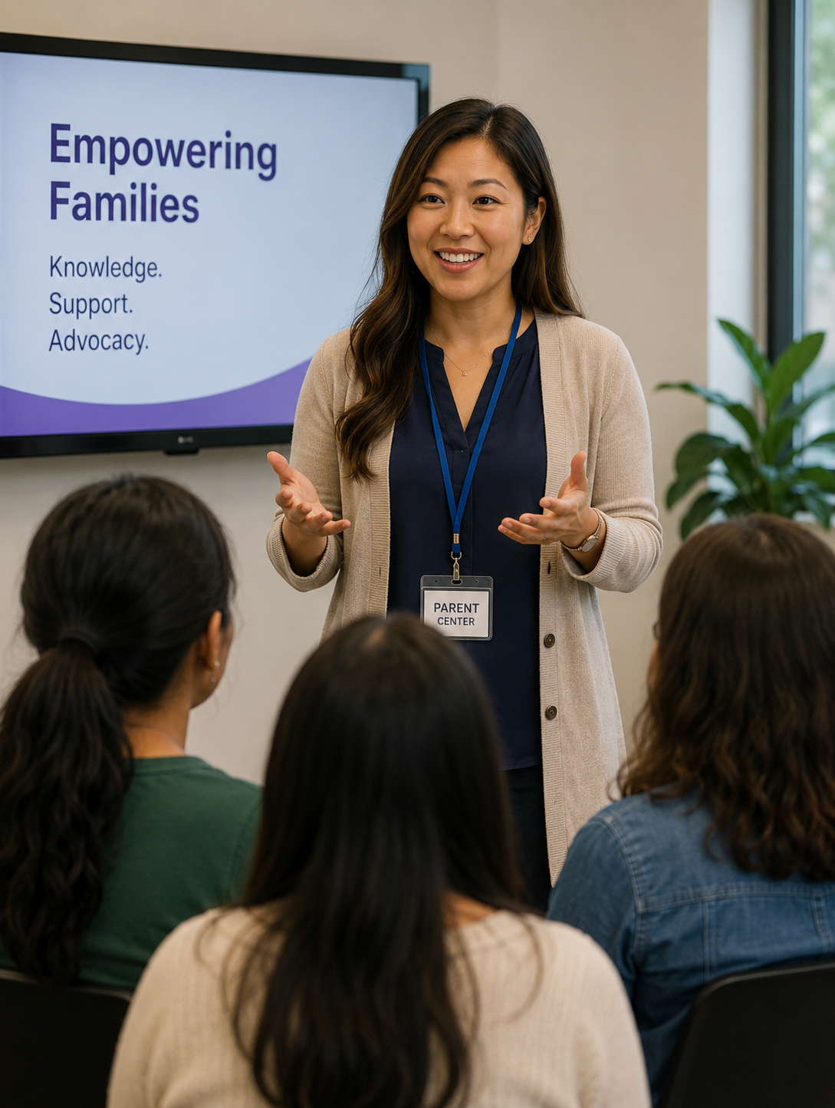
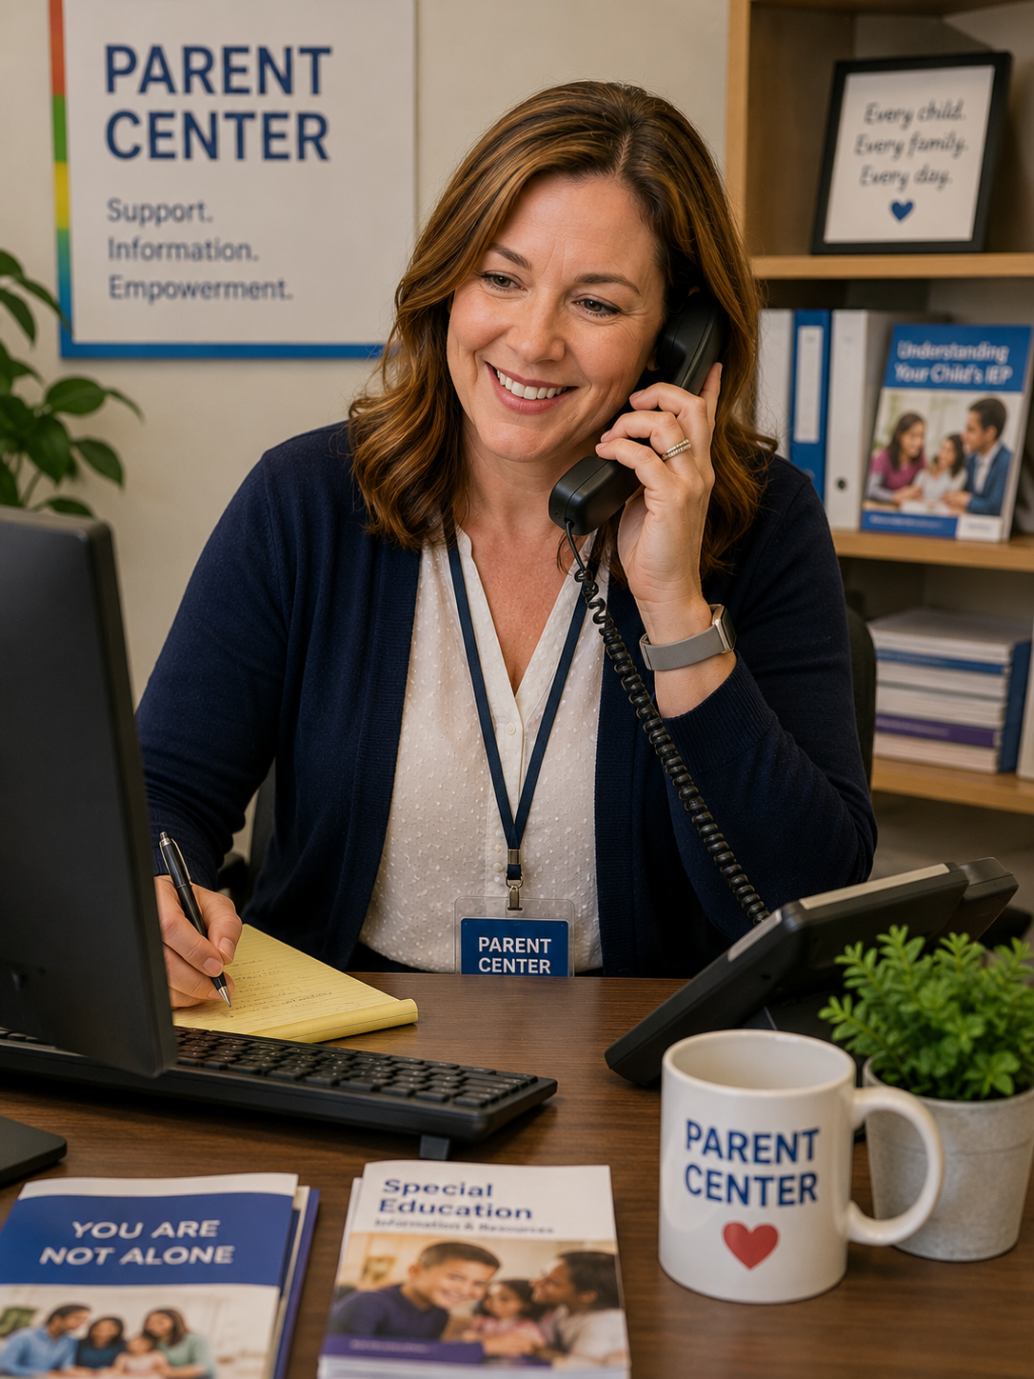

Parent Centers in Action
How many contacts did Parent Centers reach via social media
in 2024-2025?
[ Your data ]
[ Name of Your Center Trains ]
Parents/Caregivers of children with disabilities
Professionals
Youth and Young Adults with disabilities to be effective self-advocates
(virtual, in-person & on-demand)
[ Your data ]
Parents/Caregivers attended
Trainings
[ Your data ]
Professionals attended Trainings
[ Your data ]
Youth/Young Adults attended Trainings
Our Staff
is knowledgeable,
committed,
and a source of info
you can count on
IEP assistance
Via phone, email, text, mail, virtual & in-person
In-person, virtual & on-demand
Websites
Webinars
Newsletters
Partners in systems change
[ Name of
Your Center ]
also provides Individual Assistance to Parents/Caregivers,
Professionals and Youth/Young Adults with Disabilities
(virtual, in-person &
On-demand)
[ Your data ]
Parents/Caregivers received Individual Assistance
[ Your data ] Professionals received Individual Assistance
[ Your data ]
Students/Youth/Young Adults received Individual Assistance
[ Name of Your Center ]
serves [ fill in state or area served ]
Use this area to brand the flyer with your Center’s info (e.g., logo, contact info)

