Slide 1
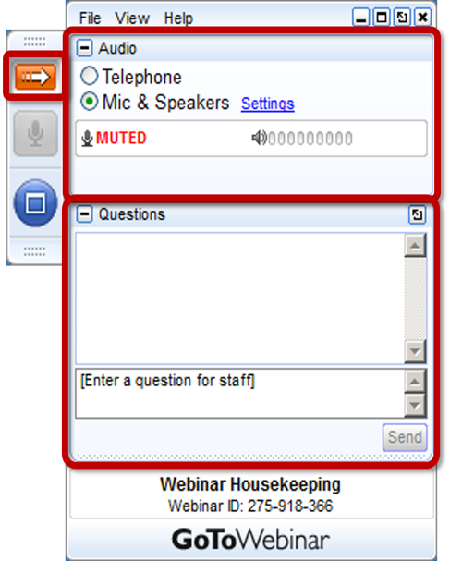
Webinar: Consumer Financial Protection Bureau (CFPB) Resources for Parent Centers
Center for Parent Information and Resources
Welcome!
The webinar will begin shortly.
Attendee Participation
Open and close your control panel.
Join audio:
Choose Mic & Speakers to use VoIP
Choose Telephone and dial using the information provided
If you are joining the audio by telephone mute your computer speakers
Submit questions and comments via the Questions panel.
Note: Today’s presentation is being recorded and the link will be sent to you when it is available.

Slide 2
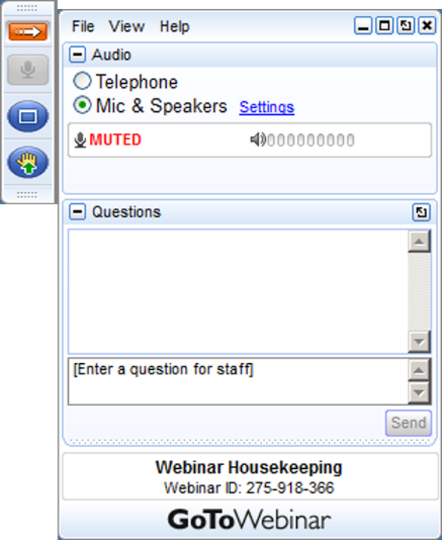
Webinar Housekeeping

Slide 3
Questions
Your Participation
Please continue to submit your text questions and comments using the Questions panel.
Please raise your hand to be unmuted for verbal questions.
Note: Today’s presentation is being recorded, and the link will be sent to you when it is available.

Slide 4
Financial Education Resources for Consumers of All Ages
CFPB Office of Financial Education
CFPB Section for Students and Young Consumers
CFPB Office of Community Affairs
CFPB Office for Older Americans

Slide 5
Disclaimer
This presentation is being made by a Consumer Financial Protection Bureau representative on behalf of the Bureau. It does not constitute legal interpretation, guidance or advice of the Consumer Financial Protection Bureau. Any opinions or views stated by the presenter are the presenter’s own and may not represent the Bureau’s views.

Slide 6
The Bureau’s Mission and Vision
MISSION
To regulate the offering and provision of consumer financial products or services under the Federal consumer financial laws and to educate and empower consumers to make better informed financial decisions.
Free, innovative, competitive, and transparent consumer finance markets where the rights of all parties are protected by the rule of law and where consumers are free to choose the products and services that best fit their individual needs.
VISION

Slide 7
What is financial well-being?

Slide 8
What is financial well-being?
Financial well-being¹: a state of being wherein a person can fully meet current and ongoing financial obligations, can feel secure in their financial future, and is able to make choices that allow them to enjoy life.
It is not how much you earn, it is about being able to make decisions with the money you have to allow you to experience peace of mind.
Financial capability is the capacity, based on knowledge, skills, and access, to manage financial resources effectively
1. Financial well-being: The goal of financial education, Consumer Financial Protection Bureau (2015), available at http://files.consumerfinance.gov/f/201501_cfpb_report_financial-well-being.pdf

Slide 9
The four elements of financial well-being
The Bureau created a first ever consumer-driven definition of personal financial well-being for adults
Our research suggests that there are four elements of financial well-being:
 | Present | Future
Security | Control over your day-to-day, month-to-month finances | Capacity to absorb a financial shock
Freedom of choice | Financial freedom to make choices to enjoy life | On track to meet your financial goals

Slide 10
Three Building Blocks of Youth Financial Capability
❶
❷
❸
 | Executive Function Self-control, planning, problem solving | Financial Habits and Norms Healthy money habits, norms, rules of thumb | Financial Knowledge & Decision Making Skills Factual knowledge, research and analysis skills
Early Childhood (begins to develop ages 3-5)
Middle Childhood (primary focus of financial development during ages 6-12)
Adolescence and Young Adulthood (does not become fully relevant during ages 13-21)
What it supports | Focusing attention, remembering details or juggling multiple tasks, planning and goal setting. | Decision shortcuts for navigating day-to-day financial life and effective routine money management | Deliberate financial decision-making, like financial planning, research, and intentional decisions
Early values and norms
Basic numeracy
Primary Development Stages
Basic money management
Development continues
Development continues

Slide 11
CFPB Youth Financial Education resources
Young children
(ages 3 – 5)
School-age to preteens
(ages 6 – 12)
Teens to young adults
(ages 13 – 21)

Slide 12
Money as You Grow: For parents and caregivers
Developing executive function
Building money habits and values
Practicing money skills and decision-making
Make it easy for parents and caregivers to find tools, activities, and information
New home for the popular moneyasyougrow.org site
And more: blog posts, social media outreach, and e-mail
consumerfinance.gov/money-as-you-grow

Slide 13
Money as You Grow Bookshelf: Parent Guides
What’s inside the guides:
The story
Key ideas
Something to think about
Before you read
Something to talk about
Something to do (age specific)
consumerfinance.gov/consumer-tools/money-as-you-grow/bookshelf/

Slide 14
Money as You Grow Bookshelf
Alexander, Who Used to Be Rich Last Sunday by Judith Viorst
A Bargain for Frances by Russell Hoban
The Berenstain Bears & Mama’s New Job by Stan and Jan Berenstain
The Berenstain Bears Trouble with Money by Stan and Jan Berenstain
My Rows and Piles of Coins by Tololwa M. Mollel
Ox-Cart Man by Donald Hall
Sheep in a Shop by Nancy Shaw
A Chair for My Mother by Verna Williams
Count on Pablo by Barbara deRubertis
Curious George Saves His Pennies by Margaret and H.A. Rey
Just Shopping with Mom by Mercer Mayer
Lemonade in Winter by Emily Jenkins
But I’ve Use All of My Pocket Change by Lauren Child
How Much Is That Doggie in the Window? By Bob Merrill
The Rag Coat by Lauren Mills
Those Shoes by Maribeth Boelts
Tia Isa Wants a Car by Meg Medina
Jingle Dancer by Cynthia Leitich Smith
Sally Jean, the Bicycle Queen by Cari Best
Sam and the Lucky Money by Karen Chinn
The Purse by Kathy Caple
consumerfinance.gov/money-as-you-grow/bookshelf/

Slide 15
Talk about money choices, big and small
consumerfinance.gov/money-as-you-grow

Slide 16
Exploring Government Agencies
Our home was terribly damaged in a hurricane. My family needs immediate help with a place to stay and needs help figuring out how to save our house. Which government agency should we contact?
My cousin needs help figuring out how to get an auto loan. Which agency has tools to help him?
My grandmother is about to retire. Which government agency will help her with her retirement benefits?
consumerfinance.gov/practitioner-resources/youth-financial-education/teach/activities/exploring-government-agencies/

Slide 17
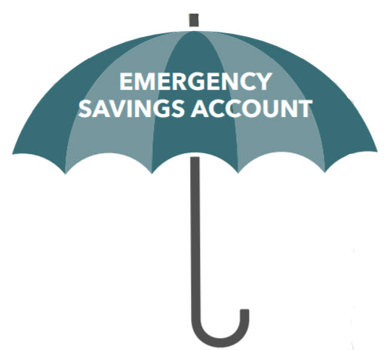
Saving for a rainy day
Students explore the importance of saving for unexpected expenses and then draw pictures of what their rainy day savings could pay for.
Students are asked to think of two to five unexpected expenses that you’d likely need to pay for with an emergency savings account.
Then they draw pictures representing those expenses on the student worksheet.
Start Small, Save Up
Whether you want to put money aside for unexpected expenses or make a plan to save for your future goals, we have resources that can help.
consumerfinance.gov/start-small-save-up/
consumerfinance.gov/practitioner-resources/youth-financial-education/teach/activities/saving-rainy-day/

Slide 18
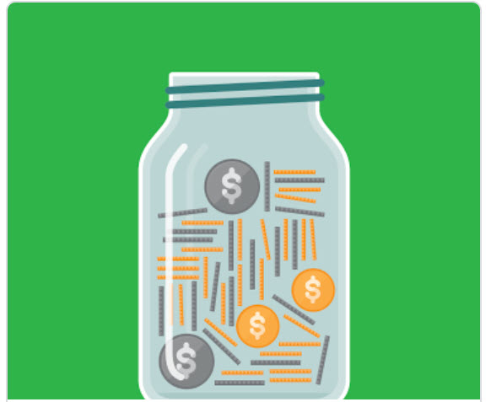
Creating a monthly household budget
Students determine how to balance their needs and wants when budgeting for household bills.
They will review a budgeting scenario and then build a budget using a fillable PDF.
The scenario: Imagine that you’re an adult, you’ve just started a new full-time job, and you’re getting ready to move out on your own for the first time. You bring home $2,000 in pay each month.
Students will select from housing options that include the costs of utilities.
They will make decisions about savings.
Then they will select their monthly wants like eating out, internet service, pets.
Finally they will balance their budget and reflect on their choices.
consumerfinance.gov/practitioner-resources/youth-financial-education/teach/activities/creating-monthly-household-budget/

Slide 19
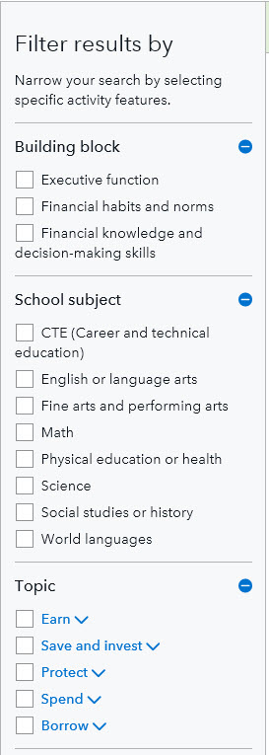
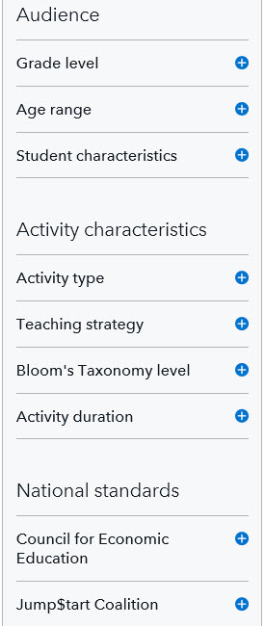
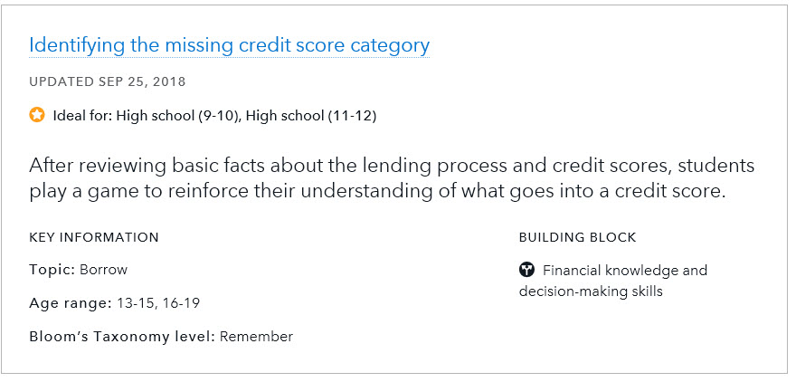
Find youth financial literacy activities
consumerfinance.gov/youth-financial-education/teach/activities/

Slide 20
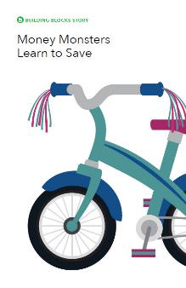
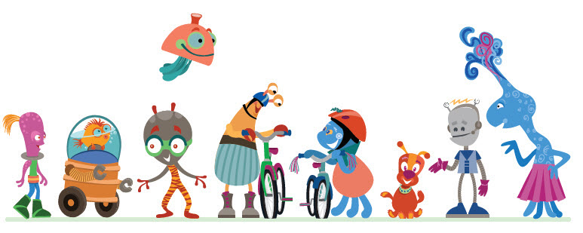
Money Monster stories
The Money Monsters are a group of creatures who are new to our universe. That means they need to learn about many important things like school, friendship, and financial literacy. These booklets are available as ePub or PDF files.
Money Monsters Learn to Save
Money Monsters Learn about Careers
Money Monsters Learn to Become Good Borrowers
Money Monsters Learn What Things Really Cost
Money Monsters Learn to Protect Their Things
consumerfinance.gov/money-monster-stories

Slide 21
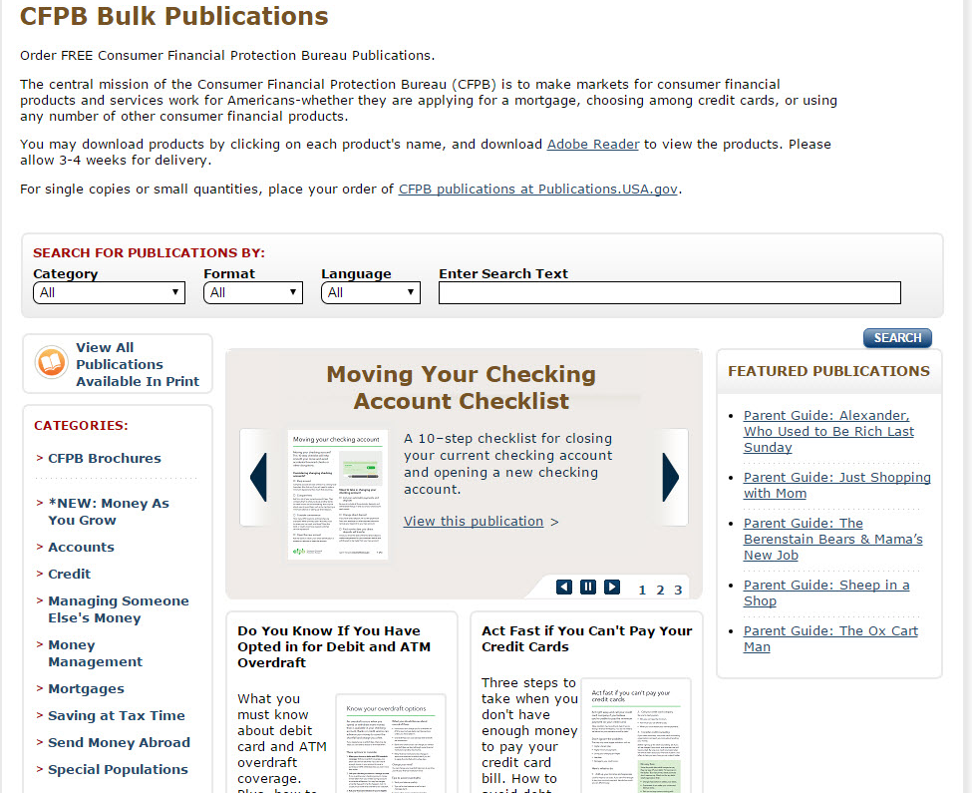
pueblo.gpo.gov/CFPBPubs/CFPBPubs.php
Order our publications

Slide 22
Office for Students and Young Consumers
Part of the Bureau’s Division of Consumer Education & External Affairs
Serves students and young adults
Works to engage students before, during, and after pursuing higher education
Engages in targeted efforts to raise awareness of key financial risks, assist borrowers of private student loans, and enhance outcomes

Slide 23
Contents
Meet the Section for Students and Young Consumers
Our new tool for students: Your financial path to graduation
Research base
Demo
Invitation to pilot

Slide 24
Consumer Education seeks to prevent harm
We serve the general public and focus on special populations:
Servicemembers, veterans, and their families
Older Americans, their families and caregivers
Traditionally underserved and economically vulnerable consumers
K-12 students
Students and young consumers: Educate and engage students to prevent student loan default

Slide 25
Other resources for students and practitioners
Mailing list | Free bulk printing | Ask CFPB
Sign up for occasional notifications of webinars and new materials | Financial education in English and other languages | Clear, impartial answers to hundreds of financial questions
Money Topics | Blog | Multilingual
Curated links for students and practitioners | Timely updates filtered by topic and audience | Resources in common languages (e.g., Spanish, Tagalog, Haitian Creole)
25

Slide 26
A new resource to share with students
https://www.consumerfinance.gov/practitioner-resources/students/financial-intuition/
26

Slide 27
For many college students, this is the first and most complex financial situation they’ll ever be in.
Many funding sources
Federal grants
Federal loans (3 types)
Military benefits
State aid and loans
School-funded aid
Private scholarships
Aid and loans from nonprofits
Employer tuition assistance
Entitlements
Personal savings
Help from family
Child care grants
Tuition installment plans
Work-study
Other job(s)
Private loans
Loan forgiveness
Varying expenses on varying timetables
Tuition and fees
Dorm and meal plan
Loan fees
Books and supplies
Club dues
Rent and utilities
Cell phone
Car/transit
Laundry
Socializing
Child care
Parents’ bills
Computer
Travel home
Study abroad
Work wardrobe
Emergencies

Slide 28
Many student loan borrowers are in distress. More planning upfront may help.
Of the ≈7,000 student loan borrowers who took the Financial Industry Regulatory Authority (FINRA) 2018 Financial Capability survey:
42% | 48%
were late with at least one payment in the previous year | were concerned that they wouldn’t be able to pay off their student loans.
47% | 57%
wish they had chosen less expensive colleges. | did not calculate monthly student loan payment before borrowing.
Figures based on an online survey of 27,091 American adults and weighted to be representative of the Census Bureau’s American Community Survey. See the study at www.usfinancialcapability.org.

Slide 29
It’s never too late to start saving and budgeting for college.
Due to
Loan fees
Typical interest rates
Lower at the moment
Interest capitalization (interest on interest)
Typical repayment periods
More than half on plans for 20+ years
Every $1 borrowed can cost $2 (or more!) to repay.
Contributions from savings and income go farther than you may realize.
https://www.savingforcollege.com/article/student-loans-will-cost-you-double
29

Slide 30
Other ways to help your student afford college
Now
Once they start school
Provide info for FAFSA
Help research grant and scholarship opportunities
Ask your employer about tuition assistance
Help your student make a budget and share your family’s cost-cutting strategies
Apply for a Federal Parent PLUS loan
If denied, student can access more Direct Unsubsidized loans
Continue to provide info for FAFSA
Allow your student to live at home
Encourage your student to build relationships at school
Volunteer or work (<20 hrs/wk)
Participate in clubs and activities
Academic advisor, financial aid, professors (office hours!), and classmates
Be honest about your past missteps and encourage them to use their resources
Be upfront about your limits!
There are no scholarships for retirement.
30

Slide 31
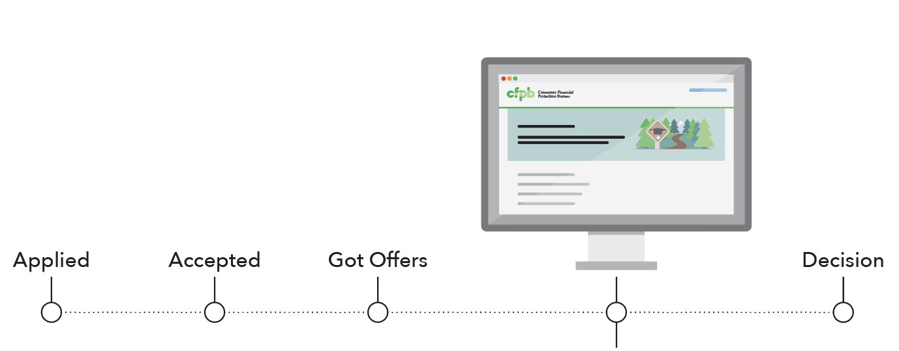
Grad Path helps students make final decisions about where (or whether) to go to school—and how to pay for it.
Your financial path to graduation
Does my funding cover my costs?
Can I afford the loans I’ll need?
Is this school worth it for me?
7

Slide 32
We used research on financial aid offers to understand the difficulties they pose for students and families.
New America and uAspire’s review of 515 award letters from unique institutions revealed:
Confusing jargon
Omission of the complete cost
Failure to differentiate types of aid
Misleading packaging of Parent PLUS loans
Vague definitions and poor placement of work-study
Inconsistent bottom line calculations
No clear next steps
Decoding the Cost of College, 2018, https://www.newamerica.org/education-policy/policy-papers/decoding-cost-college

Slide 33
Students told us they care about financial fit and want help making informed decisions about paying for college.
“Naomi” | “Derrick” | “Archer”
Outside of school and sports, Naomi works and helps her family pay bills. Her parents want her to go school but she worries that it might hurt her family financially. She wants to go where her sister goes, a popular state school. She is relieved that the school’s website says they offer financial aid to 100% of students who need it. Her parents have explained debt but they are confused by the terminology in her offer. | Derrick is aiming for a prestigious school for better career options. He also wants to finish with as little debt as possible. His parents have saved some money for his education, but they haven’t been to college, and his counselor seems busy, so Derrick relies on the internet to explain what he doesn’t understand. Despite his high GPA, he wasn’t offered as much scholarship money as he expected. Now he has to plan how to cover the gap. | Archer failed out of his first attempt at college because he was working full-time to support his family – he was afraid to use student loans. A nonprofit for teen parents helped him get his associate’s degree. His work-study supervisor in the financial aid office helped him regain his Title IV eligibility. Now that he is about to transfer into a local university, he needs a strategy to balance his academic, financial, and parental duties.
We got input from high school and college students from around the country before and during our design and development process. Student profiles are composites; these are stock photos.
33

Slide 34
Parents and advisers mirrored students’ concerns about complexity and competing priorities.
“Javier” | “Shelle” & “Marcus” | “Brittany”
Javier is a small business owner who wants to send his daughter to the school of her choice. Unfortunately, it will cost about $200,000 altogether. He found a second job, but his spreadsheet shows that they still need to borrow money. He wonders if his daughter could find more scholarships. He doesn’t want to make a bad financial decision, but he doesn’t want to crush his child’s dreams either. | Shelle and Marcus are invested in their three children going to the best schools possible. Though they started saving early and two got scholarships, the gaps are still big. Shelle remembers secretly taking out private loans because her parents didn’t understand how expensive her education would be. She and Marcus are using Parent PLUS and private loans because they want to make sure that their kids don’t end up in as much debt as Shelle did. | Brittany is a recent college grad who works at a college access nonprofit. She helps high schoolers from low-SES backgrounds with the college process. She explains offers to students line by line, color coding the different types of aid and keeping a separate spreadsheet for each kid so they can compare offers. She tries to help students see the bigger picture for their financial future and hates to be the bearer of bad news.
We got input from high school and college students from around the country before and during our design and development process. Student profiles are composites; these are stock photos.
34

Slide 35
We used this research to build a tool that equips students to turn financial aid offers into plans to pay for school.
www.consumerfinance.gov/gradpath
www.consumerfinance.gov/gradpath
New America’s report Decoding the Cost of College elucidated the challenges posed by financial aid offers. We also conducted our own research with students, parents, and college access advisers.
35

Slide 36
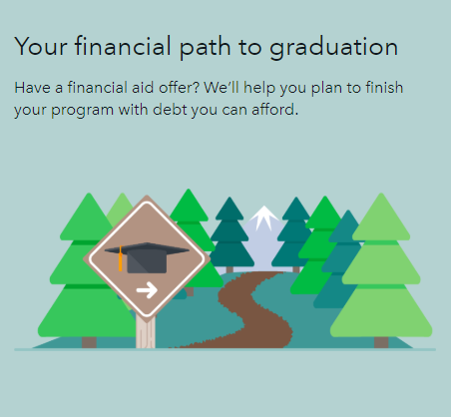
We used this research to build a tool that equips students to turn financial aid offers into plans to pay for school.
This tool provides students and families with:
An interactive plan that can be saved and revised
Simple explanations of jargon and financial concepts
Money saving tips
Running total of uncovered costs
Projected debt and information to help decide if it’s affordable
Apples-to-apples comparisons of multiple aid offers
Suggested next steps
New America’s report Decoding the Cost of College elucidated the challenges posed by financial aid offers. We also conducted our own research with students, parents, and college access advisers.
36

Slide 37
Opportunities to shape future CFPB resources
Research and feedback for:
Grad Path for families
Help relatives plan to contribute to their students’ education
37

Slide 38
Follow up with us!
Copy of this deck | katherine.mullan@cfpb.gov
Grad Path for families | katherine.mullan@cfpb.gov

Slide 39
Office of Community Affairs
Part of the Bureau’s Division of Consumer Education & External Affairs
Serves populations who may lack full, affordable access to financial services
Low- to moderate-incomes
Low wealth
Otherwise financially underserved or vulnerable

Slide 40
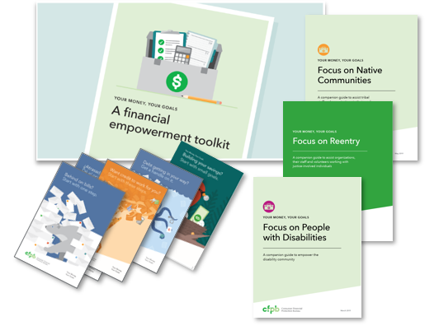
Your Money, Your Goals: Resources
Toolkit
Online resources
Issue-focused booklets
Behind on bills? Atrasado en los pagos?
Debt getting in your way?
Want Credit to Work for You?
Building your savings?
Companion guides
Native Communities
Reentry – people with criminal records
People with disabilities
https://www.consumerfinance.gov/practitioner-resources/your-money-your-goals/

Slide 41
Toolkit organization
Tool: Setting SMART goals
Tool: Putting goals into action
Tool: Planning for life events and large purchases
Handout: Revising goals
Module 2: Saving
Tool: Savings plan
Tool: Saving and asset limits
Tool: Finding a place for savings
Handout: Saving at tax time
Module 3: Tracking Income and Benefits
Tool: Income and benefits tracker
Tool: Choosing how to get paid
Tool: Increasing income and benefits
Module 4: Paying Bills
Tool: Spending tracker
Tool: Bill calendar
Tool: Choosing how to pay bills
Tool: Cutting expenses
Tool: Prioritizing bills
Module 5: Getting through the Month
Tool: Creating a cash flow budget
Tool: Improving cash flow
Tool: Adjusting your cash flow
Module 1: Setting Goals
Introduction
Tool: Financial empowerment self-assessment
Tool: My money picture

Slide 42
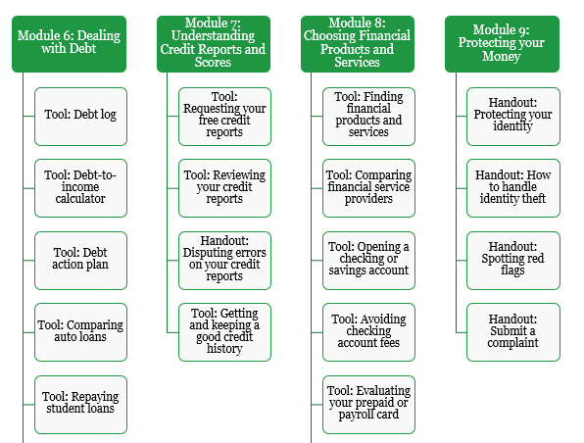
Toolkit organization

Slide 43
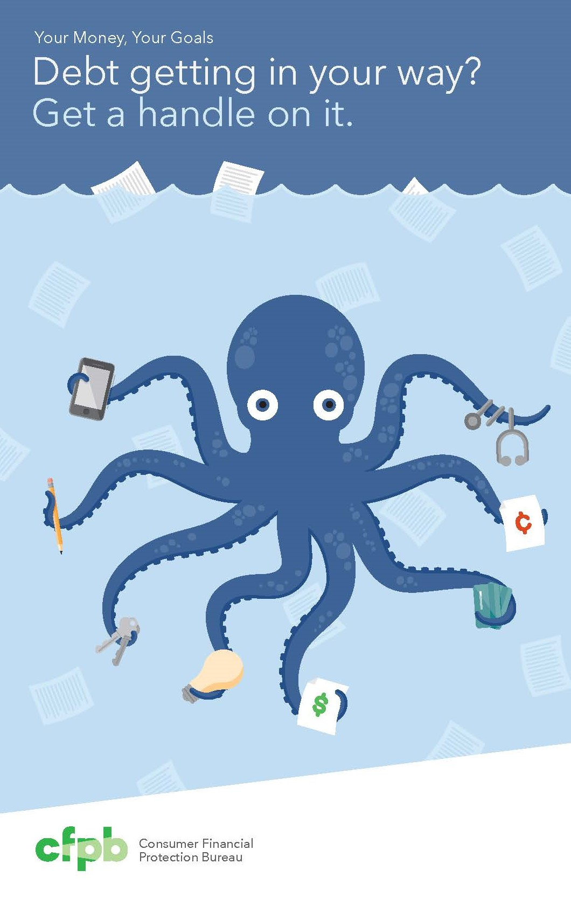
The suite of Your Money, Your Goals resources
Behind on bills?
Available in English and Spanish
Debt getting in your way?
Want credit to work for you?
Available in English and Spanish
Building your savings?
Specially formatted copies available for correctional facilities
Access electronic materials and order free printed copies online: consumerfinance.gov/your-money-your-goals

Slide 44
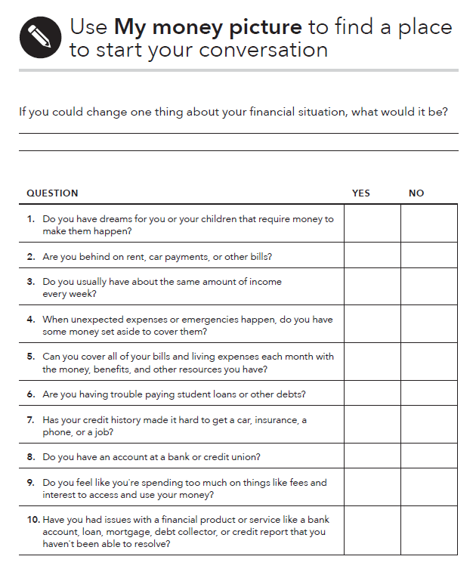
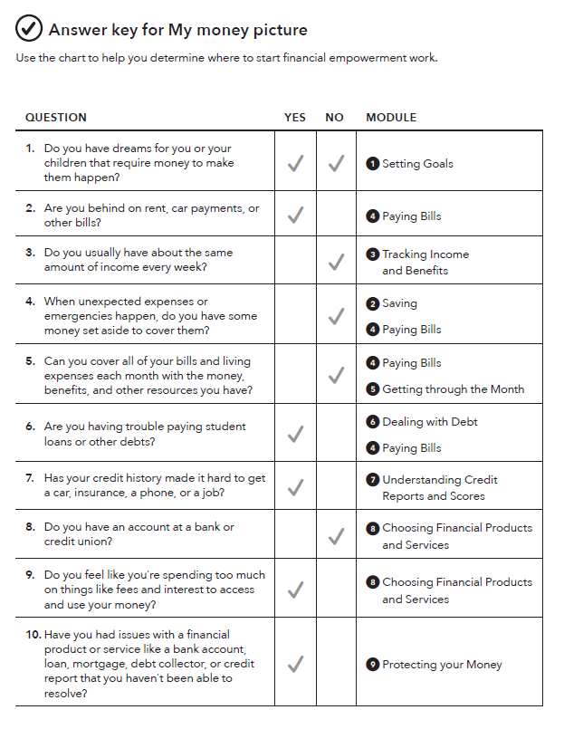
Tool: My money picture

Slide 45
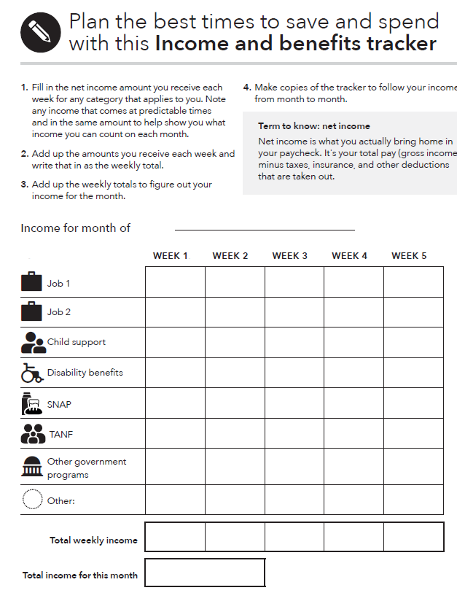
Tool: Income and benefits tracker
What to do:
Gather all of your pay stubs, benefits statements, and records of electronic payments.
Enter the amount of income or benefits you receive next to the correct category in the appropriate week of the month.

Slide 46
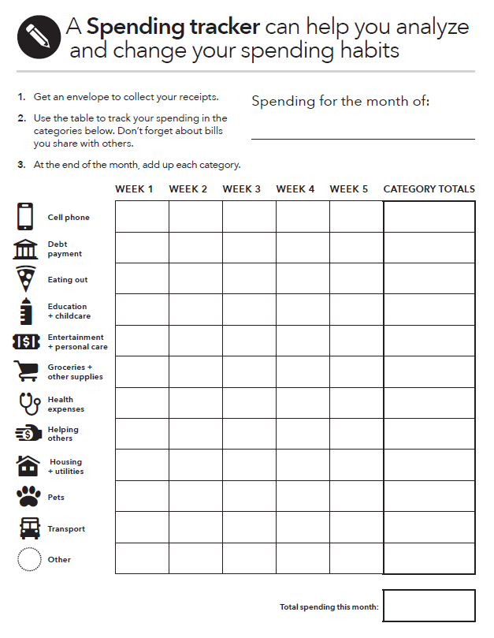
Tool: Spending tracker
What to do:
Get a small container or envelope. Every time you spend money, get a receipt and put it into the case or envelope.
Analyze your spending. Go through your receipts and enter the total you spent in each category for each week.
Notice trends. Identify any areas you can eliminate or cut back on—these will generally be wants.

Slide 47
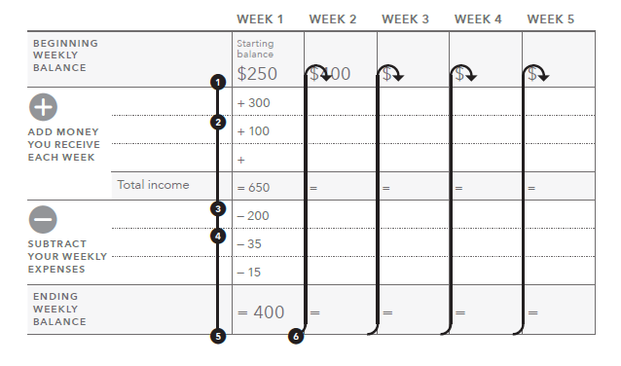
Tool: Creating a cash flow budget

Slide 48
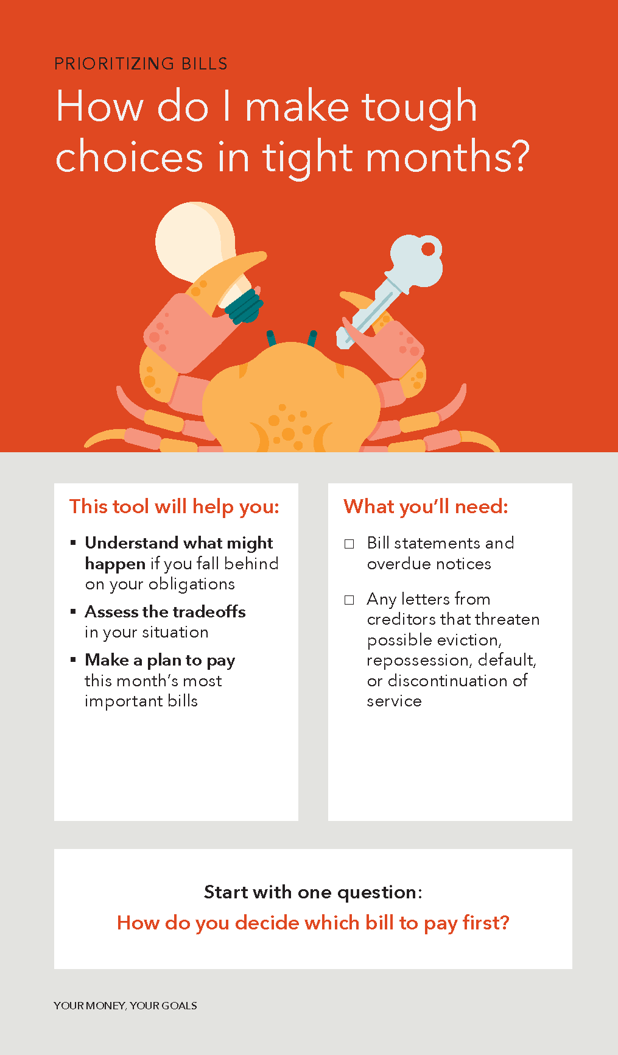
Prioritizing bills
Understand what might happen if you fall behind on your obligations
Assess the tradeoffs in your situation
Make a plan to pay this month’s most important bills

Slide 49
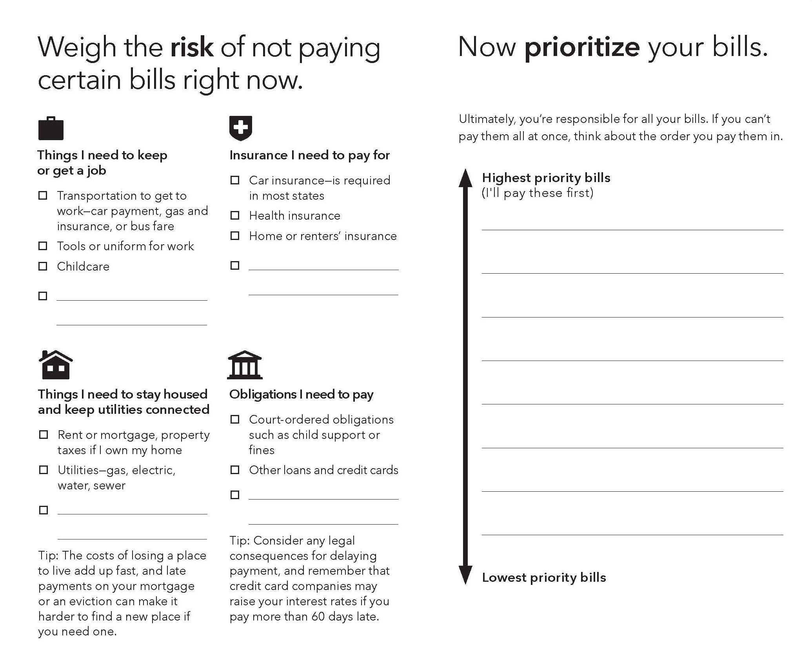

Slide 50
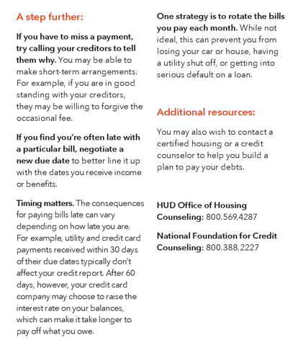
Prioritizing bills

Slide 51
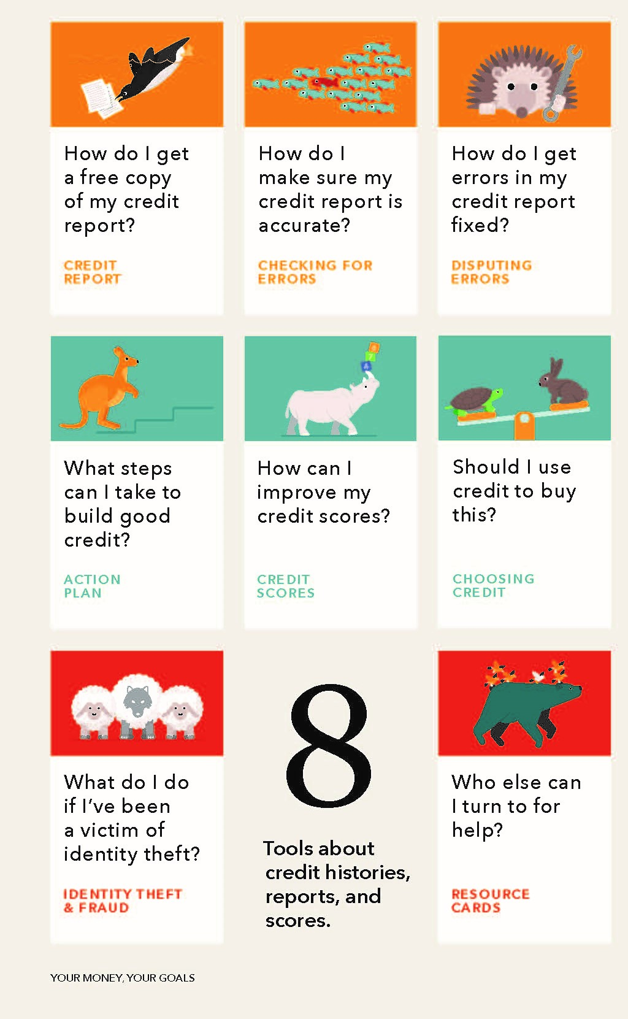
Table of contents
Eight tools related to credit
Yellow – taking the first steps of requesting and reviewing your credit report and getting errors corrected
Blue-Green – planning for action to build credit, improve scores, or deciding when to use credit
Red – can be used for immediate challenges and needs

Slide 52
Focus on People with Disabilities

Slide 53
Focus on People with Disabilities content
Module 1: Setting Goals
Tool: Paying for assistive devices
Module 2: Saving
Tool: Setting up an ABLE Account
Module 3: Tracking Income and Benefits
Tool: SSI estimator
Module 4: Paying Bills
Module 5: Getting through the Month
Tool: Monthly budget
Module 6: Dealing with Debt
Module 7: Understanding Credit Reports and Scores
Module 8: Choosing Financial Products and Services
Module 9: Protecting your Money
Tool: Identifying financial abuse and exploitation
Additional resources

Slide 54
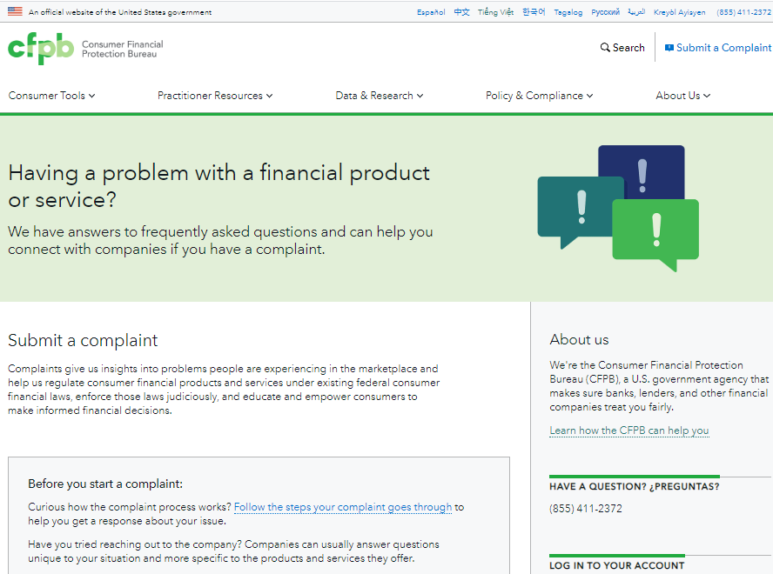
Submitting a complaint to the Bureau

Slide 55
Office for Older Americans
The Office for Older Americans (OA) develops initiatives, tools, and resources to:
Help protect older consumers from financial harm
Help older consumers make sound financial decisions as they age

Slide 56
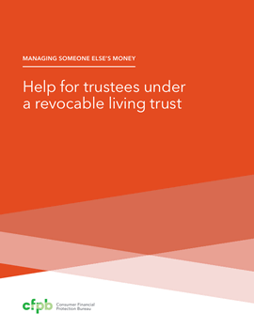
Managing Someone Else’s Money
Help for financial caregivers handling the finances for a family member or friend who is incapacitated
Guides for four common types of financial caregivers:
Agents under a Power of Attorney
Guardians and conservators
Trustees
Social Security and Department of Veterans Affairs (VA) representatives
Includes tips on protecting assets from fraud and scams.
Available in English and Spanish
https://www.consumerfinance.gov/consumer-tools/managing-someone-elses-money/

Slide 57
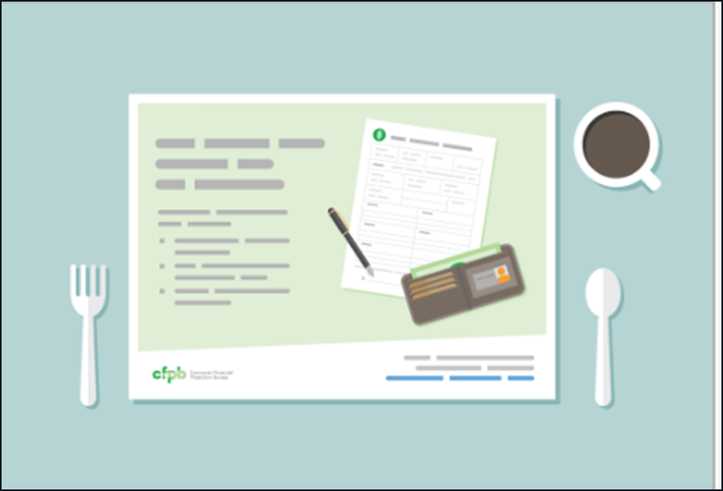
Fraud prevention tools
Fraud prevention placemats, handouts, and activity sheets on how to avoid common scams.
Check out the companion resources with tips and information to reinforce the messages.
Available to download or order in bulk for free.
Available in English and Spanish.
Consumerfinance.gov/placemats

Slide 58
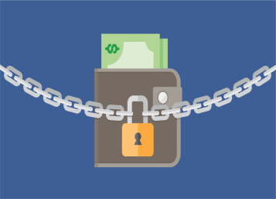
Tips and advice for consumers
Consumer advisories:
Co-signing student loans
Dealing with medical debt
Asset recovery scams
Planning for diminished capacity

Slide 59
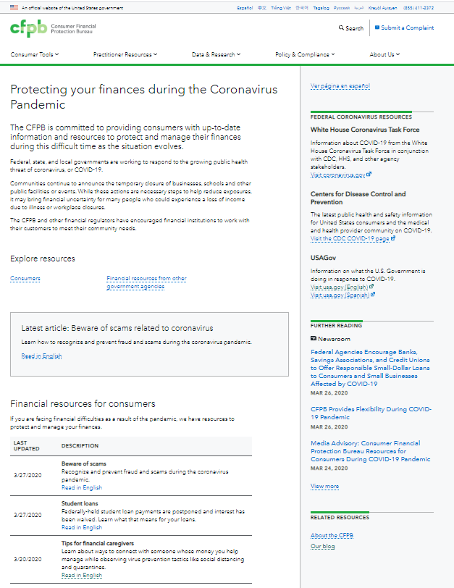
consumerfinance.gov/coronavirus Hub for critical content
Central hub on consumerfinance.gov
Resources in English and Spanish, Chinese, Vietnamese, Korean, and Tagalog
Check back for updates

Slide 60
Content topics and themes
Protect yourself financially
Submit a complaint if you are having a problem with a financial product or service
Protecting your credit
Tips for financial caregivers
Dealing with debt: Tips to help ease the impact
Student loan repayment
Be aware of scams
Mortgage relief options
A guide to COVID-19 economic stimulus relief
For a full list of topics visit: consumerfinance.gov/coronavirus

Slide 61
Protecting against fraud while using online or mobile banking
Set up security features and preferences, including using a strong password
You may be able to set up automatic notifications by email or text message to help you manage your account and alert you about certain transactions or situations.
Your bank or credit union may offer services to help you keep your account safe, such as turning off your debit card if you suspect fraud

Slide 62
Managing your accounts during a pandemic
If you do need to go in person, call or visit your bank or credit union’s website first to see if there are any special measures in place due to the pandemic
If you run into any issues, ask for help!

Slide 63
Tips for using mobile payment services
It is safer to use mobile payment services with family, friends, and others you know and trust
Set up your app to require a passcode, PIN, or fingerprint before making a payment
Consider having your friend send you a request for payment first
Always double-check before pressing “send”
You may not have the ability to recall your money once it is sent
Know when you will receive your money—and how quickly money comes out of your account when you pay someone

Slide 64
Contact us
CFPB Office of Financial Education
Website: consumerfinance.gov/practitioner-resources/youth-financial-education/
Email: Lyn.Haralson@cfpb.gov
CFPB Section for Students and Young Consumers
Website: https://www.consumerfinance.gov/paying-for-college/
Email: Katherine.Mullan@cfpb.gov

Slide 65
Contact us
CFPB Office of Community Affairs
Website: consumerfinance.gov/your-money-your-goals/
Email: YourMoneyYourGoals@consumerfinance.gov
CFPB Office for Older Americans
Website: consumerfinance.gov/olderamericans
Email: olderamericans@cfpb.gov

Slide 66
Follow us on social media
facebook.com/cfpb
linkedin.com/company/cfpb
twitter.com/CFPB

Slide 67
Next Steps?
Questions? Comments?
Notes:
Debra…
I’d like to take another quick POLL …
Write in the Chat Box – what are the next steps you would like to
take related to these Tool Kits?
Any questions or comments?
[Read questions from the Chat Box – for Jan or whomever to answer.]
Thanks again to Jan Serak for sharing information with us today about the great tools that have resulted from this OSEP Supplement Project led by Region 4 PTAC at Wisconsin FACETS.

Slide 68
Center for Parent Information and Resources
Your feedback helps CPIR improve.
Please take a moment to complete a very brief survey about the usefulness of this webinar to you.
Thank you for attending!
Notes:
Debra…
Please take a minute to complete a brief survey about this webinar.
Thank you very much for joining us today.

