Slide 2
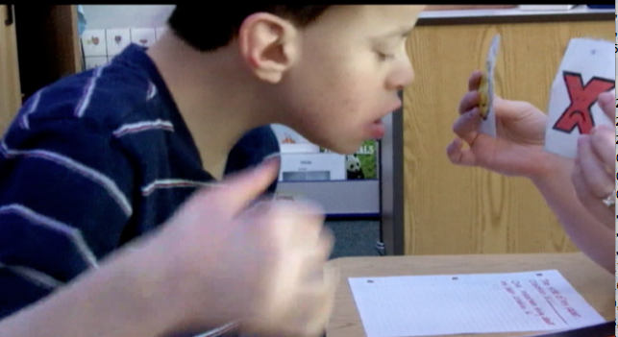
Dynamic Learning Maps Alternate Assessment Consortium
The present publication was developed under grant 84.373X100001 from the
U.S. Department of Education, Office of Special Education Programs. The views
expressed herein are solely those of the author(s), and no official endorsement
by the U.S. Department should be inferred.

Slide 3
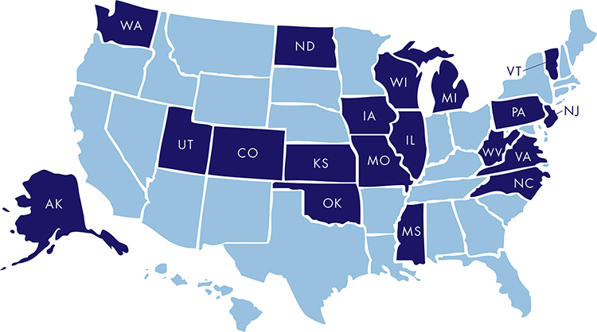
DLM™ Member State

Slide 4
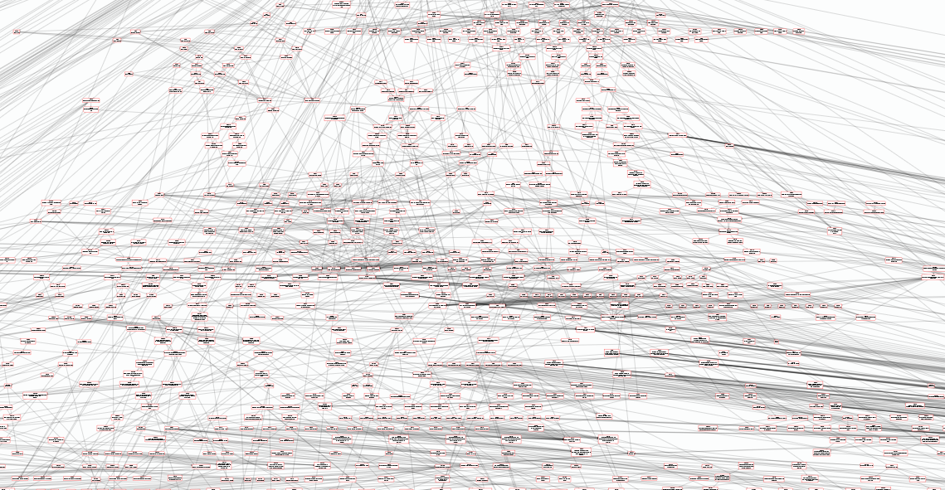
Learning Map

Slide 5
The Dynamic Learning Maps Essential Elements are specific statements of content and skills that are linked to the college and career readiness grade level expectations.

Slide 6
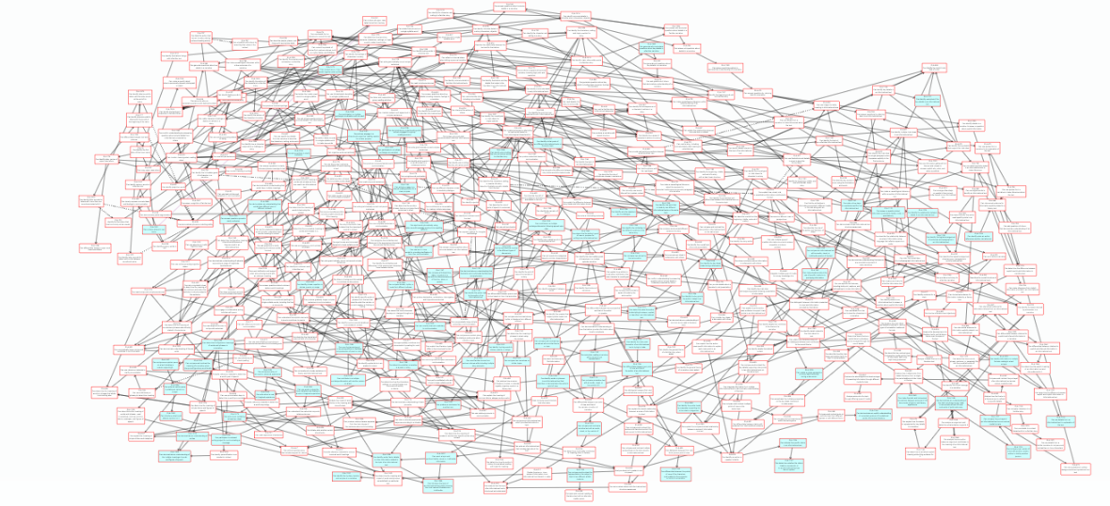

Slide 7
Learning Map
Claims
Conceptual Areas
Essential Elements

Slide 8
DLM Testlets
Designed at 5 levels to allow a wide array of access to content for the Essential Element
Five linkage levels:
Initial precursor
Distal precursor
Proximal precursor
Target (most like the Essential Elements)
Successor

Slide 9
How are we helping teams understand the system?

Slide 10
The DLM™ System of Professional Development
Modules in multiple formats
Instructional support materials
Virtual Community of Practice

Slide 11
DLM™ Professional Development Modules
Self-Directed Modules
On-demand, online, and interactive
Built in assessment and reporting
Facilitated Modules
Face-to-face delivery without having to “train the trainer”
Video delivery of content with planned group activities
Raw Materials
Can be modified as needed

Slide 12
Modules Currently Available
About College & Career Readiness and DLM
About Common Core State Standards
The DLM™ Essential Elements
The DLM™ Claims and Conceptual Areas
Students with Significant Cognitive Disabilities
General Instructional Modules
Universal Design for Learning
IEPs linked to the DLM™ Essential Elements
Symbols
DLM™ Core Vocabulary and Communication

Slide 13
ELA Modules Currently Available
Principles of ELA Instruction
Speaking and Listening
Shared Reading
Writing: Text Types and Purposes
Writing: Information and Explanation Texts
Writing: Production and Distribution
Writing: Research and Range of Writing
Writing with Alternate Pencils
Emergent Writing (early September)
Predictable Chart Writing (early September)

Slide 14
Math Modules Currently Available
Standards of Mathematics Practice
Counting and Cardinality
Composing and Decomposing Numbers
Forms of Number
Unitizing
Tens Frames
Units and Operations
Place Value
Fraction Concepts and Models Part I
Fraction Concepts and Models Part II
Basic Geometric Shapes and Their Attributes
Calculating Accurately (early September)
Measuring and Comparing Lengths (early September)

Slide 20
Facilitated Versions
For face-to-face training.
Facilitator’s guide with objectives, agenda, and step-by-step directions.
Content delivered via video.
Preplanned group activities marked by “Pause for Activity” in the video.
Activities focus on application and can be shifted based on the audience.

Slide 21
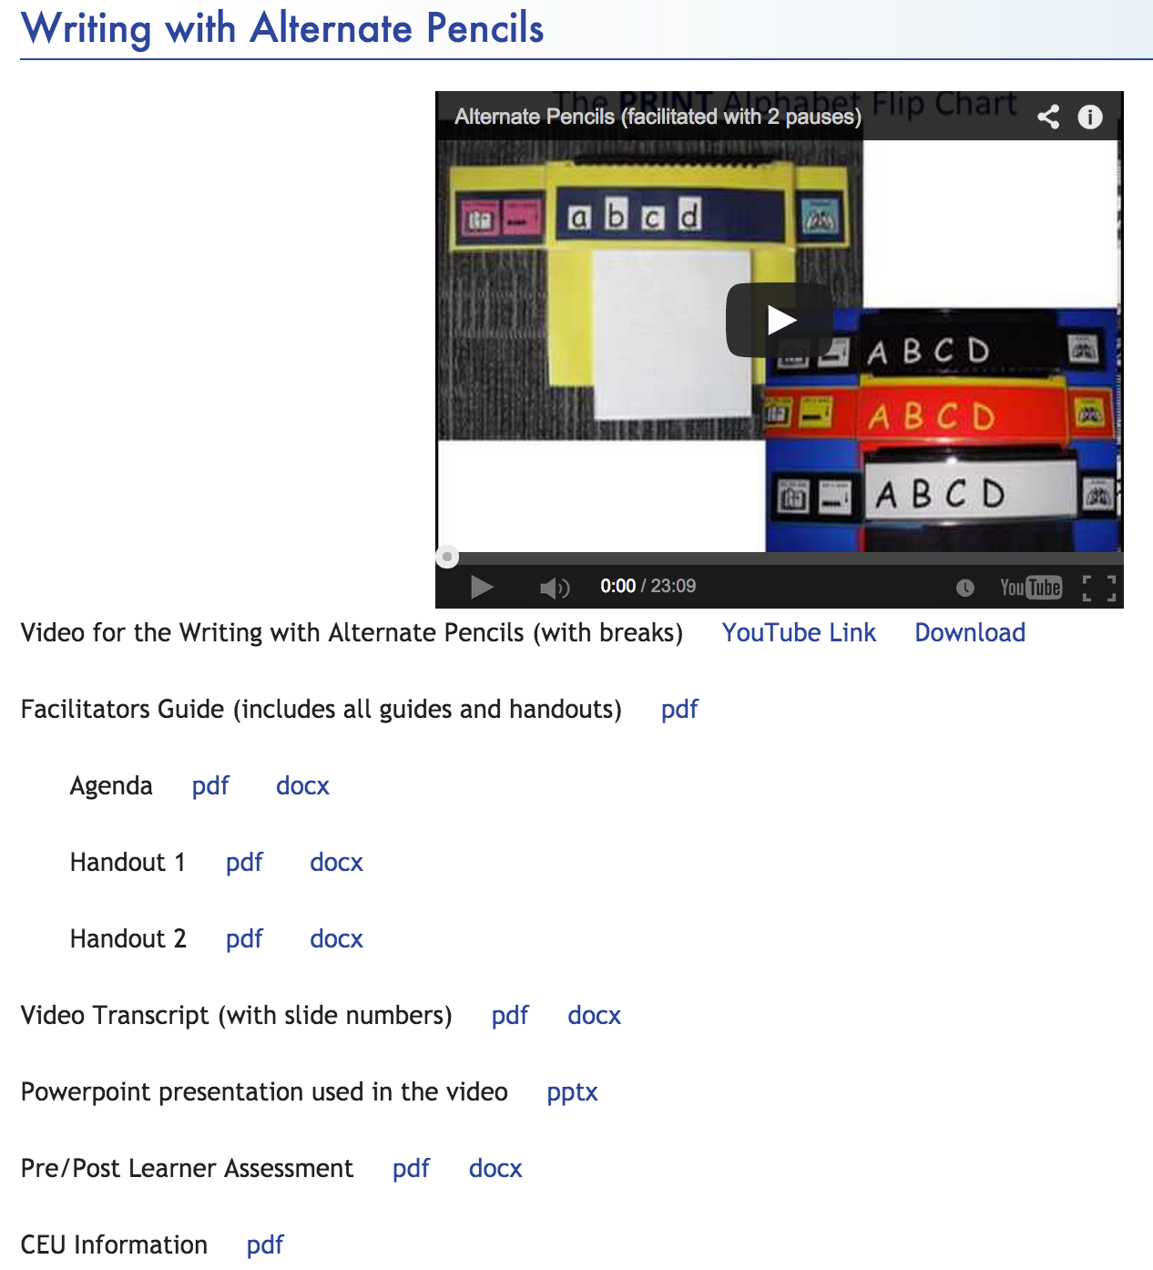

Slide 23
DLM Virtual Community of Practice
Access to DLM Familiar Texts
These are books that many students will encounter during the DLM assessment
All students will benefit from reading them
Access to Instructional Supports
Interactive Groups
Including a group for Parents, Caregivers, and Other Family Members

Slide 24
THANK YOU!
For more information, please go to:
www.dynamiclearningmaps.org

