Slide 1



Highlights
Lynne Kahn, Co-Director
Christina Kasprzak, Co-Director
October 2014
The ECTA Center is a program of the FPG Child Development Institute of the University of North Carolina at Chapel Hill, funded through cooperative agreement number H326P120002 from the Office of Special Education Programs, U.S. Department of Education. Opinions expressed herein do not necessarily represent the Department of Education's position or policy.

Slide 2
Our Mission
To provide TA to states and jurisdictions’ Early Intervention (Part C) and Preschool Special Education (Section 619) programs in order to ensure that children with disabilities (birth to 5 years) and their families receive and benefit from high quality, culturally appropriate and family-centered supports and services.

Slide 3
Who We Are:
Frank Porter Graham Child Development Institute, UNC
Puckett Institute
SRI International
University of Colorado, Denver
University of South Florida
RTI International
University of Nebraska Medical Center
PACER Center
Walsh Taylor Associates

Slide 4
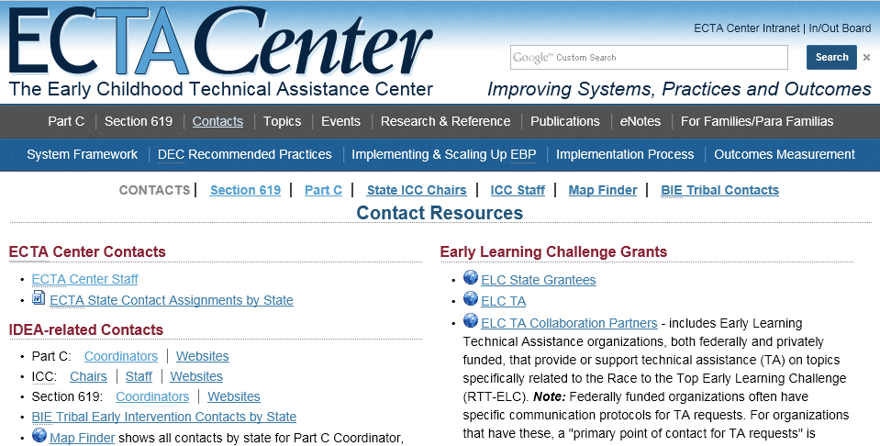
Key Contacts:
Available from: http://ectacenter.org/contact/contact.asp

Slide 5
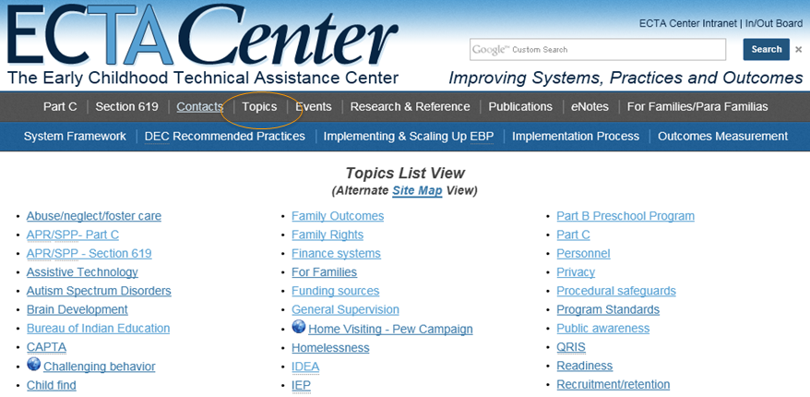
Key Topics:
Available from: http://ectacenter.org/sitemap.asp#topics

Slide 6
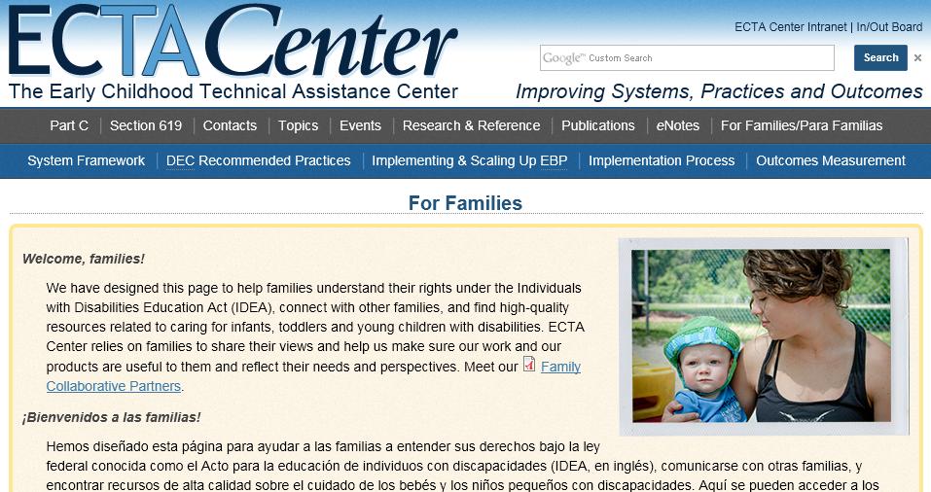
For Families/Para Familias
Available from: http://ectacenter.org/families.asp

Slide 7
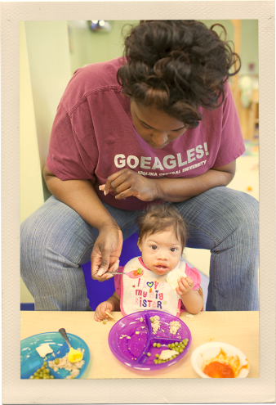
Hot Topics
Revised DEC Recommended Practices
State Systemic Improvement Plan (SSIP)
Measuring and Improving Child and Family Outcomes

Slide 8

DEC Recommended Practices
Purpose
To support the DEC, CEC in revising the DEC Recommended Practices to guide the field
Partners
DEC-appointed Commission
Process
Provided support, as needed, to the DEC Commissioners in their process to update the Recommended Practices (including providing listserv and online collaboration space, planning face-to-face meetings and monthly calls, creating videos, web space, mechanisms for gathering field input, paying consultants with expertise, synthesizing input, etc.)

Slide 9
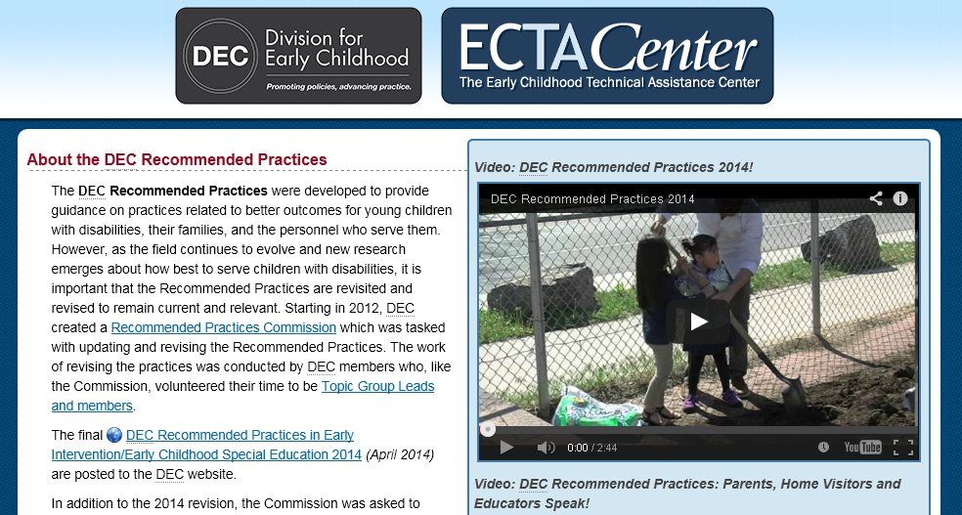
DEC Recommended Practices
Available from: http://www.decrecpractices.org

Slide 10

State Systemic Improvement Plan (SSIP)
Webinar Series and Resources:
Overview to SSIP
Data Analysis
Infrastructure Analysis
Available from: http://ectacenter.org/~calls/2014/ssip/ssip.asp

Slide 11

Measuring Child & Family Outcomes
Talking with Families
  Informing Families about Outcomes
  Family Participation in Data Collection
  Reviewing Data with Families
Self-Directed Learning
  Step by Step Video
  Understanding Child Development
Available from: http://ectacenter.org/eco/pages/talking.asp
Available from: http://ectacenter.org/eco/pages/selflearning.asp

Slide 12
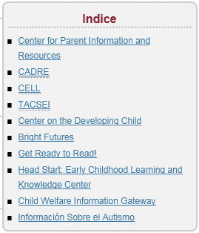

Recursos en Español
Available from: http://www.ectacenter.org/espanol/recursos.asp

Slide 13

Effectiveness of Early Childhood Programs
• National Centers
• Longitudinal Studies
• Long-Term Benefits
• Economic Impacts
• Major Reviews of Effectiveness
Available from: http://ectacenter.org/topics/effective/effective.asp

Slide 14

Thank you for your attention!
Online at ectacenter.org
Resources submitted as a part of this review, including this presentation, are available online at: http://ectacenter.org/32review.asp

