Slide 1
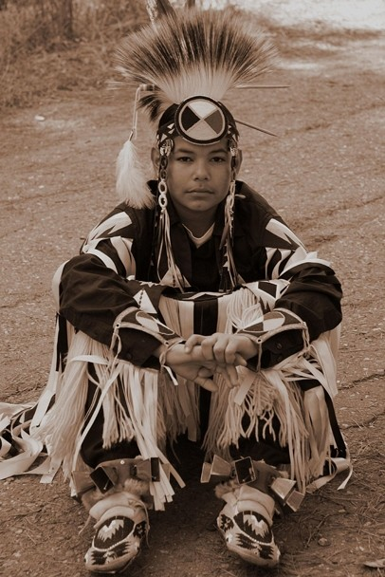
Bullying and Cyberbullying: Focusing on Native Youth with Disabilities
Joann Sebastian Morris
Native American Parent Technical Assistance Center
Available online at: https://www.parentcenterhub.org/naptac-tier3-education-youth/
Notes:
Welcome viewers to the webinar.
Thank them for taking time from their busy day to spend time to learn a bit about bullying prevention, with a special emphasis on American Indian/Alaska Native youth, especially those with disabilities.
As we all know, bullying continues to be a national problem facing children and youth. This fact is equally true in American Indian and Alaska Native communities. Yet there are few opportunities for Native parents to learn about bullying, how to spot it and, importantly, how to prevent it.
This webinar is provided to Parent Center staff as a means to model a training or webinar that you could deliver to Native parents and communities. By offering this content to Native parents, covering a topic they know is relevant to them, you can gain access to Native communities for further outreach activities and services.

Slide 2
Objectives for Today’s Webinar
To assist Parent Centers in their outreach to Native parents by:
Increasing their awareness of bullying in general and its impact on American Indian/Alaska Native (AI/AN) youth, particularly those with disabilities
Increasing their awareness of cyberbullying and sexting
Learning bullying prevention strategies that Parent Centers can share with Native parents
2
Notes:
Quickly paraphrase the objectives.
This is strictly an awareness session, given the timeframe. This webinar addresses 3 forms of bullying among school-aged youth: in-person bullying, online bullying – known as cyberbullying, and sexting, an extreme form of online bullying.
The progression of the webinar is as follows. I’ll introduce the topics of bullying, cyberbullying and sexting, and note the impact of each behavior, especially on Native youth and those with disabilities. Specific information about what parents and youth can do to prevent the various forms of bullying are provided to Parent Center staff. Other NAPTAC resources will be cited.

Slide 3
U. S. Department of Education (ED) Definition of Bullying
Per the U.S. ED’s website stopbullying.gov, bullying is defined as:
“…unwanted, aggressive behavior among school-aged children that involves a real or perceived power imbalance.
The behavior is repeated, or has the potential to be repeated, over time.”
3
Notes:
About 7 years ago, the U. S. Department of Education (ED) funded a year-long study group composed of nationally known experts in the field of bullying prevention. The intent was to arrive at a national definition of bullying. Prior to this research project, each state could define bullying behaviors as they saw fit.
The next slide provides the key elements of the national definition, as announced by the CDC, the Centers for Disease Control. You’ll notice similarities with the ED’s definition.

Slide 4
National Definition of Bullying
Bullying is an attack or intimidation intended to cause fear, distress, or harm—either physical, verbal, and/or psychological.
Bullying involves a real or perceived power imbalance between the students involved.
Bullying is repeated attacks or intimidation between the same students over time.
Centers for Disease Control & Prevention, 2011
4
Notes:
Bullying can be direct such as hitting, kicking, stealing or damaging one’s property, or threatening another, calling one derogatory names, and humiliating another in public.
Bullying can also be indirect, such as spreading rumors about a person, telling their secrets, or excluding them from a social group.
Regarding the 2nd bullet and the imbalance of power, school-aged youth who bully often target others perceived as weak, such as youth with disabilities; or a loner, such as someone new to the neighborhood/community; or those who are different racially or linguistically, especially youth of color, and immigrants and Native youth who speak their traditional languages; or youth whose families are poorer than most, such as those living on an Indian reservation; or youth for their perceived sexual orientation.

Slide 5
Bullying vs. Normal Conflict
The youth who bullies enjoys seeing his or her target afraid and upset.
The youth who bullies selects a target who is smaller, younger, or less socially able to cope.
The youth who bullies picks on the target repeatedly.
The three basic ways to know the difference
Garrity et al. (2000)
5
Notes:
Too often, bullying behaviors are overlooked and considered a normal part of growing up. The 3 most important distinctions between bullying and normal childhood conflict are:
1. intent to harm
2. power imbalance
3. repetition/frequency
These are the same elements included in the new CDC definition of bullying on the previous slide. (Could click back to prior slide to reinforce the new definition.)
Nationally, most research indicates 1 in 3 students are bullied “moderately to frequently”. (Robers et al., Nansel et al., Stockdale, et al).
Bullying continues to be one of the most common forms of aggression and what’s called peer victimization experienced by youth.
Bullying is most common among elementary and middle school-aged youth.

Slide 6
Impact of Bullying
Bullying increases absenteeism and decreases academic success.
Bullying creates feelings of helplessness, anger, and frustration.
Bullying can increase the possibility of suicidal thoughts.
Statistical Impacts:
Bullied students are 5 times more likely to be depressed.
Bullied boys are 4 times more likely to be suicidal.
Bullied girls are 8 times more likely to be suicidal.
6
Notes:
Bullying causes mental, physical, and emotional damage to all involved. And research has shown the effects are long-lasting.
Unfortunately, we frequently read of young people who have committed suicide for having been bullied, an all-too-common occurrence among Native youth.
As parents and staff at Parent Centers, we should be committed to creating safe home & community environments for vulnerable youth. If school-aged youth are in fear of physical harm or are suffering from stress and sleep disorders due to bullying, they may experience: The inability to focus on school work, poor grades, withdrawal from after-school activities or dropping out altogether.
The bottom line: Our youth can’t learn and mature emotionally if they are in fear. The good news: Bullying is solvable. And, we can help!

Slide 7
Activity: Assessing Personal Experience
Think back to your childhood/student days.
Were you ever a…
Youth who bullied?
Target?
Bully-Target?
Bystander?
7
Notes:
Ask participant to think about their childhood days or days as a student. Were you ever a youth who bullied, a target (It’s best not to use the term victim.), a bully-target (i.e., someone who was bullied and, in turn, bullied others) or a bystander (i.e., someone who witnessed the bullying but did nothing to stop it)? (PAUSE)
During in-person training sessions, many people recall being a target of a peer who bullied them and others. Other training attendees even admit that they bullied peers when they were young. In one example, a man said he still lives in the same town he grew up in and feels guilty each time he sees the parents of the boy he used to bully, so many years ago. I’ve witnessed other adults who still feel guilty for not helping a friend who was being bullied, again many years before.
Let me ask one more question to ponder: For those of you who were bullied, how many remember the name of the person who bullied you? (PAUSE) Usually during in-person trainings, many hands go up.
I raise these questions of you to make the point that bullying is not child’s play. It carries long-lasting effects.

Slide 8
Native Youth as Targets of Bullying
AI/AN youth are targeted for all forms of bullying:
Due to their race
Due to cultural and linguistic differences
Because negative stereotypes and misconceptions exist, encouraging racist beliefs and behaviors
For growing up in poverty and having low cultural self-esteem
For excelling in school (going against a negative stereotype)
8
Notes:
A national U. S. study found: 1 in 5 students of color report being bullied specifically for their race.
Stereotypes about AI/ANs have existed since historical contact. Currently, Tribes and Native groups still struggle against demeaning caricatures of our race, e.g., “Indian” team mascots and commercial logos.
Poverty isolates youth, and can make Native youth easy targets in predominantly White schools.
When Native youth excel academically and go against the negative stereotype that they don’t do well in school, there may be jealousy and backlash by other youth, Native and non-Native.

Slide 9
Youth with Disabilities— 2-3 Times More Likely to be Bullied
Youth with disabilities may start out with:
Limited communication skills
Difficulty interpreting youthful social cues
Lower social standing among peers
Academic difficulties
Limited ability to participate in physical activities/sports
Lower self-esteem
These “differences” make them vulnerable to verbal and physical bullying and even cyberbullying.
9
Notes:
Recall the definition of bullying, where one of the key traits is a power imbalance, where the target has less power, whether that’s a physical weakness or less social status. Also, those who bully like to targert youth who are different from them in some way.
Already facing academic and social challenges, the self-esteem of youth with disabilities can be impacted severely by bullying.
If you add race-based bullying to this equation, Native youth with disabilities face even more challenges as they move through life.

Slide 10
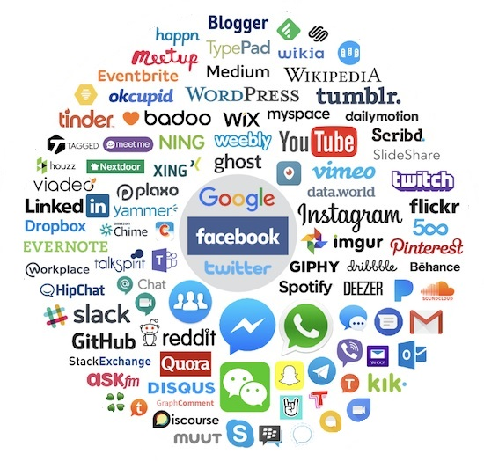
Definition of Cyberbullying
Cyberbullying includes sending or posting harmful material or engaging in other forms of social aggression using the Internet or other digital devices.
Nancy E. Willard, Cyberbullying and Cyberthreats ( 2007)
It can occur on the Internet when cyberbullies use email, chat rooms, discussion groups, social networking sites, instant messaging, or web pages to post harmful content.
10
Notes:
Recall our discussion of the definition of bullying, that bullying can be direct or indirect. An intense version of indirect bullying is cyberbullying, since it’s not done face-to-face.
Nowadays, young people are fully engaged in using the Internet, and immersed in using cell phones, digital cameras, etc. for social networking purposes. However, digital messages and images have been sent to cause harm to many youth with devastating results. Cyberbullying has become a significant challenge to parents and other caring adults because it can’t be easily detected.
Examples of cyberbullying include sending intentionally mean or insulting messages, starting rumors, sharing another’s embarrassing information, cruelly excluding someone socially, and pretending to be someone else while posting harmful content.
While most cyberbullying behavior occurs after school hours, it directly impacts the targeted students’ wellbeing and their overall school performance. Resentments and fights started online frequently spill out onto a school campus.
Please note: The author cited on this slide is an attorney who’s developed several resources on cyberbullying.

Slide 11
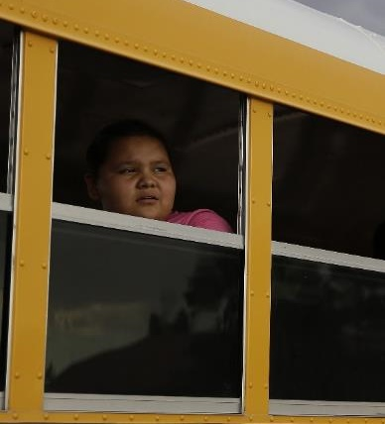
Impact of Cyberbullying
Can happen around the clock
Can be anonymous
May be more vicious than face-to-face encounters
Is easier to get away with it, due to minimal adult oversight
Spreads negative texts and images widely and immediately
Is difficult to detect and prove without a paper trail
Targets feel betrayed, shamed, and powerless.
Depression and social withdrawal can result.
11
Notes:
Parents need training on how to combat cyberbullying. One key rule is not to delete any electronic form of bullying. The first reaction of youth and parents may be to delete the offending message. However, the language and images constitute a paper trail. If the police must be engaged, they will need such a paper trail.
Remember that cyberbullying tends to peak in middle and high school; whereas, traditional in-person bullying tends to decrease as students reach middle and high school.

Slide 12
Definition of Sexting
A term coined by the media, combining the words sex and texting.
Sending or forwarding sexually explicit photos, videos, or messages of oneself or others from a mobile phone or other digital device to others.
Sharing unauthorized photos of partially nude boys or girls in locker rooms or at sleep-overs.
Sexting is…
12
Notes:
Most sexting tends to occur between young people in relationships. However, when those relationships end, the photos or videos they exchanged can be widely disseminated, whether intentionally or unintentionally.
Youth must be alerted that they could be breaking the law if they create, forward or even save this type of message.

Slide 13
Federal Law and Sexting
Federal laws treat all sexually explicit images of youth under age 18 as child pornography.
Youth could be convicted of producing, possessing, and/or disseminating child pornography, resulting in a criminal record and requiring registration as a sex offender.
13
Notes:
Maintaining open communication between parents and youth is vital but still may not stop sexting, but it does set expectations.
Education of parents, youth, and the community is a key deterrent.

Slide 14
Impact of Sexting on Youth
Unforeseen Consequences of Sexting
Damage to one’s reputation
Bullying and sexual harassment by peers
Refused admission to the college of one’s choice
Loss of future employment
14
Notes:
Most youth cannot imagine the range of possible consequences if they engage in any aspect of sexting.

Slide 15
Native Youth with Disabilities as Targets of Cyberbullying/Sexting
Cyberbullies can take advantage of unsuspecting Native youth with disabilities by manipulating them into:
Cyberbullying another
Becoming a victim of sexting
Downloading pornography
The intensity and humiliation of being cyberbullied can increase Native youth’s high risk for:
Dropping out of school
Engaging in suicidal thoughts and/or actions
15
Notes:
Native youth with disabilities are known to use the Internet as much as their non-disabled peers, so they are as vulnerable as all youth and are not sheltered by non-familiarity with the Internet.
Native youth in general have one of the highest drop out rates in the country.
The rate of suicidal tendencies among all Native youth is the highest in the nation.
When the most vulnerable among Native youth are cyberbullied, the resulting withdrawal, depression, frustration, and avoidance of peers, school and social events is intensified..

Slide 16
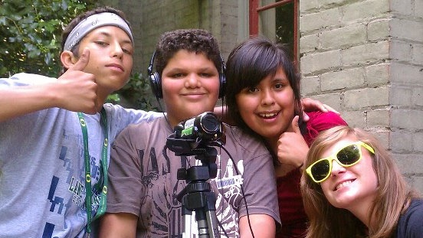
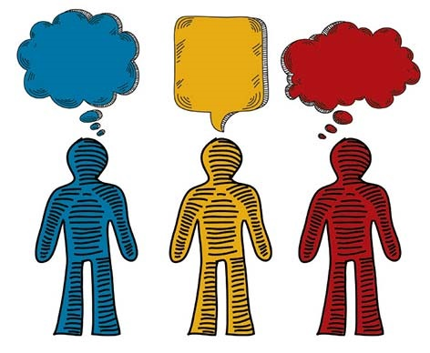
Strategies Parent Centers Can Suggest to Youth to Support Targets of Bullying
Reach out
Band together
Speak up!
Ask adults for help
Don’t join in
Interrupt the bullying
16
Notes:
Don’t allow the bullying target to be isolated, either in-person or online.
Walk/sit together to shield the target of bullying.
Label the behavior as bullying, which is just “not cool”, in-person or online.
Don’t “go along to get along”; change the subject or say something positive about the target, in-person and online.
If ignored, find another adult.
“You (target) are wanted at home (or) in the school office now.”
“Band Together” image, from: http://02af27e.netsolhost.com/oiea2/wp-content/uploads/2011/05/bogsa.jpg , as part of the Oregon Indian Education Association’s story on summer programs for Native youth, at: http://www.oiea.org/resources-2/pre-k-12/

Slide 17
Strategies Parent Centers Can Suggest to Parents About Bullying and Cyberbullying
Initiate conversations about all forms of bullying.
Don’t expect youth to solve things themselves.
Express strong disapproval of bullying when you see it, even among siblings.
Role play with youth on diffusing a bullying situation and engaging those observing, the bystanders.
17
Notes:
1. Just because your children don’t bring up bullying with you, don’t assume it’s not happening. Initiate conversations about bullying and cyberbullying. Watch for warning signs, e.g., avoiding school or increased sadness. Also, some youth don’t realize that some of their behaviors are forms of bullying.
2. Adults often tell youth to handle it themselves. But they don’t know how to; they lack the skills. That’s why they come to an adult. We adults must know how to identify bullying and cyberbullying, and have the will to stop these aggressive behaviors.
3. Remind youth that you will not tolerate bullying behavior of any sort, whether at home, in the car, at school, or online.
4. Assertiveness and other social skills must be taught to some youth. (Remind participants that I suggested 6 strategies to share with youth on the previous slide.)

Slide 18
Further Strategies for Parents on Bullying and Cyberbullying
Develop empathy and respect among youth at home.
Encourage an improved climate of respect at local schools.
Write anti-bullying strategies into your child’s IEP.
Know your federal rights and file a complaint at ocr@ed.gov.
18
Notes:
5. Create opportunities for siblings and other youth to work together on chores or projects that require sharing and collaboration.
6. Researchers use a term: School Connectedness, which is “the belief by students that adults in the school care about their learning as well as about them as individuals”. Research on bullying prevention has shown that the more connected students feel to their school, the better they do academically, meaning a climate of respect has been created so youth can focus on their studies. And, the more connected staff feel to their school, the more likely they are to intervene in bullying incidents, again because a climate of respect and caring has been created. Your school’s climate is really important!
7. Bullying at school can prevent students with disabilities from receiving a free appropriate public education. Parents can call an IEP meeting at any time. Write into the IEP new strategies to prevent bullying of your child, e.g., allowing your child to leave classes early to avoid hallway bullying.
8. If American Indian or Alaska Native youth with disabilities are bullied or cyberbullied for their race or disability, that can be discrimination and harassment, which are against federal civil rights laws. Contact the Office for Civil Rights in the U. S. Department of Education at ocr@ed.gov, the website on the slide .

Slide 19
Strategies Parent Centers Can Suggest to Parents on Cyberbullying and Sexting
Set rules for using technology
Know what your children are doing online
Save evidence of cyberbullying and sexting
File complaints
19
Notes:
Discuss with your children what’s proper and improper to share online. For example, they should not share their home address, mobile phone number, personal photos & videos, and other personal information.
Parents must be responsible for establishing rules about passwords so you can access your child’s cell phone, text history, social networking sites, and other computer accounts. Limit children’s time online. Keep the computer your child uses in an open area, where you can supervise online activity. Install parent controls on the computer.
Ignore the urge to delete inappropriate and offensive texts and images. Save chats and instant messages. Electronic messages leave a trail that can lead back to the perpetrator.
Most web sites and services prohibit bullying. In an email request to your phone or Internet provider, attach the hurtful or sexually explicit content and request that it be removed. They can help your child block messages or calls from select senders, and even close the cyberbully’s account. If the cyberbullying or sexting could constitute a crime, contact the police.

Slide 20
Native Resources You Can Share
NAPTAC published 3 briefs to inform Native parents on bullying, cyberbullying, and sexting
Bullying: What American Indian and Alaska Native Parents Need to Know
Cyberbullying: What American Indian and Alaska Native Parents Need to Know
Resources on Bullying and Cyberbullying of Native Youth
All are available at the Center for Parent Information and Resources, at:
https://www.parentcenterhub.org/naptac-tier3-education-youth/
20
Notes:
NAPTAC and I urge you to become familiar with these 3 Briefs which provide further details on these topics.
Your Parent Center could sponsor bullying prevention trainings for Native parents/communities and share these Briefs.
When your Parent Center sponsors an exhibit booth at or near a Native community, display these Briefs. It will help Native parents realize you have an interest in and care for them and their needs.
Well, that closes our webinar today. Thank you again for your interest and for spending time with us today.
If there’s time, offer to take a couple of questions.

Slide 21
Thanks for attending this webinar.
NAPTAC All of NAPTAC’s products are available at the Center for Parent Information and Resources: https://www.parentcenterhub.org/welcome-to-the-naptac-library/
Native American Parent Technical Assistance Center

