Slide 1
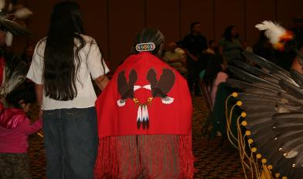

Outreach to Native Parents Through Title VI
Robin Butterfield
Native American Parent Technical Assistance Center
Available online at:
https://www.parentcenterhub.org/naptac-outreach/
Notes:
Participants in this power point will:
Gain additional educational data on Native student performance.
Begin to identify strategies to improve Native parental outreach and engagement using the existing resources available in Title VI of the Indian Education Act.
Understand the reasons why this federal program is necessary, including its unique status as a trust responsibility of the federal government.
Receive suggest for how to specifically collaborate with Title Vi programs.

Slide 2
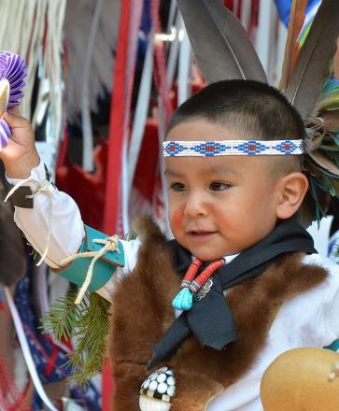
Overview of Presentation
Key Outreach Questions
Indian Education Act: Why?
Unique Legislation
Legislative Changes
Services Provided
Implications for Parent Center Staff
Notes:
Image from: http://img2.10bestmedia.com/Images/Photos/284546/Santa-Fe-Indian-Market-Flickr-Larry-Lamsa_54_990x660.jpg
This slide shows the organization of the entire power point.

Slide 3

That’s Me!
Answer each statement that applies to you by standing and proudly proclaiming “That’s me!”
Or press the letters “TM” in the answer window of this webcast.
Notes:
Suggested statements:
Press the TM on the question box of the webcast.
I love chocolate.
I have more than ten years as a special educator.
I have worked with Native special education students.
Our Center has a significant number of tribes in our region.
I have provided training to Native parents already.
I have participated in a tribal community event, i.e., Pow wow, sports event , cultural gathering, Native arts/crafts show, Native rodeo, etc.
I know what Title VI provides but need more information.
I came here eager to learn.

Slide 4

What | So What | Now What?
Let’s reflect.
What did we just do? What did we find out?
Notes:
This slide allows time for reflection on the activity. Why start this presentation here?
What? What did we just do? (Some possible responses might be:)
We identified characteristics of people participating in this webinar/workshop.
We identified who already had experience with tribal communities.
We identified people with a wealth of Special Educational background.
So what? Why did we do this activity now? (Some possible responses might be:)
Based on the responses, we know how much background information to provide,
specifically about American Indians and their communities.
Now what? How might this activity be used in the future?
This activity can be used with parents in workshops by changing the questions asked.
We often are not aware of our lack of experience and understanding of a community unless challenged to reflect on it.

Slide 5

We don’t see things as they are,
We see them as we are.
. . .Anais Nin
Notes:
This quote captures the cultural isolation we all live with unless placed in situations which cause us to shift world view.

Slide 6
Education
“There is no such thing
as a neutral educational process.
Education either functions as an instrument which is used to facilitate the integration of the younger generation into the logic of the present system and bring about conformity to it,
or it becomes the practice of freedom, the means
by which men and women deal critically and creatively
with reality and discover how to participate in the transformation of their world.”
Paolo Friere
Notes:
This is one of the most powerful quotes about the true nature of education. Paolo Friere challenges us to try to really understand education’s true purpose. Title VI is the result of trying to move schooling for Natives to the “practice of freedom” in helping American Indians/ Alaska Natives(AIAN) truly be able to transform their own worlds as best as they can.
The negative impact of historical trauma can still be operating in Native communities today. These experiences were so horrible for some Native people that they are consciously or even unconsciously being passed on to other generations. These scars need to be dealt with compassion and understanding. Extra efforts on the part of educators will help communities mend from this historical trauma.

Slide 7
Indian Education Act: Why?
“As early as 1744, an Indian elder described members who returned from schools of the white man, as being unfit for tribal life, not able to speak the tribal language well, unfit to be counselors, and hence unable to make worthwhile contributions to the tribe.”
Notes:
This quote captures how different tribal cultures were/are to educational cultures. Without going through the whole history of Indian education, this quote captures the feelings of frustration many Native people still feel about the value of formalized schooling.
Non-Native education was never meant to acknowledge that Native cultures had anything positive worth passing on to young Native children. Title VI attempts to provide bridges between the different cultures by providing specific services for students and Native parents

Slide 8

Key Outreach Questions
What are the most effective ways to publicize our next workshop for Native parents?
Who knows the Indian community best in our area?
Who might have a history with Native students in the school district?
Who could be called upon to serve as an advocate for Native parents who need to attend an IEP meeting?
Who might be able to give some history of the Native community in our area?
Notes:
Title VI programs have been in place in many communities since 1972 and recognize the following:
Native parents and families have always cherished their children.
There are many strengths from historical traditional Native communities.
It is important to remember that many Native communities may still possess remnants of their cultural tribal systems that can serve as a resource today to those wishing to rebuild rapport with Native parents and families.

Slide 9

About 93% of Native students attend public schools, but there exists little in the curriculum
to attend to their cultural needs.
Native Students are disproportionately suspended from school.
Native high school students are also retained disproportionately.
Indian Education Act: Why?
American Indian/Alaska Native (AI/AN) high school students are chronically absent (26%).
AI/AN males represent 0.6% of all students, yet 2% of students are expelled without educational services.
Notes:
Eagle Symbol from: https://www.aaanativearts.com/AN02469_.gif
It is important to be aware of why this unique program, funds and services exist. Native student data continues to reveal disparities in terms of student outcomes. Some Native students may still be over-identified for special educational placement due to cultural differences.

Slide 10

More than 1 out of 5
AI/AN males with disabilities served by IDEA
received one or more out of school suspensions
compared to
1 out of 10
white males with disabilities served by IDEA
Indian Education Act: Why?
Notes:
Image from: http://www.warpaths2peacepipes.com/images/wolf-symbol-1.jpg

Slide 11
“It is the policy of the United States to fulfill the Federal Government’s unique and continuing trust relationship with and responsibility to the Indian people for the education of Indian children.”
Indian Education Act: Why?
Notes:
Eagle Symbol from: https://www.aaanativearts.com/AN02469_.gif
From 25 USC 2000: Declaration of policy.

Slide 12
“The Federal Government will continue to work with local education agencies, Indian tribes and organizations, postsecondary institutions, and other entities toward the goal of ensuring that…
…programs that serve Indian children are of the highest quality and provide for not only basic elementary and secondary educational needs, but also the unique educational and culturally related academic needs of these children.”
Indian Education Act: Why?

Slide 13

Early Recognition of Unique Needs
for Federal Funds for Indian Education
Congress authorized targeted funds
to improve Indian education
Johnson O’Malley (PL 81-874, 1958) | Funds were allocated to provide supplemental services for Native children
Indian Education Act (1972) | Reauthorized in 1974, 1988, 1992, 1994, & 2015
Native American Languages Act (PL 101-477, 1990/ 1992)
Notes:
Johnson O’Malley (PL81-874, 1958) funds were allocated to provide supplemental services for native children(i.e., band uniforms, counseling, athletic uniforms, tutoring, home-schooling liaisons, etc.).
Indian Education Act (1972) Reauthorized in 1974,1988, 1992,1994 and 2015. Indian Parent committees were established to oversee use of funds at the school district level.
Native American Languages Act(PL101-477 (1990/ 1992) This law supports the use of Native Languages as a medium of instruction in order to encourage and support the survival, educational opportunity, increased student success and performance, increased student knowledge of their culture and history, and increased student and community pride.

Slide 14

Unique Legislation: Indian Education Act
What makes this legislation unique?
1
2
It recognizes that American Indian/Alaska Natives(AIAN) have unique educational and culturally related academic needs and distinct language and cultural needs.
It is the only
comprehensive Federal legislation that provides for educational opportunities from pre-school to
graduate level.

Slide 15

Unique Legislation: Indian Education Act
What does this legislation provide?
3
It focuses national attention on the educational needs of AI/AN learners, reaffirming the Federal government’s special trust responsibility for the education of Native people due to treaties.
4
It provides services
to AI/ANs that are not provided by the Bureau of Indian Affairs, and to the
over-93% of Native students attending public schools.

Slide 16

Indian Education Act: Legislative Changes
The Act primarily authorizes formula and competitive grants directly to local educational agencies, tribes, and tribal organizations
Teacher training programs and fellowships for Natives seeking to become teachers [Title IV, 1974]
BIA schools became eligible for grants, and authorization for Gifted and Talented was added [Title V, 1988]
Comprehensive educational plans to meet high academic standards were added [Title IX, 1994]

Slide 17

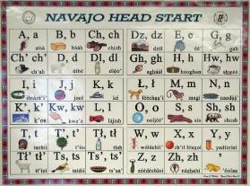
Indian Education Legislative Changes
Currently, the Indian Education Act strengthens the priorities of:
collaboration between tribes and school districts, and
increased tribal language programs [Title VI, 2015]
As part of the Elementary and Secondary Act (ESEA)|No Child Left Behind, the formula grants were to be based on the same challenging content standards as all students [Title VII, 2001]
Notes:
Image, top left, from: http://www.southwesttraditions.com/at_Hopi/at_hopi.html
Image, bottom right, from: http://indiancountrytodaymedianetwork.com/2015/03/09/navalish-shifting-world-navajo-language-159513

Slide 18
Basic Services Provided
Attendance strategies
Native cultural activities
Counseling
Cultural resources
Dropout strategies
Learning events
Field trips
Newsletters
Regular parent meetings / family events
Transition strategies
Tutoring
Youth activities / Native games
Summer programs / camps
other

Slide 19
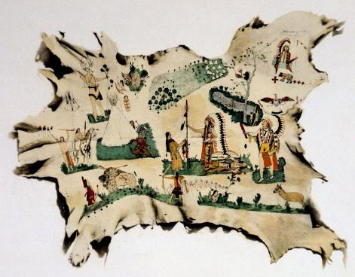
Implications for Parent Center Staff:
Improving Outreach to Native Parents
Regular meetings
Newsletters
Posters or flyers disseminated
Targeted trainings
Expanded networks
Title VI trainings for Parent Center Staff
Notes:
So, how can a Parent Centers expand their Outreach using Title VI?
Regular Meetings: Attend a Title VI Indian Education Parent/Family night. Most Indian Education Programs host a meeting for parents and families on a monthly or regular basis as part of their grant requirements. Center staff can get on the agenda for one or more of these meetings to share pertinent information.
Newsletters: Many of these Programs circulate a periodic newsletter and this can be used as an outreach tool for the Center initiatives.
Posters or Flyers: Most schools have areas where they allow flyers about various events. Indian Education staff visit school buildings all day long working with students. They may be willing to help post flyers in building wherever they go.
Targeted Trainings: Since Indian Education work with parents and Indian families, they may be willing to host trainings for the Parent Center Staff.
Expanded networks: Many Title VI staff network regularly with other similar Title VI programs to share resources, and can help broaden the outreach through out their network. These programs also communicate regularly with the Indian Education Office at the state department of education. Contact the se offices by contacting the NAPTAC website.
Title VI Trainings: Title VI staff may benefit from Parent Center Special Education trainings. They are often called upon to attend as parent advocates for families in IEP meetings.

Slide 20
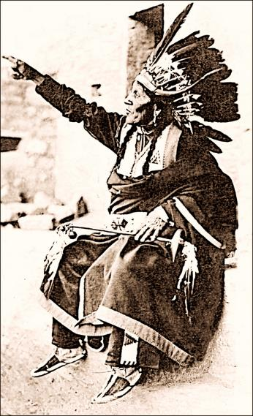
Questions?
Concerns?
Comments?

