Slide 1
Act Early Ambassadors and Parent Centers:
Collaborating to Promote Developmental Health of Young Children
https://ctd1.adobeconnect.com/cpir/
The system will prompt you to connect to audio. Select Option #1, and the system will call you.
The webinar will begin shortly.
Please use the box below to tell us:
The name of your organization
Your state
Your email address
Center for Parent Information & Resources

Slide 2
A Few Reminders on Webinar Etiquette
Everyone will be muted.
Please feel free to use the “Chat” box for your questions or comments.
You can also “Raise Your Hand” using the icon at the top left.

Slide 3
Please join us in welcoming our presenters:
Carmen Sánchez | USED Office of Special Education Programs, Research to Practice
Debra Jennings | Director, Center for Parent Information and Resources
Debra Sarmento | California Act Early Ambassador
Deepa Srinivasavaradan | New Jersey Act Early Ambassador
Diana Autin | Executive Co-Director, SPAN Parent Advocacy Network
Julia Abercrombie | Centers for Disease Control and Prevention, National Center on Birth Defects and Developmental Disabilities
Kelly Young | WarmLine Family Resource Center

Slide 4
Agenda for Today’s Webinar
Welcome | Debra Jennings
Overview of Parent Center Program | Carmen Sánchez
Overview of Learn the Signs and Ambassador Network | Julie Abercrombie
How Parent Centers and Ambassadors Can Work Together: Two Examples | Carmen Sánchez
New Jersey Collaboration | Deepa Srinivasavaradan and Diana Autin
California Collaboration | Debra Sarmento and Kelly Young
Questions and Answers Chat | Everyone!
Suggestions for Other States | Debra Sarmento, Deepa Srinivasavaradan, and Diana Autin

Slide 5
Debra Jennings
Director, Center for Parent Information and Resources
debra.jennings@spannj.org

Slide 6
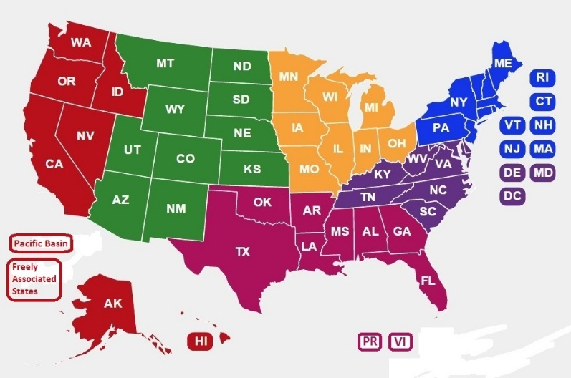
Overview of Parent Center Program
Carmen Sánchez
Education Program Specialist, Office of Special Education Programs, U.S. Department of Education
carmen.sanchez@ed.gov

