Slide 1
Act Early Ambassadors and Parent Centers: Collaborating to Promote Developmental Health of Young Children
Carmen M. Sánchez
February 6, 2018

Slide 2
Supporting Families Navigate Systems
Individuals with Disabilities Education Act (IDEA) provides discretionary funding to States, institutions of higher education, and non-profits to support the provision of early intervention and special education services.
IDEA funds a system of parent training and information centers and community parent resource centers (collectively “parent centers”) to help families navigate early intervention and special education systems.
IDEA also funds parent technical assistance centers (PTACs) to support parent centers in doing their job.

Slide 3
Parent Centers (PTIs, CPRCs)
63 PTIs serve states or areas within states, the District of Columbia, Puerto Rico, and the Virgin Islands (IDEA Sec. 671)
23 CPRCs serve targeted, underserved communities (IDEA Sec. 672)
5-year competitive grants
Organizations with PTI or CPRC grants must be parent-led nonprofits; majority of the board of directors must be parents of children with disabilities
Most organizations that have PTI or CPRC grants also have other Federal, State, or local grants
Parent centers are well connected to States and communities

Slide 4
Parent Training and Information Centers & Community Parent Resource Centers
Provide training and assistance to help parents:
Understand their children’s disabilities and their educational needs
Understand their rights and responsibilities under IDEA
Communicate effectively and work collaboratively with educators and service providers
Participate in their children’s education and early intervention services
Resolve disputes with schools
Variety of services including one-on-one assistance, workshops, publications, and Web sites
Must serve families of children who are suspected as having a disability
(IDEA Sec. 671, (b) )

Slide 5
Parent Technical Assistance Centers
Parent Technical Assistance Centers help parent centers
More effectively coordinate their parent training efforts;
Disseminate research and information;
Reach underserved populations, including parents of low-income and limited English proficient children with disabilities;
Provide many other supports to better serve families
OSEP currently funds 9 PTACs
Center for Parent Information and Resources (National)
6 Regional PTACs
Native American PTAC & Military PTAC (National)

Slide 6
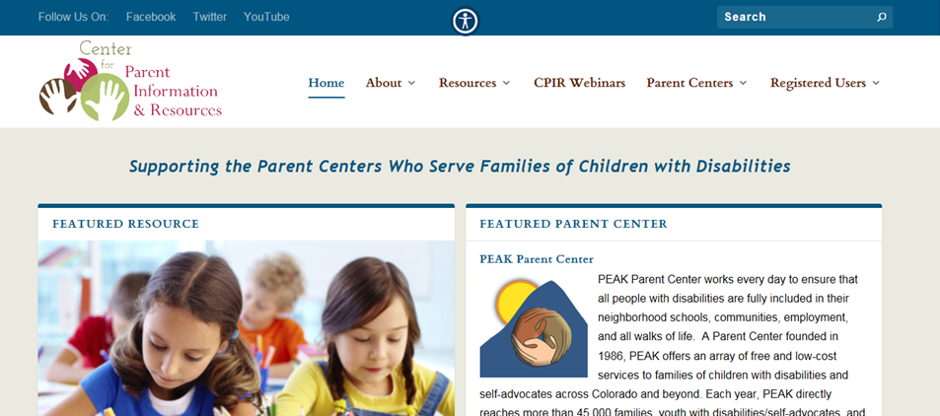
Center for Parent Information & Resources
www.parentcenterhub.org

Slide 7
Thank You!
Carmen M. Sánchez Education Program Specialist Office of Special Education Programs US Department of Education carmen.sanchez@ed.gov 202.245.6595

