Slide 1
Act Early Ambassadors and Parent Centers: Collaborating to Promote Developmental Health of Young Children February 6, 2018
Learn the Signs. Act Early.
Julia Abercrombie, MPH, Behavioral Scientist National Center on Birth Defects and Developmental Disabilities Centers for Disease Control and Prevention
Disclaimer: The findings and conclusions in this presentation are those of the author and do not necessarily represent the official position of the Centers for Disease Control and Prevention.

Slide 2
Learn the Signs. Act Early.
Improve early identification of developmental disabilities, including autism, so children and their families can get the services and support they need as early as possible
Materials
Research and Evaluation
“Act Early” Initiatives

Slide 3
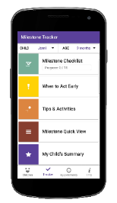
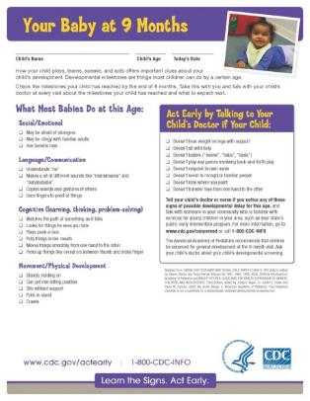
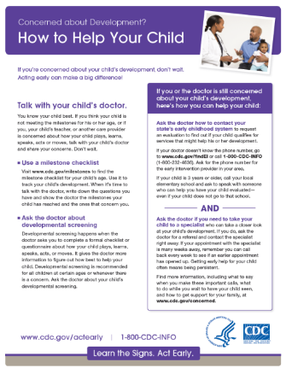
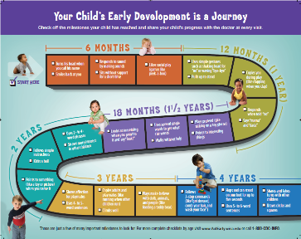
Learn the Signs. Act Early. Materials

Slide 4
Act Early Ambassadors
Serve as state or territory point-of-contact for the national LTSAE program
Support the work of Act Early Teams and other state/territorial or national initiatives to improve early identification of developmental delay and disability
Promote the LTSAE resources, including materials to support developmental monitoring and professional education tools

Slide 5
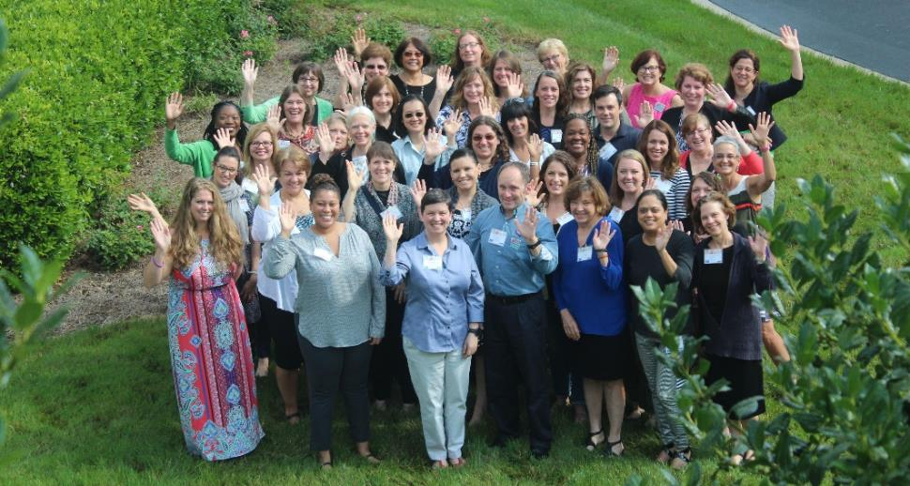
Who Are the Act Early Ambassadors?
55 state and territory champions to increase awareness and improve early identification practices

Slide 6
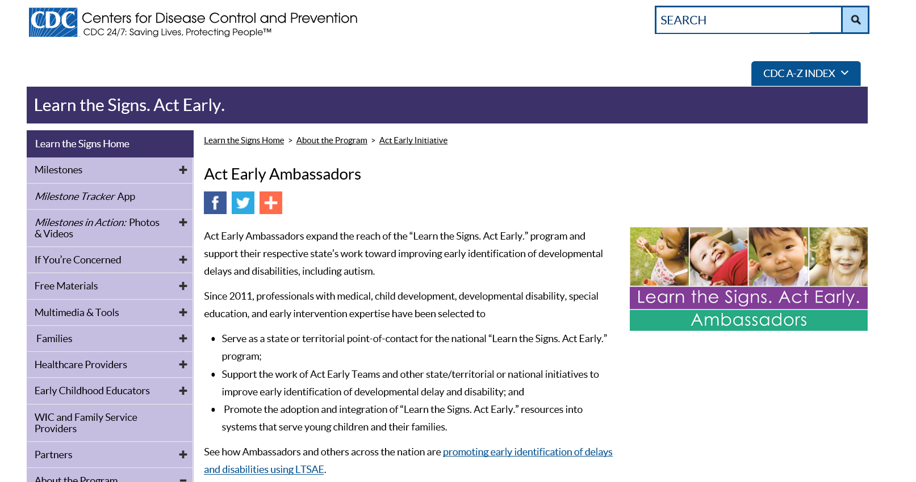
Find Ambassador Contacts
www.cdc.gov/ncbddd/actearly/ambassadors-list.html

Slide 7
Ambassadors and Parent Centers
How Ambassadors and Parent Centers are working together to support parents and improve early identification
Information sharing and making referrals to each other
Serving on committees together
Collaborating on grants and training activities
Being involved together in Act Early State Teams
Sharing and disseminating each other’s information
Co-developing resources
Having formal relationships--contracts or other relationships with each other’s organizations

