Slide 1
Questions? Comments?

Slide 2
Suggestions for Other States
Debra Sarmento, Deepa Srinivasavaradan, and Diana Autin

Slide 3
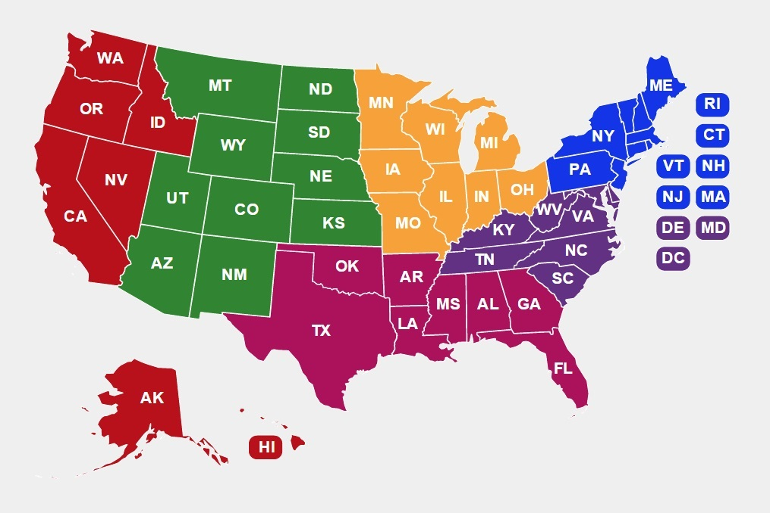
http://www.parentcenterhub.org/webinar21-parentcenters-ambassadors/
Act Early Ambassadors and Parent Centers:
Collaborating to Promote Developmental Health of Young Children
You can find the slides, helpful handouts, and the recording of this webinar on the webpage we’ve created for this event.

Slide 4
Thank you to all of our presenters today!
Carmen Sánchez | USED Office of Special Education Programs, Research to Practice
Debra Jennings | Director, Center for Parent Information and Resources
Debra Sarmento | California Act Early Ambassador
Deepa Srinivasavaradan | New Jersey Act Early Ambassador
Diana Autin | Executive Co-Director, SPAN Parent Advocacy Network
Julia Abercrombie | Centers for Disease Control and Prevention, National Center on Birth Defects and Developmental Disabilities
Kelly Young | WarmLine Family Resource Center

Slide 5
Thank you very much for attending this webinar.
Debra Jennings, Project Director
debra.jennings@spannj.org
Myriam Alizo, Project Assistant malizo@spannj.org
Jessica Wilson, Communication and Dissemination jwilson@spannj.org
Lisa Küpper, Product Development lkupper@fhi360.org
Ana-Maria Gutierrez, Tech Support and Social Media agutierr@fhi360.org

Slide 6
Your feedback helps CPIR improve.
Please take a moment to complete a very brief survey about the usefulness of this webinar to you.
We’ve posted the link in the “Chat” box.
http://survey.constantcontact.com/survey/a07ef3dczk3jd6axxvg/start
Again, thank you!

