Slide 1

Webinar: Introduction to Tool Kits for Board Professional Development for Parent Centers
Webinar: Introduction to Tool Kits for Board Professional Development for Parent Centers
Center for Parent Information and Resources
March 22, 2018

Slide 2


Parent Center
Board Professional Development Tool Kits
STRENGTHENING PARENT CENTER CAPACITY

Slide 3



Introduction
WI FACETS’ Region 4 Parent TA Center
  OSEP Supplement to develop resources for Regional Parent TA Centers and Parent Centers to use for Board professional development
Development team:
  Jan Serak (R4 PTAC)
  David Blanchard (R3 PTAC)
  Glenda Hicks (CPA from GA)
  Rachel Howard (Rachel Howard Consulting)
Other contributors:
  Region 1 PTAC (Diana Autin, Carolyn Hayer)
  Region 2 PTAC (Laura Weber, Connie Hawkins, Rene Averitt-Sanzone)
  Region 3 PTAC (Debi Tucker & Stephanie Moss)
  Region 4 PTAC (Courtney Salzer)
  Region 5 PTAC (Barb Buswell, Jacey Tramutt, Emily Rome)
  Region 6 PTAC (Nora Thompson)
  Center for Parent Info. & Resources (Debra Jennings, Jessica Wilson)
  Atlanta Webcast & Video Production
  Additional Parent Centers
STRENGTHENING PARENT CENTER CAPACITY

Slide 4
Project Charge & Process
Project Charge - To provide nonprofit management PD resources that will strengthen the capacity of Parent Center Boards, Executive Directors, and Project Directors to effectively maintain a stable, effective nonprofit organization, capable of carrying out Federal grant requirements
Process
  Significant input from the leaders of the six Regional Parent TA Centers & CPIR, beginning in Fall 2016
  RPTACs shared their existing trainings & resources
  Development Team created the Tools
  RPTACs reviewed Tools
  Development Team finalized

Slide 5
Six Parent Center Board PD Tool Kits
1 – Board Structure
Board Recruitment
Board Orientation
Board Book
2 –Financial Governance
Financial Statements
Form 990
Fundraising
3 – Board Legal Responsibilities
3D’s: Duty of Care, Loyalty, Obedience
Board Policies
Conflicts of Interest
4 – Board/Staff Responsibilities
Management vs Governance
Evaluation of the Exec. Director
Responsibilities of Parent Center Boards
5 –Succession Planning
Exec. Director Succession Planning
Emergency Succession Planning
Board Member Succession Planning
6 – Strategic Planning
Why Strategic Planning is Important
How to Prepare a Strategic Plan
Implementing a Strategic Plan
---------------------------------------------
7 – RPTACs’ TA Tool Kit

Slide 6

Poll Time!

Slide 7
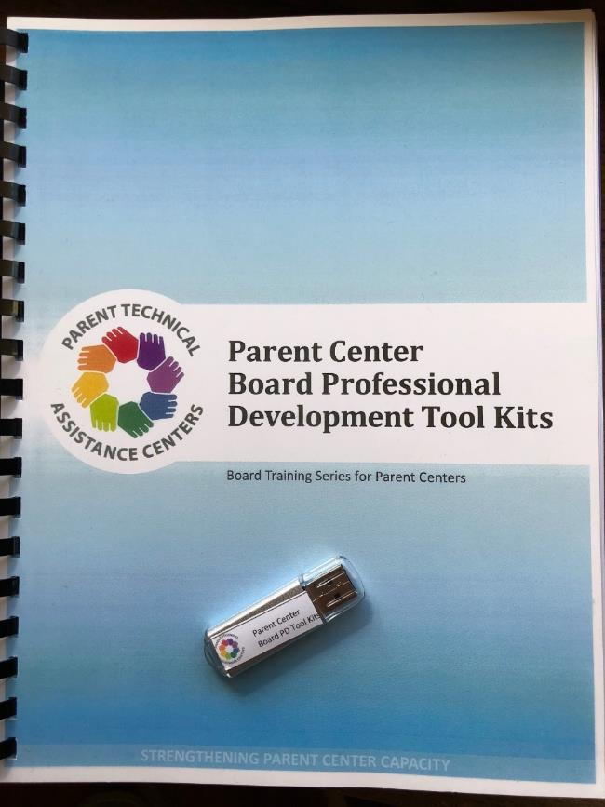
Your Tool Kits
Manual
Flash Drive
68 Products!

Slide 8
What’s in Each Tool Kit?
3 Videos
How to Use Guide
3 Dialogue Guides
3 FAQs,
Resource List,
& Resources
Evaluation Form

Slide 9
Where to Start?
Available from your RPTAC

Slide 10
How Do I Use the Tools?
Pick a Module
Read the “How to Use” Guide
Show the Video (11-21+ minutes)
Use the Dialogue Guide (10-15+ minutes)
Hand out the FAQ Sheet (1-15+ minutes)
Hand out the Resource List & select resources (1-15+ minutes)
Complete the Evaluation form (2 minutes)
20 - 45+ minutes

Slide 11
TK#1 – HOW TO USE Guide
First - Review the “How to Use” Guide
STRENGTHENING PARENT CENTER CAPACITY

Slide 12
TK#1 – HOW TO USE Guide
Description of content, time, and other materials needed

Slide 13
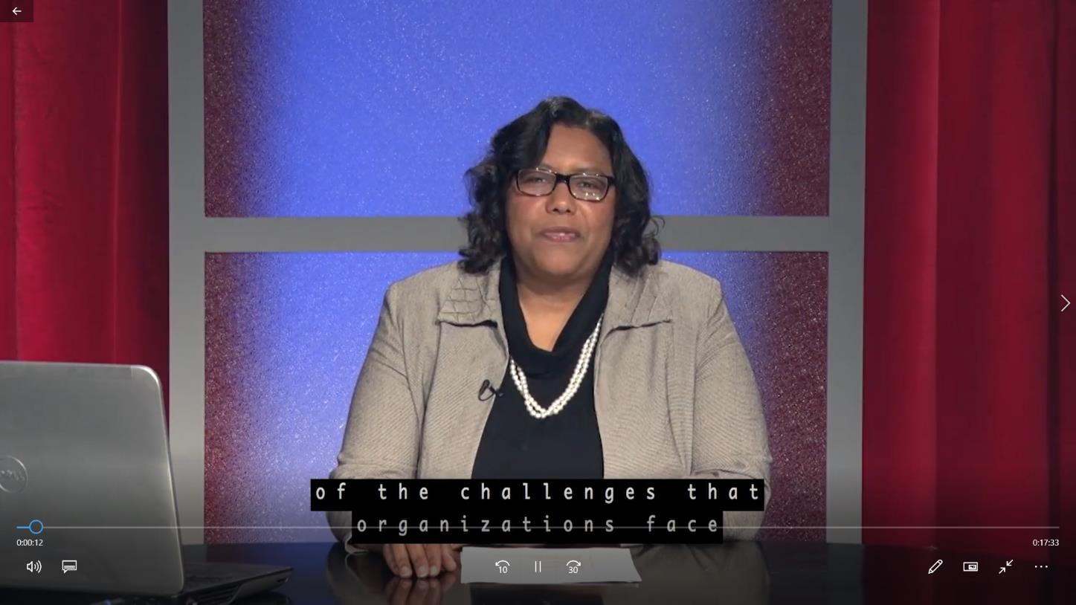
TK#1 - Board Recruitment - VIDEO
https://youtu.be/Vo7Ew1QB4Lk
Watch the Video

Slide 14
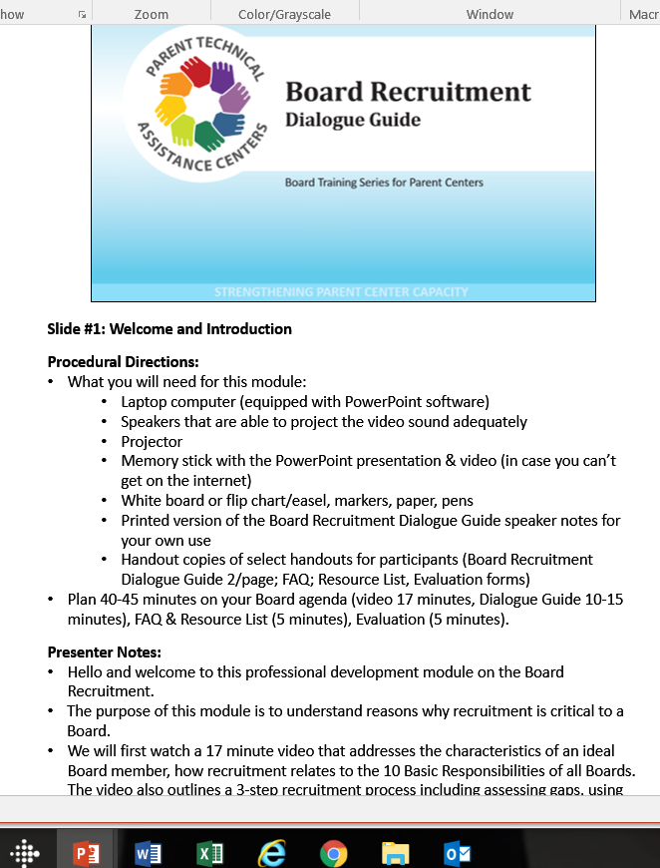
Next—Read the DIALOGUE GUIDE
TK#1 - Board Recruitment – DIALOGUE GUIDE
Next – Read the Dialogue Guide notes

Slide 15
Next—the FAQ Handout
TK#1 - Board Recruitment - FAQ
Next –FAQ handout

Slide 16
Next—Check out the resources
TK#1 - Board Recruitment – RESOURCE LIST
Next – Check out the resources

Slide 17
Next—Read the resources included in the tool kit
TK#1 - Board Recruitment - RESOURCES
Next – Read the 6 resources

Slide 18
Last—complete the evaluation form
TK#1 - Board Recruitment – EVALUATION FORM
Last – Complete the evaluation
STRENGTHENING PARENT CENTER CAPACITY

Slide 19
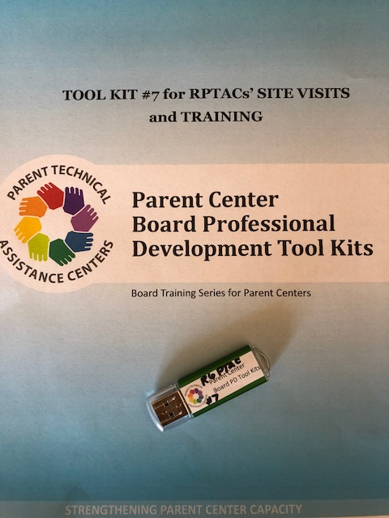
Tool Kit #7 – for RPTACs
Comprehensive Board Self-Assessment Tool
TA Guides for all 6 Tool Kits
  Additional modules
  More activities
  More resources
Site Visit Tool

Slide 20
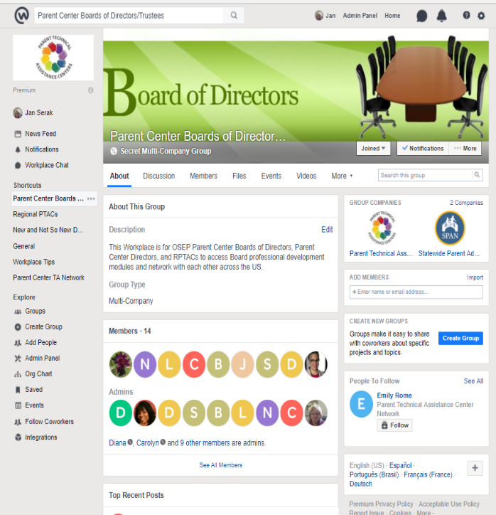
Parent Center Boards of Directors Workplace
Exclusive Facebook Workplace site
For Boards, EDs, Project Directors of OSEP Parent Centers
Intended as a networking platform for Boards
Storage for the 6 Tool Kits, including all 18 videos
RPTACs are Administrators – they will issue the invitations to join

Slide 21


Another Poll | Time for Questions/Comments
Next Steps?
Questions?
Comments?

Slide 22

Thank You’s and Acknowledgements
Thank you to Jan Serak, our presenter today,
WI FACETS and the development team,
and all who shared materials
and reviewed drafts!

Slide 23
Closing Slide: Center for Parent Information & Resources thanks you for attending!
Center for Parent
Information and Resources
Your feedback helps CPIR improve.
Please take a moment
to complete a very brief survey
about the usefulness of this webinar to you.
Thank you for attending!

