Slide 1
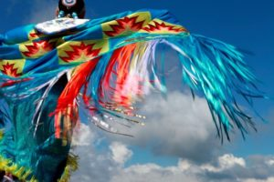
Welcome!
The webinar will begin shortly.
Serving Native American Families: A Resource Collection
February 6, 2020
3:00 pm – 4:15 pm Eastern

Slide 2
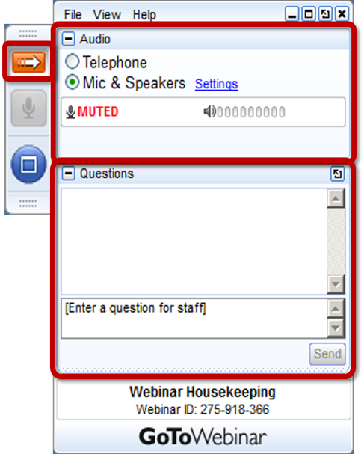
Webinar
Center for Parent Information and Resources
Welcome!
The webinar will begin shortly.
Attendee Participation
Open and close your control panel.
Join audio:
Choose Mic & Speakers to use VoIP
Choose Telephone and dial using the information provided
If you are joining the audio by telephone mute your computer speakers
Submit questions and comments via the Questions panel.
Note: Today’s presentation is being recorded and the link will be sent to you when it is available.

Slide 3
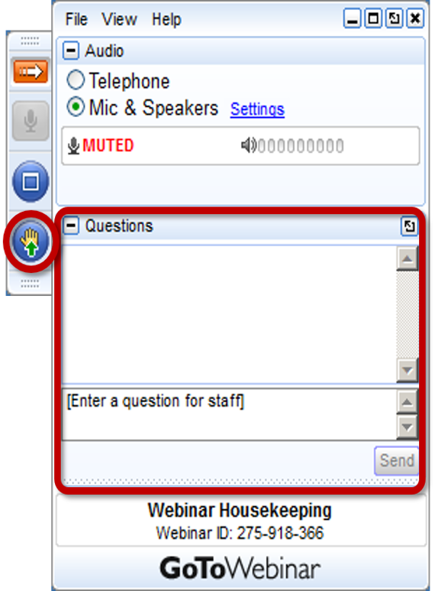
Webinar Housekeeping
Please submit your text questions and comments using the Questions panel.
Please raise your hand to be unmuted for verbal questions.
Note: Today’s presentation is being recorded, and the link will be sent to you when it is available.

Slide 4
Introducing
The NAPTAC Library
now hosted at CPIR
Debra Jennings
Director
Center for Parent Information & Resources
debra.jennings@spanadvocacy.org
https://www.parentcenterhub.org/ welcome-to-the-naptac-library/

Slide 5
A story matrix connects all of us.
There are rules, processes, and circles of responsibility in this world. And the story begins exactly where it is supposed to begin. We cannot skip any part.
—Joy Harjo, First Native American U.S. Poet Laureate (2019—2021), Muscogee Creek. From her poem Crazy Brave: A Memoir.

Slide 6
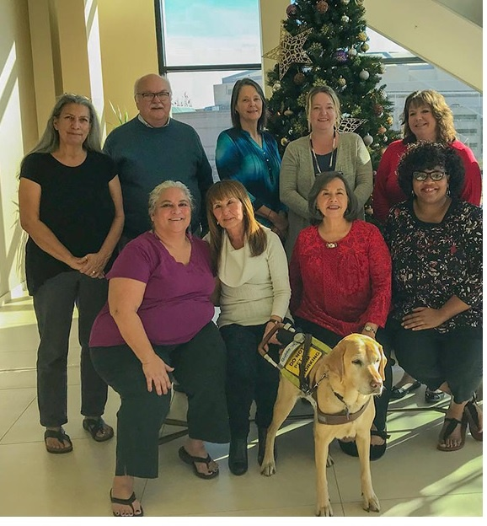
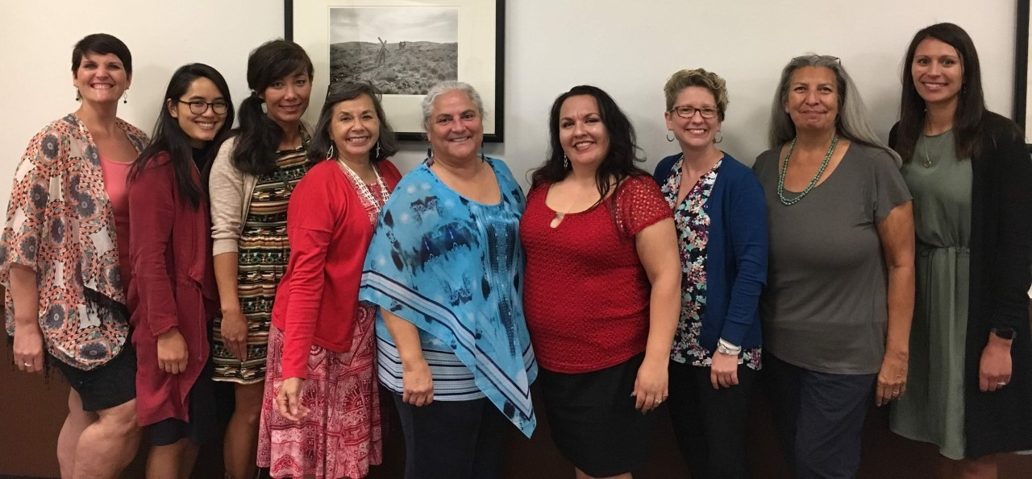
Carmen Sánchez | About NAPTAC
NAPTAC, the Native American Parent Technical Assistance Center, was funded by OSEP to:
Equip Parent Centers with the cultural knowledge and skills they would need to build trust and establish lasting relationships within Native communities
Build Parent Center capacity to conduct effective outreach to Native families within their service area

Slide 7
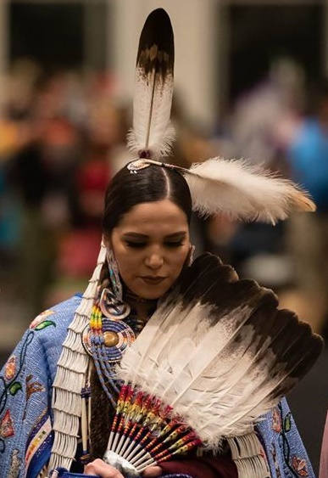
CPIR’s Commitment
Is honored to host the library of resources created by NAPTAC
Recognizes the unique American Indian and Alaska Native (AI/AN) perspective of the materials
Is responsible for updating the published print and video materials
Will create new content on current topics in the future
Will disseminate information broadly about the NAPTAC Library to non-Native and Native groups
Will continue to build capacity of Parent Centers to provide culturally appropriate services to Native families who have children with disabilities

Slide 8
Please welcome today’s presenters.
Voices from the Field
NAPTAC, in Brief
Let’s Tour the Native American Resource Collection
Jennifer Cole
WA PAVE
Alexandra Fogarty
Stone Soup Group
Kristi Moscato
Parent Network of WNY
Yvonne Sinisgalli
Formerly of the Long Island Advocacy Center
Judy Wiley Program Manager
NAPTAC
Judy Wiley
Program Manager NAPTAC
Joann Sebastian Morris
NAPTAC Trainer & Author

Slide 9
Please do tell us…

Slide 10
Structure of the Library
Designed to support current and new Parent Center staff
Recognizes that visitors to the Library have their own level of prior learning & research on Native peoples
Recognizes that visitors to the Library possess a range of personal experiences with Native families and communities

Slide 11
Structure of the Library (continued)
Four Tiers of Learning, built on research on how one learns about a culture different than one’s own:
Gain background information about the culture—Must reads!!
Gain experience with people within the group (e.g., conduct outreach)
Learn about subgroups within the culture (e.g., youth)
Commit to continued learning via resources and experiences

Slide 12
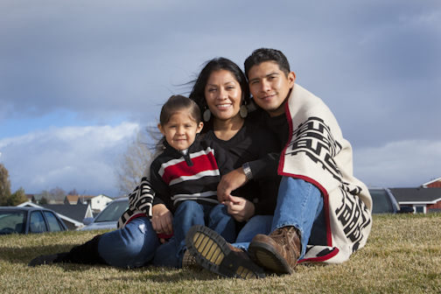
Welcome | Landing Page
https://www.parentcenterhub.org/welcome-to-the-naptac-library/
Major Sections of the Page
Greetings and welcome!
How the library is organized (4 tiers of learning)
NAPTAC’s story
Links at bottom so you can easily travel to any other tier page
Let’s visit!

Slide 13
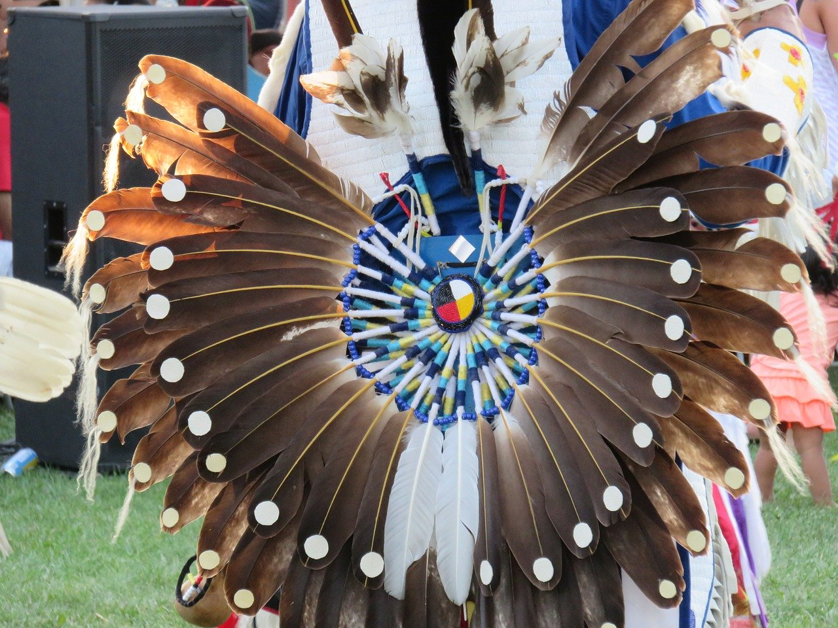
Tier 1: Native Culture & Background
https://www.parentcenterhub.org/naptac-tier1-culture/
Must reads!
Let’s visit!
Major Topics in Tier 1
Historical Trauma
AI/AN Values
Tribal Sovereignty
Education policies of the past

Slide 14
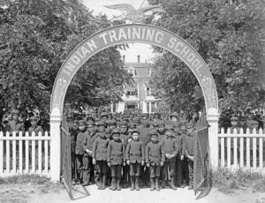
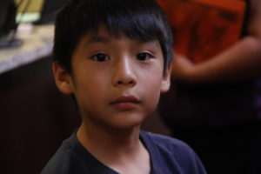
Voices from the Field | Tier 1 Resources
Jennifer Cole
WA PAVE
Historical Perspectives for Working with Native Families
Webinar
Brief
Historical Trauma: Developing an Understanding of American Indians and Alaska Natives
Brief
Alexandra Fogarty
Stone Soup Group
https://www.parentcenterhub.org/naptac-tier1-culture/

Slide 15
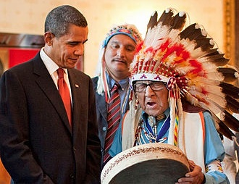
Tier 2: Outreach to Native Communities
https://www.parentcenterhub.org/naptac-tier2-outreach/
Major Topics in Tier 2
Outreach barriers & opportunities
Title VI Indian Education programs as a connection point for conducting outreach
Outreach to Native youth
Let’s visit!
Being a good listener is highly valued by Native communities.

Slide 16
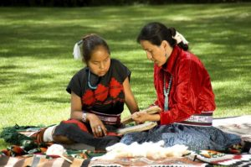
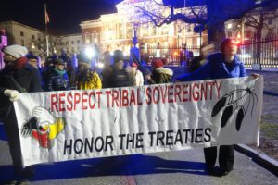
Voices from the Field | Tier 2 Resources
Cultural Awareness and Connecting with Native Communities
Brief
Kristi Moscato
Parent Network of WNY
Yvonne Sinisgalli
Formerly of the Long Island Advocacy Center
Introducing Your Parent Center to American Indian/Alaska Native Communities
Brief
https://www.parentcenterhub.org/naptac-tier2-outreach/

Slide 17
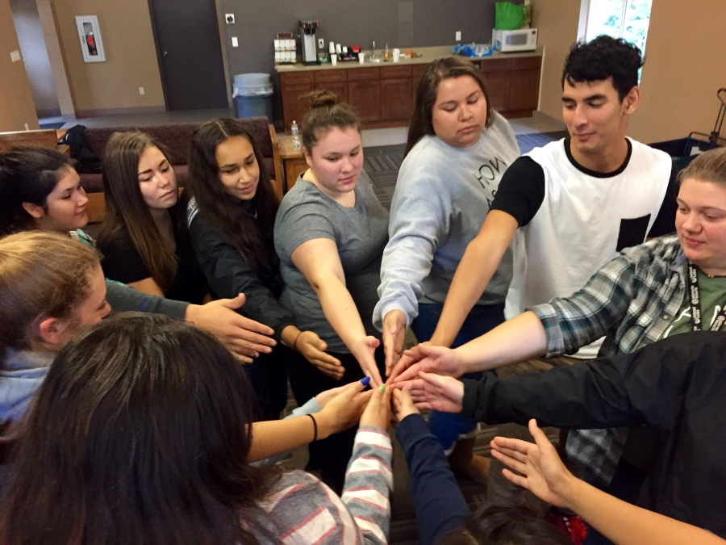
Tier 3: Native Children and Youth
https://www.parentcenterhub.org/naptac-tier3-education-youth/
Major Topics in Tier 3
Current state of Native education
Preschool suspensions & expulsions of Native children
What’s important to Native youth
Bullying & cyberbullying
Resilience & Native youth
Native perspective on transition planning
Youth involved in the Native American Youth Leadership Academy

Slide 18
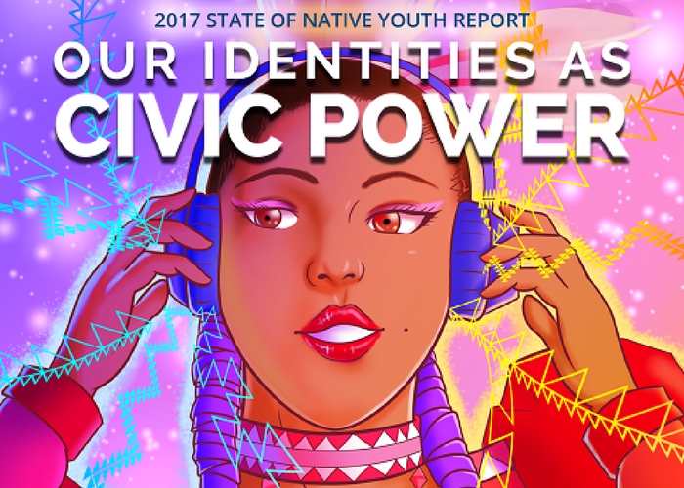
Tier 4: Additional Information & Resources
Major Topics in Tier 4
Lists you can use to support outreach (e.g., State Indian education contacts, tribes by state, urban Indian centers)
Links to education reports by Native organizations
Links to articles about cultural awareness
Training activities & worksheets used in NAPTAC webinars
Relevant resource materials

Slide 19
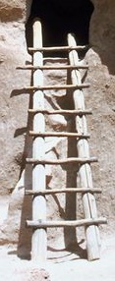
Next Steps in Hosting the NAPTAC Library
Tiers 3 & 4 landing pages
will be completely assembled and uploaded in February—March 2020
will be reviewed by Parent Centers, Native specialists, and others, then revised
will be officially “rolled out” to Parent Centers and public in April 2020

Slide 20
Questions?
Comments?

Slide 21
Don’t forget that your Rptac is a ready source of targeted and intensive technical assistance!
Region A
Region B
Region C
Region D
WI Facets
Wisconsin Family Assistance Center for Education, Training, and Support
Matrix & PEAK
Matrix Parent Network (in CA) and PEAK Parent Center (CO)
SPAN of NJ
Statewide Parent Advocacy Network
P2PGA
Parent to Parent of Georgia
CT, DC, DE, MD, ME, MA, NH, NJ, NY, PA, Puerto Rico, RI, VT, and the US Virgin Islands
AL, AR, FL, GA, LA, MS, NC, OK, SC, TN, TX
IL, IN, IA, KS, KY, MI, MN, MO, MT, NE, ND, OH, SD, WI, WV, WY
AK, AZ, CA, CO, HI, ID, NM, NV, OR, UT, WA, the outlying areas of the Pacific Basin, and the Freely Associated States
Your Rptac’s contact info is listed at:
https://www.parentcenterhub.org/rptacs/

Slide 22
Thank you for joining us today. May the rich collection of Native American resources in this library help you plan and conduct effective outreach to American Indian and Alaska Native families whose children have disabilities.
CPIR also expresses its heartfelt appreciation to Judy Wiley, Joann Sebastian Morris, and other Native authors for their creation of these resources and for their deep involvement in designing how they are integrated into the Parent Center Hub. Keep leading the way!

Slide 23
We would also like to send a very special thank you to the Parent Center Native Parent Specialists who shared their insights and experiences today and whose commitment to Native communities and families inspires us all.
Jennifer Cole
Alexandra Fogarty
Kristi Moscato
Yvonne Sinisgalli
February 2020 | A CPIR Webinar for Parent Centers
The CPIR is made possible through Cooperative Agreement Number H328R180005 between OSEP and the Statewide Parent Advocacy Network (SPAN). The contents of this document do not necessarily reflect the views or policies of the Department of Education, nor does mention of trade names, commercial products, or organizations imply endorsement by the U.S. Government.

Slide 24
Center for Parent Information and Resources
Your feedback helps CPIR improve.
Please take a moment to complete a very brief survey about the usefulness of this webinar to you.
Thank you for attending!
Notes:
Debra…
Please take a minute to complete a brief survey about this webinar.
We have posted the link in the Chat box.
Thank you very much for joining us today.

