Slide 1
OSEP Parent Center Webinar
May 5, 2022

Slide 2
Agenda
OSEP Reminders and Updates
Conference Participation
Parent Center Participation in Differentiated Monitoring System (DMS 2.0)
Parent Center Data 2021
Resources from the Center for Parent Information and Resources

Slide 3
OSEP Reminders and Updates
Annual Reports Due Friday, May 6 (tomorrow), by 4:30 p.m.
Extensions granted if needed
Remember “substantial progress” not perfection
Thanks for Program Measures Submissions
2022 Parent Center Funding

Slide 4
Conferences in 2022
Project Directors and Leadership Conference
July 18-21
Virtual
2022 Family Leadership Conference – Moving Forward: Embracing Change and Transformation
October 18 – 20
In-Person and Virtual
Expectations for Attendance
Grant Requirements
Costs
Masking

Slide 5
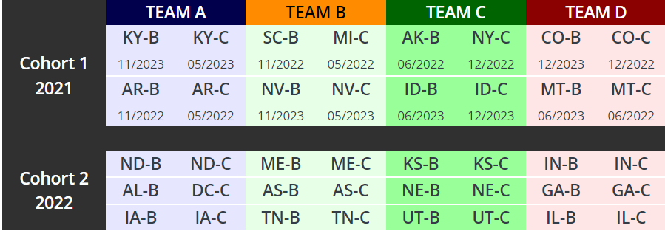
Parent Centers and DMS 2.0
DMS 2.0 Website: https://sites.ed.gov/idea/grantees/#DMS,DMS-2
Parent Center data on families’ experiences in early intervention and special education
Focus Groups
All States will be monitored over time

Slide 6
Parent Center Data – Parent Training

Slide 7
Parent Center Data – Professional Training

Slide 8
Training Distribution by Parent Center Type

Slide 9
National Data and Parent Center Data - Disabilities

Slide 10
National Data and Parent Center Data - Ethnicity

Slide 11
National Data and Parent Center Data - Race

Slide 12
Meeting Attendance

Slide 13
Thank you for all that you do for families and children!

