Slide 1
Before We Start
All participants are muted. We will use the chat space for questions.
Captioning is available at: http://www.fedrcc.us//Enter.aspx?EventID=3053213&CustomerID=321
Stakeholder Brief is available at: http://www2.ed.gov/policy/gen/guid/school-discipline/files/dcl-summary-for-stakeholders.pdf

Slide 2
OSEP Dear Colleague Letter on Behavior
Friday, September 16, 2016
2 p.m. ET
Notes:
Carmen – Welcome to this webinar discussion of the Dear Colleague Letter on Behavior the Office of Special Education Programs issued on August 1, 2016. I’m Carmen Sanchez, a project officer in OSEP. Before we begin, I want to remind you that this webinar will be recorded and archived on the IDEAS that Work website. All participants will remain muted during the course of the webinar in order to assure the highest possible sound quality. If you have a question, please use the chat space to type in your question and we will get to as many as time allows. If you need captioning, please see the link in the chat space to get the captions on a second screen. Now I will turn it over to Nancy Reder, at the National Association of State Directors of Special Education to start the webinar. You may enter your questions in the chat space and address it to “Everyone” or to “Presenters Only” if you wish to remain relatively anonymous.

Slide 3
Agenda for the Webinar
Welcome – Nancy Reder, NASDSE
Overview of the Dear Colleague Letter – Renee Bradley, OSEP
Discussion of Informal Removals – Diane Smith Howard , NDRN, and Kris Keranen, MI P&A
Notes:
Good afternoon everyone. This webinar is an opportunity for State directors, protection and advocacy systems, parent training and information centers, and community parent resource centers to learn more about the Dear Colleague Letter that OSEP issued on August 1, 2016. It’s also an opportunity to discuss how the letter may impact your work with students and families, particularly around issues with suspensions and expulsions and more informal removals from the classroom and learning. We have with us Dr. Renee Bradley from the Office of Special Education Programs, who is well known for her work on behavior and students with disabilities. She has been the project officer for the Positive Behavioral Supports and Intervention national technical assistance center since its inception almost twenty years ago. After Renee provides an overview of the Dear Colleague Letter and answers some questions, Diane Smith Howard from the National Disability Rights Network and Kris Keranen from the Michigan Protection and Advocacy System will discuss informal removals of students with disabilities. Todd Loftin the Director of Special Education for the Oklahoma Department of Education and Sharon House, Executive Director of the Oklahoma PTI, will then talk about their state’s experience in changing how they address behavior. We hope to address any questions or comments that were not discussed between presentations at the end. Finally, Debra Jennings from the Center for Parent Information and Resources will discuss additional resources you may find helpful in your work.
So without further ado, Let me turn this over to Dr. Renee Bradley.

Slide 4
Agenda for the Webinar Continued
Discussion of a State’s Efforts around Behavior – Todd Loftin, OK Department of Education, and Sharon Coppedge Long, OK Parent Center
Questions
Resources – Debra Jennings, CPIR @ SPAN
Notes:
Good afternoon everyone. This webinar is an opportunity for State directors, protection and advocacy systems, parent training and information centers, and community parent resource centers to learn more about the Dear Colleague Letter that OSEP issued on August 1, 2016. It’s also an opportunity to discuss how the letter may impact your work with students and families, particularly around issues with suspensions and expulsions and more informal removals from the classroom and learning. We have with us Dr. Renee Bradley from the Office of Special Education Programs, who is well known for her work on behavior and students with disabilities. She has been the project officer for the Positive Behavioral Supports and Intervention national technical assistance center since its inception almost twenty years ago. After Renee provides an overview of the Dear Colleague Letter and answers some questions, Diane Smith Howard from the National Disability Rights Network and Kris Keranen from the Michigan Protection and Advocacy System will discuss informal removals of students with disabilities. Todd Loftin the Director of Special Education for the Oklahoma Department of Education and Sharon House, Executive Director of the Oklahoma PTI, will then talk about their state’s experience in changing how they address behavior. We hope to address any questions or comments that were not discussed between presentations at the end. Finally, Debra Jennings from the Center for Parent Information and Resources will discuss additional resources you may find helpful in your work.
So without further ado, Let me turn this over to Dr. Renee Bradley.

Slide 5
Dr. Renee Bradley
Assistant Director
Research to Practice Division
Office of Special Education Programs
US Department of Education renee.bradley@ed.gov

Slide 6
Dear Colleague Letter on Behavior
The DCL clarifies the responsibility of IEP teams to include behavioral interventions and supports on IEP’s of students whose behavior impedes their own learning or the learning of others to prevent the unnecessary removal of a student

Slide 7
A focus on developing IEPs to address behavioral supports and services and expands on the responsibility of IEP teams to address behavioral supports in the IEP and ensure those supports and services are being implemented.
Although the Department considers this DCL to be significant guidance, it does not add any new legal requirements. Further, it does not change any of the existing discipline provisions of the IDEA.

Slide 8
Ensures that eligible children with disabilities who have behavioral needs receive a free appropriate public education (FAPE) and placement in the least restrictive environment (LRE).
This guidance is not intended to limit schools’ and agencies’ appropriate use of disciplinary removals that are necessary to protect children; instead, it is intended to provide alternatives, which schools can use to effectively support and respond to problem behaviors so that disciplinary removals are infrequent or unnecessary

Slide 9
IDEA requires individualized education program (IEP) Teams to consider the use of positive behavioral interventions and supports for children with disabilities whose behavior interferes with their learning or the learning of others.

Slide 10
When a child displays inappropriate behavior, such as violating a code of student conduct or disrupting the classroom, this may indicate that behavioral supports should be included in the child’s IEP; this is especially true when the child displays inappropriate behavior on a regular basis or when the behavioral incidents result in suspensions or other disciplinary measures that exclude the child from instruction.

Slide 11
If a child displays inappropriate behavior despite having an IEP that includes behavioral supports, this may indicate that the behavioral supports in the IEP are not being appropriately implemented, or the behavioral supports in the IEP are not appropriate for the child. In these situations, the IEP Team would need to meet to discuss amending the current IEP to ensure that the interventions and supports in the IEP can be implemented, or to revise the behavioral interventions and supports that are currently in place.

Slide 12
IDEA requires that needed behavioral supports in the IEP, whether provided as special education, related services, or supplementary aids and services, be based on peer-reviewed research to the extent practicable. The supports chosen should be individualized to the child’s needs.

Slide 13
Some examples of supports that schools may use include instruction on, and reinforcement of, school expectations for behavior, violence prevention programs, anger management groups, counseling for mental health issues, life skills training, social skills instruction, meetings with a behavioral coach, or other approaches.

Slide 14
In addition to behavioral supports for children with disabilities, it may also be necessary, and consistent with IDEA requirements, to provide supports for school personnel and training on the use of positive behavioral interventions and supports in order to appropriately address the behavioral needs of a particular child.

Slide 15
While providing individualized behavioral supports to students with disabilities who need them through the IEP process is required as part of IDEA, research has shown that these supports are typically most effective when they are delivered within a school-wide evidence-based multi-tiered behavioral framework that provides all children with clear expectations, targeted intervention for small groups who do not respond to the school-wide supports, and individualized supports for those children who need the most intensive behavioral services.

Slide 16
It is important for schools and agencies to keep in mind that, in general, placement teams may not place a child with a disability in special classes, separate schooling, or other restrictive settings outside of the regular educational environment solely due to the child’s behavior if the child’s behavior can be effectively addressed in the regular education setting with the provision of behavioral supports.

Slide 17
The failure to make behavioral supports available throughout a continuum of placements, including in a regular education setting, could result in an inappropriately restrictive placement and may violate IDEA’s LRE requirements. Doing so may constitute failure to provide the child with access to the LRE.

Slide 18
Schools should exercise caution in using disciplinary measures that remove a child from his or her current placement, such as suspension. Research has shown that exclusionary measures, in general, are not only ineffective at reducing or eliminating the reoccurrence of the misbehavior but may even be harmful to the child, possibly leading to lower academic performance, disengagement from school, and the decision to drop out.

Slide 19
Parents have the right to request an IEP Team meeting at any time, and public agencies generally must grant a reasonable request from a parent for an IEP Team meeting.
Parents may want to request an IEP Team meeting following disciplinary removal or changes in the child’s behavior that impede the child’s learning or that of others, as these likely indicate that the IEP may not be properly addressing the child’s behavioral needs or is not being properly implemented.

Slide 20
Press release
  http://www.ed.gov/news/press-releases/us-department-education-releases-guidance-schools-ensuring-equity-and-providing-behavioral-supports-students-disabilities
Dear Colleague Letter
  http://www2.ed.gov/policy/gen/guid/school-discipline/files/dcl-on-pbis-in-ieps--08-01-2016.pdf
Stakeholder Brief
  http://www2.ed.gov/policy/gen/guid/school-discipline/files/dcl-summary-for-stakeholders.pdf

Slide 21
Resource Documents
  PBIS Blueprint
    http://www.pbis.org/blueprint/implementation-blueprint
  Classroom Management Matrix
    https://www.osepideasthatwork.org/evidencebasedclassroomstrategies
Blog
  http://sites.ed.gov/osers/2016/08/moment-to-moment-and-year-to-year-preventing-contemporary-problem-behavior-in-schools/

Slide 22
Questions?
Participants will remain muted to ensure the highest sound quality. Please enter your questions in the chat box, either addressed to “Everyone” or “Presenters.”

Slide 23
Informal Removal
Diane Smith Howard, Senior Staff Attorney for Juvenile Justice and Education Issues; National Disability Rights Network (NDRN)
Kris Keranen, Advocate, Michigan Protection and Advocacy Inc.

Slide 24
What is “Informal Removal”?
Removal of students from school without due process
  Goss v. Lopez (gen’l ed) 419 U.S. 565 (1975)
  I.D.E.A.
  Section 504
  Various Methods
  “Sent homes”
  Shortened Days
  Homebound/tutoring
  Transfers to no where

Slide 25
Who Does It Impact?
It appears to impact particularly disenfranchised families
  Student: School removals increase likelihood of JJ referral and drop out
  Community: Unsupervised youth
  Family: Parents often have to quit work
Hard to say for sure because of lack of data collection, but anecdotally
  People of Color
  Low Income People
  Single parents

Slide 26
Who are the P&As ?
Protection and Advocacy (P&A) agencies have the authority to provide legal representation and other advocacy services, under all federal and state laws, to all people with disabilities (based on a system of priorities for services).
Maintain a presence in facilities that care for people with disabilities, where they monitor, investigate and attempt to remedy adverse conditions.

Slide 27
Who are the P&As? Part 2
57 agencies: State and Federal Funds
Lawyers with “Special Powers” (access and standing )

Slide 28
A view from the ground
Michigan P & A’s long term work with children facing “push out”
Potential impact of the “Dear Colleague Letter” for improved outcomes for student
Meet the students:
  Joseph
  Markita
  Da’Quan

Slide 29
Why does the guidance matter?
Schools still struggle to appropriately address disability-related behavior
Continuing lack of understanding about the role of behavior supports in improving outcomes
Information in one place that clarifies and assisting in correcting widely held noncompliant practices
Great potential for vastly improved student outcomes

Slide 30
Some Approaches …
IDEA and Section 504 Statute and Regulations (e.g. FAPE/LRE/ Discipline Protections; Federal guidance: 3 Factor Test
  IEP and Section 504 Meetings
  Appeals as necessary ( due process and complaints)
State regulation (tutoring, SSD process) and state complaints
Data Collection: Add to the Civil Rights Data Collection
Truancy Analysis

Slide 31
Contact
Kris Keranen: Advocate; Michigan Protection and Advocacy Service, Inc.; (906) 228-5910 or (866) 928-5910; KKeranen@mpas.org
Diane Smith Howard: Senior Staff Attorney for Juvenile Justice and Education Issues; National Disability Rights Network (NDRN); (207) 522-2871; diane.smithhoward@ndrn.org

Slide 32
Questions?
Participants will remain muted to ensure the highest sound quality. Please enter your questions in the chat box, either addressed to “Everyone” or “Presenters.”

Slide 33
Todd Loftin
Executive Director of Special Education Services
Oklahoma Department of Education http://sde.ok.gov/sde/special-education
Sharon Coppedge Long
Executive Director
Oklahoma Parent Center http://oklahomaparentscenter.org

Slide 34
Questions?
Participants will remain muted to ensure the highest sound quality. Please enter your questions in the chat box, either addressed to “Everyone” or “Presenters.”

Slide 35
Debra Jennings
Director
Center for Parent Information and Resources at the
Statewide Parent Advocacy Network www.parentcenterhub.org

Slide 36

Center for Parent Information & Resources
http://www.parentcenterhub.org/
Parent Centers prepare parents of children with disabilities to:
Be effective advocates for their children, AND
Improve education and other systems for all children.
Last year, more than:
650,000 contacts with parents for
training and individual assistance
and,
14,000 state, local and federal systems change meetings attended.
There’s at least 1 Parent Center in every State
There are almost 90 Parent Centers nationwide

Slide 37
There are 2 types of Parent Centers
working with families of children with disabilities (and the professionals involved in their lives)
PTIs | Parent Training and Information Centers
CPRCs | Community Parent Resource Centers
Find Yours:
http://www.parentcenterhub.org/find-your-center/

Slide 38



OSEP provides a network of support for Parent Centers
and the important work they do with families and professionals
Center for Parent Information and Resources
Providing Parent Centers with a central hub of information and products
http://parentcenterhub.org/
NAPTAC
Building Parent Center capacity to reach and serve Native American families who have children with disabilities
http://naptac.org/
The Branch
Building Parent Center capacity to support military families who have children with disabilities
https://branchta.org/
Six (6) Regional Parent Technical Assistance Centers
Building Parent Center Capacity to efficiently manage their programs and services in order to impact the families of infants, toddlers, children and youth with disabilities

Slide 39


Relevant Resources You Can Find at the Hub
Supporting Behavior of Students with Disabilities
(Handout prepared for this webinar)
http://www.parentcenterhub.org
/repository/handout-dcl-behavior-summary/
The Behavior Suite
(5 separate resource pages)
http://www.parentcenterhub.org
/repository/behavior/
Placement and
School Discipline
http://www.parentcenterhub.org
/repository/disciplineplacements/

Slide 40

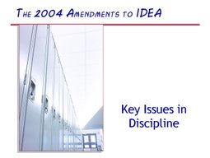
Other Relevant Resources You Can Find at the Hub
Discipline, in Detail
(Thorough discussion of
IDEA’s disciplinary provisions)
http://www.parentcenterhub.org
/repository/disc-details/
Key Issues in Discipline
(Module 19 from
the NICHCY training curriculum
on IDEA 2004)
http://www.parentcenterhub.org
/repository/partb-module19 /

Slide 41
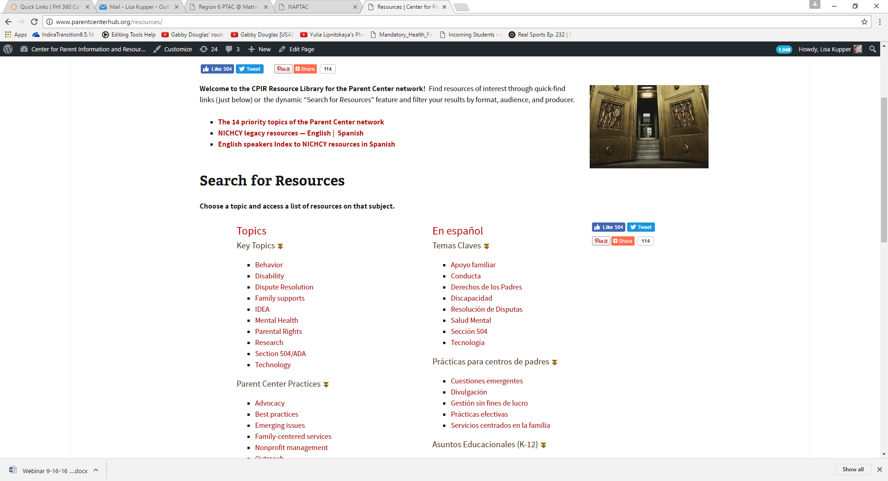
Search on the Hub’s Resources Page! http://www.parentcenterhub.org/resources/
Click here on “Behavior”
or here on “Conducta”
You’ll get results galore!
Filter them as you like—
by audience, format, language, or producer

Slide 42
Resources
You may also be interested in information about chronic absenteeism
http://www2.ed.gov/datastory/chronicabsenteeism.html
Guidance: http://www2.ed.gov/policy/elsec/guid/secletter/151007.html
Resources/Toolkit: http://www2.ed.gov/about/inits/ed/chronicabsenteeism/toolkit.pdf

Slide 43
Thank You!
Look for the archived webinar at www.osepideasthatwork.org

