Slide 1


Reaching and Serving Students with Disabilities in Juvenile Justice
Thanks for joining us today.
We’re glad you’re here.
Resources for Access, Independence, Self-Advocacy
& Employment
Center for Parent Information
& Resources

Slide 2

Agenda for Today’s Webinar
Welcome and Introduction | Peg Kinsell & Debra Jennings
How ESSA Changes Impact JJ-Involved Youth |Kate Burdick, Esq.
Questions and Conversation
Reaching and Serving Youth in Juvenile Justice | Parent Center Activities
Resources on working with JJ-Involved and their families | Lisa Kupper

Slide 3
Reaching and Serving Students in
Juvenile Justice
Amendments to Title I, Part D
CPIR/RAISE Webinar for Parent Centers
The National Resources for Advocacy Independence Self-determination and Employment (RAISE) Technical Assistance Center is a SPAN project in collaboration with the seven (7) RSA-funded Parent Training and Information Centers. RAISE products and services are also available to the network of OSEP Parent Centers through the Center for Parent Information and Resources (CPIR), www.parentcenterhub.org.

Slide 4

Our Presenter:
Kate Burdick
Juvenile Law Center - www.jlc.org
Legal Center for Youth Justice and Education: National collaboration of Southern Poverty Law Center, Juvenile Law Center, Education Law Center-PA, and the American Bar Association Center on Children and the Law. Our mission is to ensure that all children in the juvenile and criminal justice systems can access their right to a quality education.

Slide 5
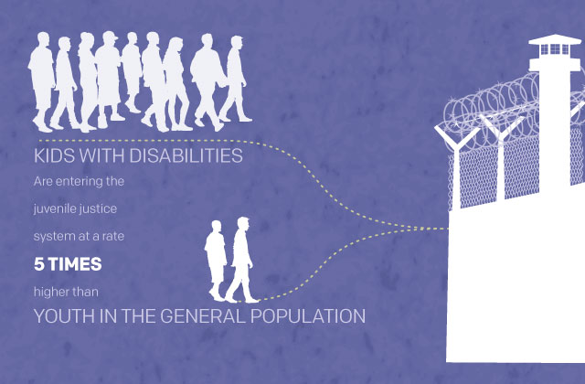
http://www.colorlines.com/content/infographic-disability-criminality

Slide 6
Children in the Juvenile Justice System are Struggling Academically
Disproportionate need for special education services (estimates as high as 77.5%)
In juvenile correctional facilities, nearly 4x as many youth w/ special education as compared to national average of students w/ disabilities.
Below grade level
  2/3 in state institutions below grade level in math & reading
  44% in local JJ facilities below grade level in math & reading
Notes:
Youth of color under- and over-diagnosed.
Lisa Geis article citing Mary Magee Quinn et al., Youth with Disabilities in Juvenile
Corrections: A National Survey, 71 EXCEPTIONAL CHILD. 339, 342 (2005) and THOMAS D. SNYDER & SALLY A. DILLOW, U.S. DEP’T OF
EDUC., DIGEST OF EDUCATION STATISTICS 2011, at 61 (2012). Of those children,
4.9% are identified with a specific learning disability, and 2.9% have a
speech or language impairment.
Drop out stat: Just Learning Report, citing Joseph C. Gagnon, Brian R. Barber, Christopher L Van Loan, and Peter E. Leone, “Juvenile Correctional
Schools: Characteristics and Approaches to Curriculum
,” Education and Treatment of Children
, Vol. 32, no. 4, 673
-
696,
2009; Joseph C. Gagnon, “State
-
Level Curricular, Assessment, and Accountability Policies, Practices, and
Philosophies for Exclusionary School Settings,”
The Journal of Special Education
, vol. 43,No. 4, 206
-
219,February
2010; Joseph C. Gagnon, Christopher
L Van Loan, and Brian R. Barber, “Secondary Psychiatric Schools:
Characteristics and Approaches to Curriculum,”
Preventing School Failure
, Vol. 55. No.1, 42
-
52, 2010; Joseph C.
Gagnon and Brian Barber, “Characteristics of and Services Provided to Youth in
Secure Care Facilities,”
Behavioral
Disorders
, vol. 36, no. 1, 7
-
19, November 2010.
Grade level – Just Learning Report: Test results
from the
juvenile justice schools’ own
federal
reports provide
additional supporting
evidence
.
In 2008
-
09, roughly two
-
thirds of all students in the South and the nation who were tested as they entered state juvenile residential institutions were behind grade level in reading and in math. In local juvenile institutions, below-grade rates in reading were 42 percent in the South and 44 percent throughout the nation.
http://www.southerneducation.org/getattachment/b80f7aad-405d-4eed-a966-8d7a4a12f5be/Just-Learning-Executive-Summary.aspx

Slide 7
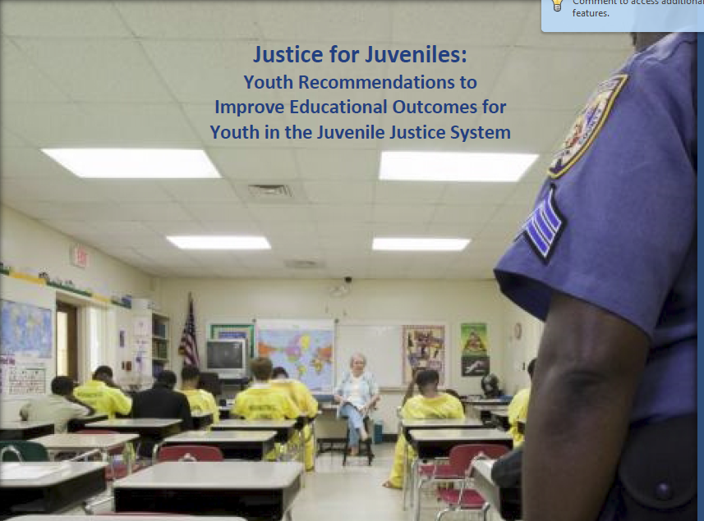
Reentry Struggles
2/3 of students
drop out
“When I left a juvenile justice facility and returned home, I was only one credit away from graduating…Unfortunately…my public school said that they would not accept my credits and that I would have to go back to 9th grade or take GED classes.”
“After I left my placement, I tried to re-enroll in my community school, but was told that I would be denied entry because I had been ‘truant.’”
Notes:
Students who return to school from JJ placements often learn that:
They are not doing well academically in “regular” school
They are below grade level in core subjects
Credits earned in the JJ placement will not count; at best they have only earned partial credits due to fragmented learning
They are not on track to graduate; overaged & under-credited
They are discouraged, overwhelmed & drop out.
Lisa Geis article citing Mary Magee Quinn et al., Youth with Disabilities in Juvenile
Corrections: A National Survey, 71 EXCEPTIONAL CHILD. 339, 342 (2005) and THOMAS D. SNYDER & SALLY A. DILLOW, U.S. DEP’T OF
EDUC., DIGEST OF EDUCATION STATISTICS 2011, at 61 (2012). Of those children,
4.9% are identified with a specific learning disability, and 2.9% have a
speech or language impairment.
Drop out stat: Just Learning Report, citing Joseph C. Gagnon, Brian R. Barber, Christopher L Van Loan, and Peter E. Leone, “Juvenile Correctional
Schools: Characteristics and Approaches to Curriculum
,” Education and Treatment of Children
, Vol. 32, no. 4, 673
-
696,
2009; Joseph C. Gagnon, “State
-
Level Curricular, Assessment, and Accountability Policies, Practices, and
Philosophies for Exclusionary School Settings,”
The Journal of Special Education
, vol. 43,No. 4, 206
-
219,February
2010; Joseph C. Gagnon, Christopher
L Van Loan, and Brian R. Barber, “Secondary Psychiatric Schools:
Characteristics and Approaches to Curriculum,”
Preventing School Failure
, Vol. 55. No.1, 42
-
52, 2010; Joseph C.
Gagnon and Brian Barber, “Characteristics of and Services Provided to Youth in
Secure Care Facilities,”
Behavioral
Disorders
, vol. 36, no. 1, 7
-
19, November 2010.
Grade level – Just Learning Report: Test results
from the
juvenile justice schools’ own
federal
reports provide
additional supporting
evidence
.
In 2008
-
09, roughly two
-
thirds of all students in the South and the nation who were tested as they entered state juvenile residential institutions were behind grade level in reading and in math. In local juvenile institutions, below-grade rates in reading were 42 percent in the South and 44 percent throughout the nation.
http://www.southerneducation.org/getattachment/b80f7aad-405d-4eed-a966-8d7a4a12f5be/Just-Learning-Executive-Summary.aspx

Slide 8

Getting started…
Relationships are the key
Notes:
Too often siloed
Reach out to PD, probation, community partners

Slide 9
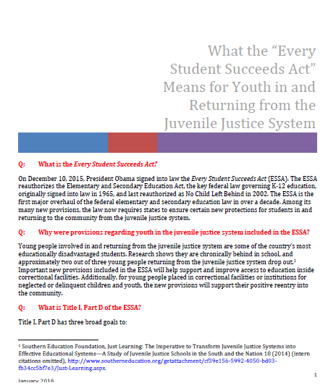
Title I, Part D Amendments
What the Every Student Succeeds Act Means for Youth in the Juvenile Justice System: http://www.jlc.org/sites/default/files/ESSAJJ_Factsheet_FinalWebinarVersion_Jan262016.pdf
Notes:
Also other parts of ESSA relevant to JJ in some way – e.g. foster care provisions, school discipline including new school climate indicator, graduation cohort. Important to remember IDEA, 504 and ADA as important federal law tools to improve education for this population as well.

Slide 10

Title I, Part D Amendments
http://www.neglected-delinquent.org
Fast Facts Web pages present national and State longitudinal data on funding, program types, and student demographics for children and youth who are neglected, delinquent or at-risk and enrolled in Title I, Part D, Subpart 1 and Subpart 2 programs.
      Nationally in 2013-2014:
      Subpart 1: 31% students with disabilities
      Subpart 2: 24% students with disabilities
Notes:
Also other parts of ESSA relevant to JJ in some way – e.g. foster care provisions, school discipline including new school climate indicator, graduation cohort. Important to remember IDEA, 504 and ADA as important federal law tools to improve education for this population as well.

Slide 11
Title I, Part D
3 broad goals:
Improve educational services in institutions
Improve youth transition between institutionalization to further schooling or employment
Prevent dropout
Notes:
Improve educational services in local, tribal, or State institutions for neglected and delinquent children and youth in order to provide opportunity to meet State academic standards;
Improve youth transition between institutionalization to further schooling or employment; and
Prevent dropout of youth, and provide young people returning from correctional facilities or institutions for neglected and delinquent children and youth with reentry support to ensure their continued education and involvement of their families and communities.
Title I, Part D of the ESSA provides federal funds to State Educational Agencies (SEA’s) to establish or improve educational programs for neglected, delinquent, or at-risk children and youth. Funding is distributed in two parts. In Subpart 1, SEA’s receive funds by formula, which they then subgrant to state agencies serving neglected or delinquent children or youth. In Subpart 2, SEA’s award funds to local educational agencies in the State with high numbers of children and youth in locally operated juvenile correctional facilities (including community day programs).
States that accept funding through Title I, Part D have to provide certain assurances and comply with reporting and other obligations. For more information, visit the website of the National Technical Assistance Center for the Education of Neglected or Delinquent Children and Youth (NDTAC): http://www.neglected-delinquent.org/what-title-i-part-d.
The ESSA modifies the definition of “at risk” to include not only students at risk of either dependency or delinquency adjudication, but also children and youth who have come into contact with the child welfare system.
Currently all 50 states, DC, and Puerto Rico, receive Title I, Part D funding, and the programming reaches hundreds of thousands of young people.

Slide 12
Educational Assessment
Educational assessments when youth enter a juvenile justice facility
“when practicable”
Notes:
‘‘(c) STATE AGENCY APPLICATIONS.—Any State agency that
desires to receive funds to carry out a program under this subpart
shall submit an application to the State educational agency that—
‘‘(1) describes the procedures to be used, consistent with
the State plan under section 1111, to assess the educational
needs of the children to be served under this subpart and, to the
extent practicable, provide for such assessment upon entry into a
correctional facility;

Slide 13
Records Transfer
Correctional facilities
work w/youth’s family & LEA
ensure academic records & plans re: continuation of ed. services for youth are shared
and transfer with the youth to the facility
Notes:
facilities that have an agreement with a local educational agency under Section 1423(2) of Title I, Part D to provide service s to children and youth under this subpart
‘‘(c) STATE AGENCY APPLICATIONS.—Any State agency that
desires to receive funds to carry out a program under this subpart
shall submit an application to the State educational agency that—
‘‘(9) describes how the State agency will encourage correc-
tional facilities receiving funds under this subpart to coordinate
with local educational agencies or alternative education pro-
grams attended by incarcerated children and youth prior to and after
their incarceration to ensure that student assessments and
appropriate academic records are shared jointly between the
correctional facility and the local educational agency or alter-
native education program in order to facilitate the transition of such
children and youth between the correctional facility and the local
educational agency or alternative education program;
‘‘SEC. 1416. INSTITUTION-WIDE PROJECTS.
‘‘A State agency that provides free public education for children
and youth in an institution for neglected or delinquent children
and youth (other than an adult correctional institution) or attending
a community-day program for such children and youth may use
funds received under this subpart to serve all children in, and
upgrade the entire educational effort of, that institution or program
if the State agency has developed, and the State educational agency
has approved, a comprehensive plan for that institution or program
that—
and how relevant and appropriate academic records and
plans regarding the continuation of educational services for such
children or youth are shared jointly between the State agency
operating the institution or program and local educational agency
in order to facilitate the transition of such children and youth
between the local educational agency and the State agency;
‘‘SEC. 1425. PROGRAM REQUIREMENTS FOR CORRECTIONAL FACILI-
TIES RECEIVING FUNDS UNDER THIS SECTION.
‘‘Each correctional facility entering into an agreement with
a local educational agency under section 1423(2) to provide services
to children and youth under this subpart shall—
“(12) upon the child’s or youth’s entry into the correctional
facility, work with the child’s or youth’s family members and
the local educational agency that most recently provided services
to the child or youth (if applicable) to ensure that the relevant and
appropriate academic records and plans regarding the continuation
of educational services for such child or youth are shared jointly
between the correctional facility and local educational agency in
order to facilitate the transition of such children and youth between
the local educational agency and the correctional facility; and

Slide 14
Reentry Planning:
“Think Exit at Entry”
Correctional facilities must work w/ LEA
minimize disruption to a youth’s education when he/she exits facility
coordinate ed services
Notes:
‘‘SEC. 1425. PROGRAM REQUIREMENTS FOR CORRECTIONAL FACILI-
TIES RECEIVING FUNDS UNDER THIS SECTION.
‘‘Each correctional facility entering into an agreement with
a local educational agency under section 1423(2) to provide services
to children and youth under this subpart shall—
‘‘(13) consult with the local educational agency for a period
jointly determined necessary by the correctional facility and local
educational agency upon discharge from that facility, to coordinate edu-
cational services so as to minimize disruption to the child’s or youth’s
achievement.

Slide 15
Credit Transfer
SEAs must ensure timely transfer of credits earned in JJ placements.
Notes:
‘‘(E) provide assurances that the State educational agency
has established—
‘‘(i) procedures to ensure the timely re-enrollment
of each student who has been placed in the
juvenile justice system in secondary school or in
a re-entry program that best meets the needs of
the student, including the transfer of credits that
such student earns during placement

Slide 16
Timely and Appropriate
Re-enrollment
Timely re-enrolled in school or program that best meets student’s needs
Programs to facilitate transition for reentering youth
Notes:
“timely re-enrollment of each student …in a re-entry program that best meets the needs of the student”
‘‘(E) provide assurances that the State educational agency
has established—
‘‘(i) procedures to ensure the timely re-enrollment
of each student who has been placed in the
juvenile justice system in secondary school or in
a re-entry program that best meets the needs of
the student, including the transfer of credits that
such student earns during placement

Slide 17
Ed. Opportunities at Reentry
Opportunities for credit-bearing coursework.
Forge partnerships w/ higher ed or businesses to facilitate post-secondary & workforce success.
Notes:
Education opportunities upon reentry: State educational agencies must establish opportunities for reentering students to participate in credit-bearing coursework while in secondary school, postsecondary education, or career and technical education programming. As appropriate, local agencies seeking funding must describe partnerships with higher education institutions or local businesses to facilitate post-secondary and workforce success for re-entering youth. This may include opportunities for youth exiting correctional facilities to enroll in credit-bearing coursework while in secondary school; enroll in post-secondary education; and participate in career and technical education programming.
‘‘(E) provide assurances that the State educational agency
has established—
‘‘(ii) opportunities for such students to participate
in credit-bearing coursework while in secondary
school, postsecondary education, or career and
technical education programming.
‘‘SEC. 1423. LOCAL EDUCATIONAL AGENCY APPLICATIONS.
‘‘Each local educational agency desiring assistance under this
subpart shall submit an application to the State educational agency
that contains such information as the State educational agency
may require. Each such application shall include—
“(4) a description of the program operated by participating schools
to facilitate the successful transition of children and youth reentering from
correctional facilities and, as appropriate, the types of services that such
schools will provide such children and youth and other at-risk children and
youth;
‘‘(7) as appropriate, a description of any partnerships with
institutions of higher education or local businesses to develop training,
curriculum-based youth entrepreneurship educationfacilitate postsecondary
and workforce success for children and youth returning from correctional
facilities, such as through participation in credit-bearing coursework while
in secondary school, enrollment in postsecondary education, participation
in career and technical education programming, and mentoring services for
participating students;

Slide 18
HS Diploma
Prioritize traditional HS diploma
LEA accountability
Track # youth who graduate on time.
Notes:
one accountability standard for local education agencies is devoted to increasing the number of youth attaining high school diplomas or its recognized equivalent, and states and local jurisdictions must collect program evaluation data on the number of youth served who graduate on time.
‘‘SEC. 1414. STATE PLAN AND STATE AGENCY APPLICATIONS.
‘‘(a) STATE PLAN.—
‘‘(1) IN GENERAL.—Each State educational agency that
desires to receive a grant under this subpart shall submit,
for approval by the Secretary, a plan—
‘‘(A) for meeting the educational needs of neglected,
delinquent, and at-risk children and youth;
‘‘(B) for assisting in the transition of children and
youth from correctional facilities to locally operated pro-
gramsbetween correctional facilities and locally operated
programs; and
‘‘(C) that is integrated with other programs under this
Act or other Acts, as appropriate.
‘‘(2) CONTENTS.—Each such State plan shall—
“describe how the State will place a priority for such children to attain a regular high school diploma, to the extent feasible;
‘‘SEC. 1426. ACCOUNTABILITY.
‘‘The State educational agency may—
‘‘(1) reduce or terminate funding for projects under this
subpart if a local educational agency does not show progress
In the number of children and youth attaining
a regular high school diploma or its recognized equivalent;
‘‘(c) STATE AGENCY APPLICATIONS.—Any State agency that
desires to receive funds to carry out a program under this subpart
shall submit an application to the State educational agency that—
‘‘(16) provides an assurance that the State agency will
work with children and youth who dropped out of school before
entering the correctional facility or institution for neglected
or delinquent children and youth to encourage the children
and youth to reenter school and attain a regular high school diploma
once the term of the incarceration is completed or provide the child
or youth with the skills necessary to gain employment, continue
the education of the child or youth, or achieve a secondary school diploma
attain a regular high school diploma or its recognized equivalent
if the child or youth does not intend to return to school;
‘‘SEC. 1416. INSTITUTION-WIDE PROJECTS.
‘‘A State agency that provides free public education for children
and youth in an institution for neglected or delinquent children
and youth (other than an adult correctional institution) or attending
a community-day program for such children and youth may use
funds received under this subpart to serve all children in, and
upgrade the entire educational effort of, that institution or program
if the State agency has developed, and the State educational agency
has approved, a comprehensive plan for that institution or program
that—
‘‘(3) describes the steps the State agency has taken, or
will take, to provide all children and youth under age 21
with the opportunity to meet challenging State academic con-
tent standards and student academic achievement standards
challenging State academic standards
in order to improve the likelihood that the children and youth
will complete secondary school, attain a secondary diploma
attain a regular high school diploma
or its recognized equivalent, or find employment after leaving
the institution;
‘‘SEC. 1425. PROGRAM REQUIREMENTS FOR CORRECTIONAL FACILI-
TIES RECEIVING FUNDS UNDER THIS SECTION.
‘‘Each correctional facility entering into an agreement with
a local educational agency under section 1423(2) to provide services
to children and youth under this subpart shall—
‘‘(4) provide support programs that encourage children and
youth who have dropped out of school to reenter school and attain a
regular high school diploma once their term at the correctional
facility has been completed, or provide such children and youth with
the skills necessary to gain employment or seek a secondary school
diploma a regular high school diploma or its recognized equivalent;
‘‘SEC. 1426. ACCOUNTABILITY.
‘‘The State educational agency may—
‘‘(1) reduce or terminate funding for projects under this
subpart if a local educational agency does not show progress
in reducing dropout rates for male students and for female
students over a 3-year period the number of children and youth attaining
a regular high school diploma or its recognized equivalent; and
‘‘(2) require correctional facilities or institutions for
neglected or delinquent children and youth to demonstrate,
after receiving assistance under this subpart for 3 years, that
there has been an increase in the number of children and
youth returning to school, obtaining a secondary school diploma
attaining a regular high school diploma or its recognized equivalent,
or obtaining employmentattaining employment after such children
and youth are released.
‘‘Subpart 3—General Provisions
‘‘SEC. 1431. PROGRAM EVALUATIONS.
‘‘(a) SCOPE OF EVALUATION.—Each State agency or local edu-
cational agency that conducts a program under subpart 1 or 2
shall evaluate the program, disaggregating data on participation
by gender, race, ethnicity, and age while protecting individual student
privacy,, not less than once every 3 years, to determine the program’s
impact on the ability of participants—
‘‘(1) to maintain and improve educational achievement
and to graduate from high school in the number of years established
by the State under either the four-year adjusted cohort graduation
rate or the extended-year adjusted cohort graduation rate, if applicable;

Slide 19
Other Provisions
Family involvement
Students in tribal institutions
Dual-status youth
Definition of “at-risk” youth
Notes:
“(20) describes how the State agency will, to the extent feasible—
“(A) note when a youth has come into contact with
both the child welfare and juvenile justice systems; and
***
‘‘(2) PROGRAMS AND PROJECTS.—
Such programs and projects—
‘‘(A) may include the acquisition of equipment;
“(A) may include—
“(i) the acquisition of equipment;
“(ii) pay-for-success initiatives
“(iii) providing targeted services for youth who
have come in contact with both the child welfare system
and juvenile justice system;
***
‘‘(8) as appropriate, a description of how the program will
involve parents and family members in efforts to improve the educational
achievement of their children, assist in dropout prevention activities,
and prevent the involvement of their children in delinquent
activities;
‘‘(2) AT-RISK.—The term ‘at-risk’, when used with respect
to a child, youth, or student, means a school aged individual
who is at-risk of academic failure, dependency adjudication or delinquency
adjudication, has a drug or alcohol problem, is pregnant or is a parent,
has come into contact with the juvenile justice system or child welfare
system in the past, is at least 1year behind the expected grade level for
the age of the individual, has limited English proficiencyis an English
learner, is a gang member, has dropped out of school in the past,
or has a high absenteeism rate at school.

Slide 20
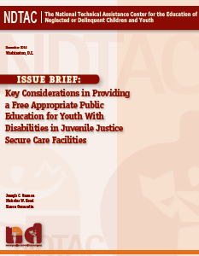
Other laws!
http://www.neglected-delinquent.org/resource/ndtac-issue-brief-key-considerations-providing-free-appropriate-public-education-youth
Notes:
IDEA, 504, ADA
Provision of special ed in facilities – FAPE, evals, etc.
When to appoint a surrogate parent
MDRs and discipline
Transition services

Slide 21
More Resources
Find out more at http://jlc.org/current-initiatives/protecting-incarcerated-youth/access-quality-education
national juvenile justice and education listserv!
Coming soon… Blueprint for Change

Slide 22
Contact Information
Kate Burdick
Staff Attorney
Juvenile Law Center
kburdick@jlc.org
www.jlc.org

Slide 23

Questions?

Slide 24
Reaching and Serving Youth in Juvenile Justice Systems
How are you working with youth involved with Juvenile Justice?

Slide 25
Reaching and Serving Youth in Juvenile Justice Systems
What can we do to assist your efforts moving forward?

Slide 26
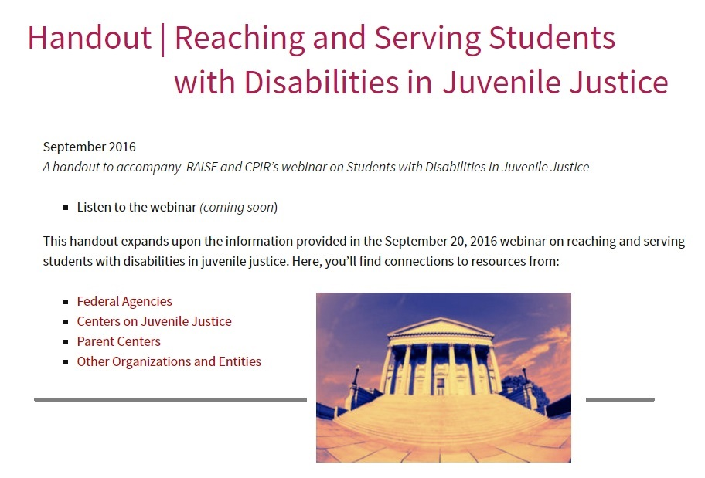
Resources You Can Find on the Hub
http://www.parentcenterhub.org/repository/webinar-handout-jj/

Slide 27
Please share your feedback:
Complete the webinar evaluation at:
http://survey.constantcontact.com/survey/a07ed8dh2xlitbnsj7f/start

