Slide 1

New Parent Center Products You Can Use
The webinar will begin shortly.
For Audio: 877-713-0446,
Conference Code: 101 725 8988
Please use the box below to tell us:
The name of your Parent Center
Your state
Your email address
Center for Parent
Information & Resources

Slide 2



A Few Reminders on
Webinar Etiquette
Everyone will be muted.
Please feel free to use the “Chat” box for your questions or comments.
You can also “Raise Your Hand” using the icon at the top left.

Slide 3
New Parent Center Products
You Can Use
Our Presenters
  Carolyn Hayer, NE-PACT Region 1 Parent Technical Assistance Center @ SPAN
  Debi Tucker, Region 3 Parent Technical Assistance Center @ Parent to Parent of Georgia
  Debra Jennings, Center for Parent Information and Resources

Slide 4

Agenda for Today’s Webinar
In today’s webinar, we will:
Describe the two new products developed by and for Parent Centers
Explore The Inclusion Curriculum and how Parent Centers can use it
Explore the Resource Collection on Behavior and Discipline and describe what kinds of information and tools are included

Slide 5



Developing Resources for Parent Centers
Identifying topics based on Parent Centers’ interests and needs
Engaging Parent Center staff as product developers and advisors
Reviewing what’s out there that can inform our resources

Slide 6


The Inclusion Curriculum
Posted on the Hub | Only for Parent Centers |
Password-protected | Find password in the Workspaces
A Complete Training Workshop
for Parent Centers to Use with Families
Coordinated by the Region 3 Parent Technical Assistance Center @ Parent to Parent of Georgia

Slide 7

Today we’ll discuss…
Who helped develop this
What is included in this curriculum
Where Parent Centers can access it
How you can use it

Slide 8
Who Helped Develop This?
Thank you to the NINE (9) wonderful Parent Centers who participated in the review process!
Region One | Amanda Haught, United We Stand of NYC (CPRC)
 | Carolyn Hayer, SPAN
Region Two | Karen Harrison, STEP of TN
Region Three | Jon Howell, PRN (Texas)
 | Kodey Toney, OK CPRC Used other staff members too
Region Four | Karen Thompson, ASK (Iowa) Used other staff members too
Region Five | Naomi Sandweiss and Cindy Lafon, Parents Reaching Out (NM PTI)
 | Beth Schaffner, PEAK (CO)
Region Six | Christy Reese, FACT (OR)
Notes:
The Process
The Reviewers
Finalizing

Slide 9
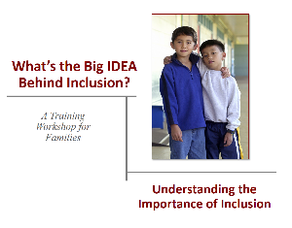
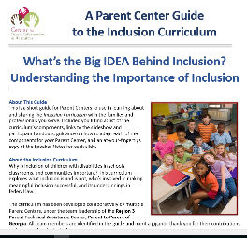
What Is Included in This Curriculum?
A ready-to-use Powerpoint
A customizable Powerpoint
Three handouts:
  Acronyms, Abbreviations,
  and Words to Know
  What Is Inclusion?
  Six Key Principles of IDEA
A User’s Guide/Trainer Notes
Notes:
We have developed a training that Parent Centers can take, modify, and use to train parents and youth on the idea of inclusion. The powerpoint, trainer notes and accompanying handouts are tools to help your Parent Center increase/improve the understanding of inclusion in the families you serve. They are designed to get families excited about and want to push for full inclusion of their children.
To be clear, this is not the “how to” of ensuring a child is fully included. This is about understanding that inclusion is a right, that research has and continues to demonstrate that inclusion works, and that the Individuals with Disabilities Act (IDEA) has protections built into it that can be used to build a case for inclusion.

Slide 10
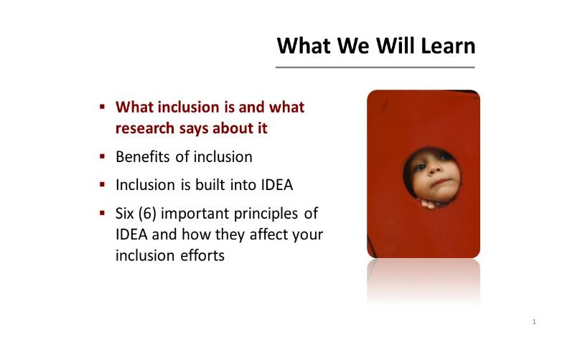
The Powerpoints … General Organization
Notes:
46 slides in the powerpoint. These are the four learning objectives.
Slides 1-6: introduction slides: Introduce your org, what you do, how to reach, etc.
Slides 7-16: What is inclusion: legal basis, myth vs research, allows for discussion
Slides 17-24: Benefits (membership, knowledge and skills, relationships), guiding principles, a valued life
Slides 25-34: how IDEA is organized to support inclusion (how it’s built into B, C, D, etc)
Slides 35-42: 6 Key Components (All means all, Nondiscriminatory Identificiation and Evaluation, FAPE, LRE, Due Process Safeguards, and Shared Decision Making)
Slides 43-46: Review and Wrap Up slides

Slide 11

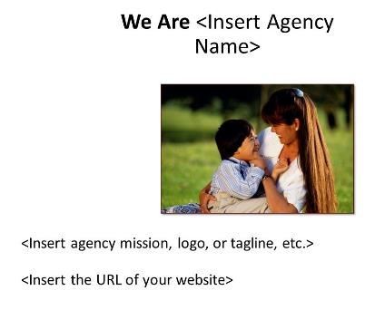
The Powerpoints … Two Options
Ready to Use
Customizable

Slide 12
The Handouts…There are Three!
Acronyms, Abbreviations and Words to Know: A two-sided handout with frequently used words related to inclusion
What is Inclusion: Aligns with the first two objectives, is a two-sided philosophical ideology of inclusion, can be used to really get families thinking and discussing inclusion
Six Principles of IDEA: Aligns with 4th learning objective, is a two-sided handout where families can follow along and add their own notes as this information is presented
Notes:
AAWtK: alphabetical, words include “access to the general curriculum”, “modifications”, Section 504, LRE, etc
What is Inclusion: Examples: Involving students with disabilities with the supports they need in age-appropriate academic classes, all classroom and school activities during the school day, and extracurricular and nonacademic activities. Teaching all children to understand and accept human differences.
Students with and without disabilities demonstrate increased benefits, both academically and socially
6 IDEA Components (All means all, Nondiscriminatory Identificiation and Evaluation, FAPE, LRE, Due Process Safeguards, and Shared Decision Making)

Slide 13
The User’s Guide!
Notes:
General Directions at the beginning, help with knowing what slides need customization and then suggested trainer notes for each slides

Slide 14
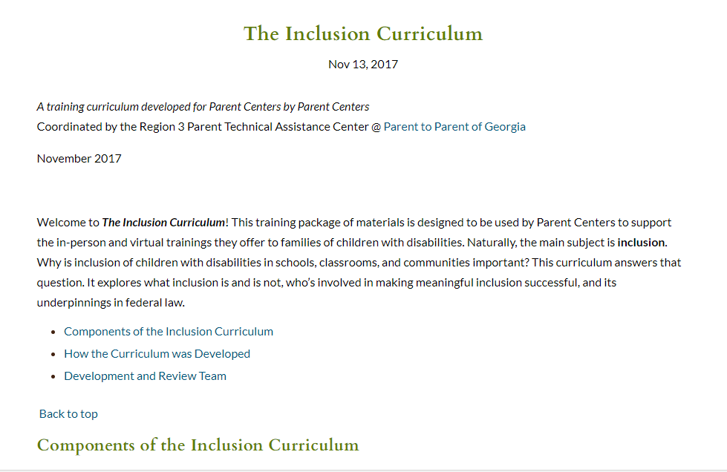
Where You Can Access the Curriculum
Posted on the Hub | Only for Parent Centers |
Password-protected | Find password in the Workspaces
Notes:
The Process
The Reviewers
Finalizing

Slide 15

How Can You Use It?
Take it “As Is” and go!

Slide 16
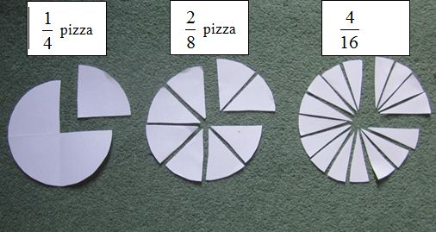
How Can You Use It?
Whole vs. Sections

Slide 17
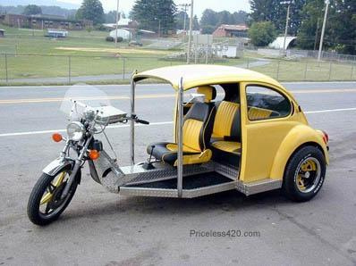
How Can You Use It?
Modify It!
Notes:
Modification Ideas:
Add discussion points
Add videos
Add information about other laws (ADA, WIOA)
Make it State Specific with state examples and state terminology

Slide 18

Let’s Review…
Who helped develop this
What is included in this curriculum
Where you can access it and when you can access it
How you can use it

Slide 19

Questions?
Comments?

Slide 20


Slide 21

A Resource Collection on Positive Behavior Supports, Functional Behavioral Assessment, and School Discipline
A resource collection compiled by
and for Parent Centers
Coordinated by
NE Parent Center Assistance & Collaboration Team/
Region 1 Parent Technical Assistance Center @ SPAN
in collaboration with NH Parent Information Center

Slide 22
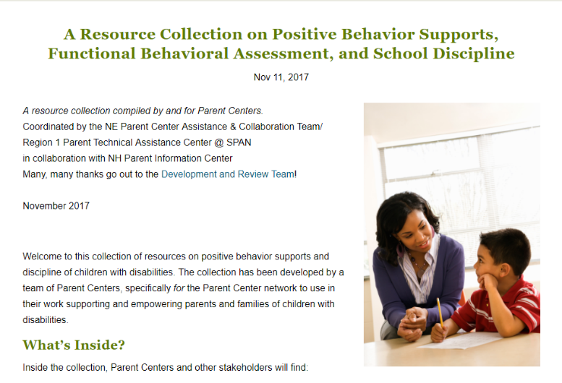
http://www.parentcenterhub.org/
pbs-fba-bip-discipline-resource-collection/
Notes:
What’s Inside?
Inside the collection, Parent Centers and other stakeholders will find:
an overview of the requirements for functional behavior assessments and positive behavior supports (PBS) in the IEP under IDEA, both proactively and in response to behavioral incidents; and
the discipline-related procedural safeguards under general and special education law and court cases, including manifestation determinations.
Parent Centers and others can search the collection to identify key strategies, tools, and resources that they can use:
when advising and supporting parents around PBS and discipline issues, and
when partnering with state agencies on evidence-based strategies to improve performance on discipline-related indicators in the State Performance Plan/Annual Performance Report.

Slide 23
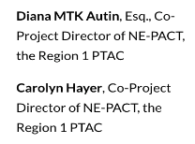
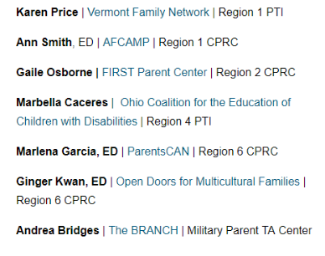

How the Resource Collection Was Built
Coordinators
Review Team
Curator
Notes:
How was the Collection Developed?
Parent Center product advisors and reviewers identified resources on PBS, functional behavioral assessment, behavior intervention plans, and IDEA’s discipline rules and pooled their results—more than 110 resources. This was the initial “to be reviewed” collection of possibilities.
Before review began | Two screening tools were developed with an ad hoc group of Regional Parent TA Centers (RPTACs) and the Center for Parent Information and Resources (CPIR), to enable reviewers to have a tool that would provide consistency and guidance as they screened the resources and products.
The first tool was developed to quickly cull out the resources that didn’t “make the grade.”
The second tool enabled the reviewer to dig deeper into the resources to determine if it was of sufficient quality, relevance, and usefulness to be used by Parent Centers.
____________________________
The Review Process and Results
A training was developed and administered on how to use the two screening tools. Feedback was gathered (and will continue to be gathered) on how useful the tools are in providing Parent Center reviewers with a method to screen resources in a consistent manner.
Results of the review | 45 resources emerged from the review process as rated to be of high quality, highly relevant, and highly useful to Parent Centers. Those are the resources that comprise the collection you find here. The Center for Parent Information and Resources (CPIR) is very pleased to produce it online and host the collection.
In summary
As we began to plan for this collection, we realized right away that such a rich issue would need a repository as opposed to one tool. The Curator of this Collection, Bonnie Dunham of the New Hampshire Parent Information Center, led the charge as resources from parent centers across the country were identified, collected and organized. Then, the reviewers were tasked with identifying the materials that best met the standards of high quality, relevant, and useful. The combined efforts of everyone mentioned resulted in this comprehensive collection. We invite you to take a look at some of the resources housed in this collection, we’re sure you’ll return again and again.

Slide 24
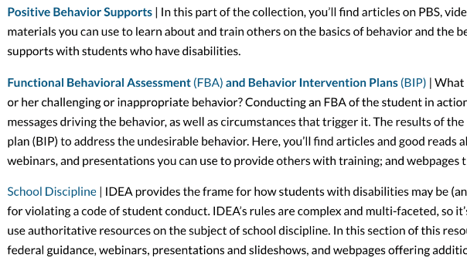
How’s the Collection Organized
By TOPIC, on separate webpages
Notes:
The collection is divided into 3 topics:
Positive Behavior Supports
Functional Behavioral Assessment and Behavior Intervention Plans
School Discipline
Each of the 3 topics has 3 types of resources:
Good Reads
Webinars, presentations, videos
Webpages
Let’s take a tour of the 3 topics and for each topic, we’ll take a look at one type of resource…

Slide 25
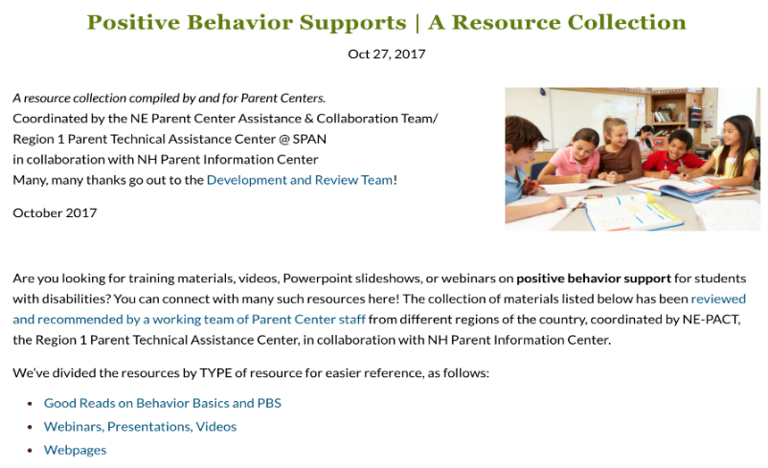



Slide 26
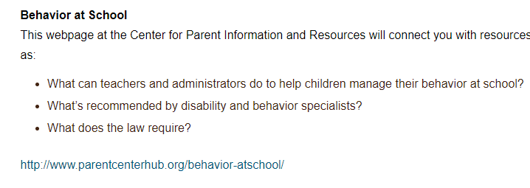
Webpages

Slide 27
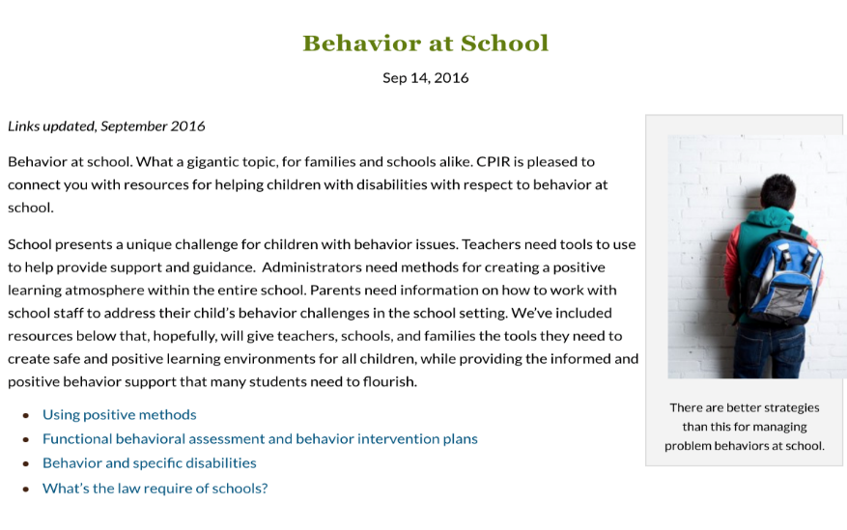

Slide 28
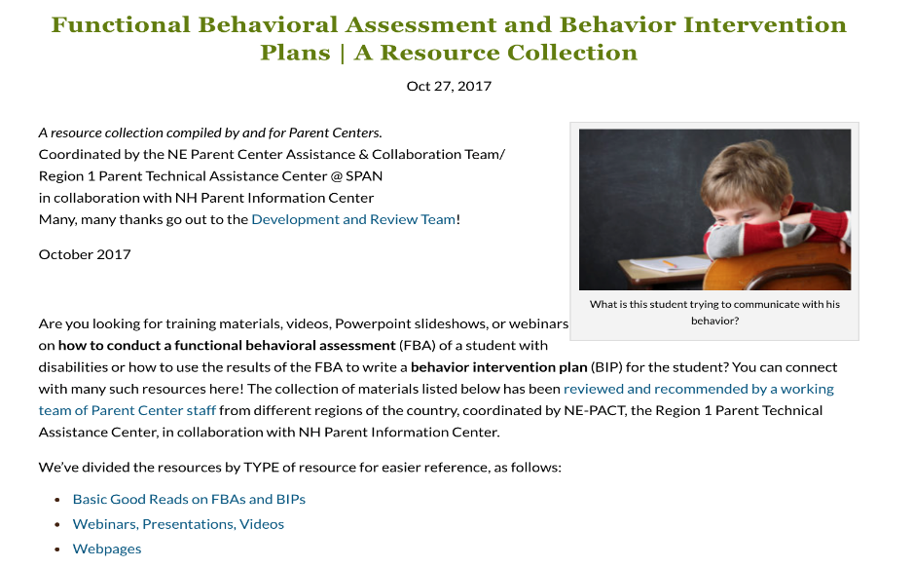
Another TOPIC…

Slide 29
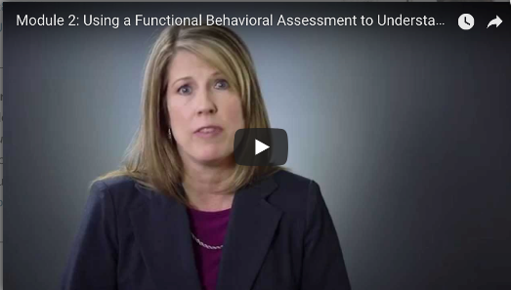
Webinars, Presentations, and Videos
Using a Functional Behavioral Assessment to Understand Behavior
Online Video Module, available in English and Spanish | This 14-minute online captioned module is available at YouTube. From the Utah Parent Center.
English | https://youtu.be/aL1eHt8DR7U
Spanish | https://youtu.be/7qSCUy-WBJc?list=PL0Ifs2Vo5bLzK-j_DipqeNxNn4A78ot6W

Slide 30

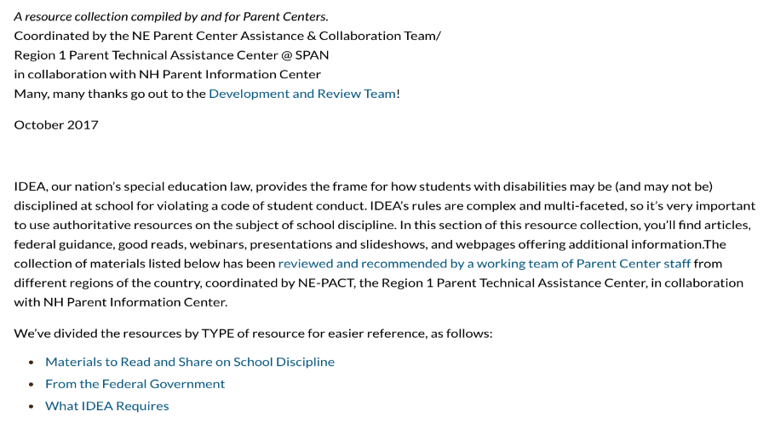
And on TOPIC 3…

Slide 31
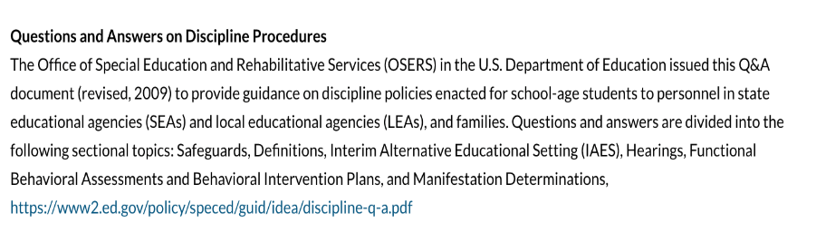
From the Federal Government

Slide 32
Questions?
Comments?

Slide 33

Carolyn Hayer
NE-PACT Region 1 PTAC @ SPAN

Slide 34

http://www.parentcenterhub.org/webinar20-newresources/
New Resources!
For Parent Centers…
by Parent Centers
You can find the slides, helpful handouts, and the recording of this webinar on the webpage we’ve created for this event.

Slide 35


Thank you very much for attending this webinar.
Debra Jennings, Project Director
debra.jennings@spannj.org
Myriam Alizo, Project Assistant malizo@spannj.org
Jessica Wilson, Communication
and Dissemination
jwilson@spannj.org
Lisa Küpper, Product Development lkupper@fhi360.org
Ana-Maria Gutierrez, Tech Support and Social Media
agutierr@fhi360.org

